Slide 1
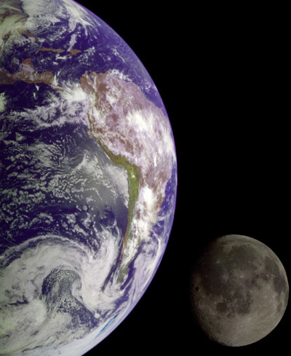
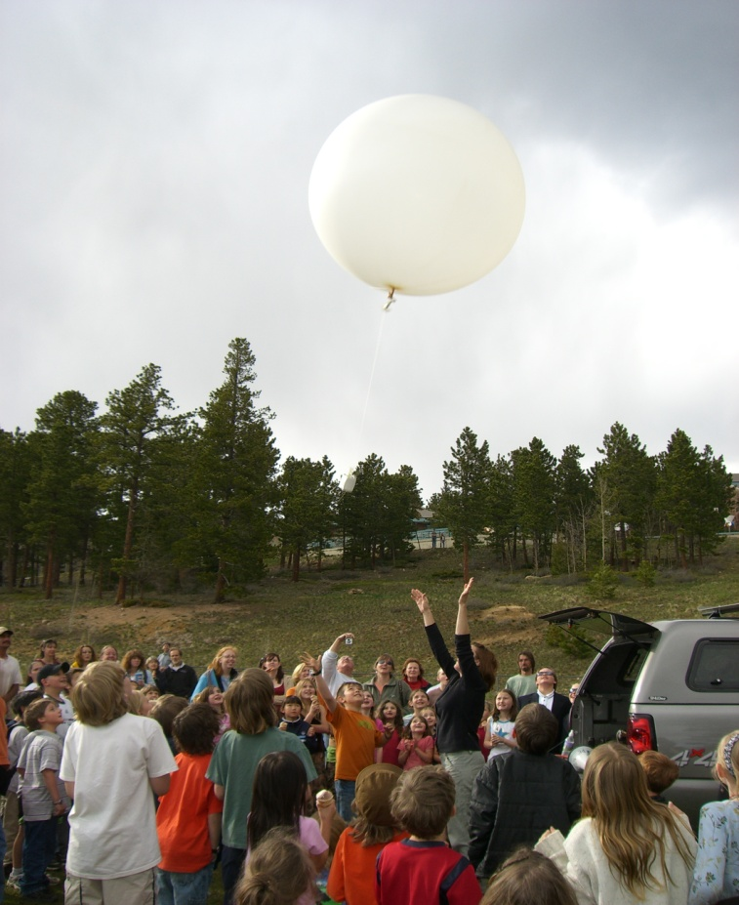
Atmospheric Soundings:
Radiosondes, Dropsondes and Driftsondes
Kate Young & Junhong Wang
kbeierle@ucar.edu
NCAR Earth Observing Laboratory

Slide 2
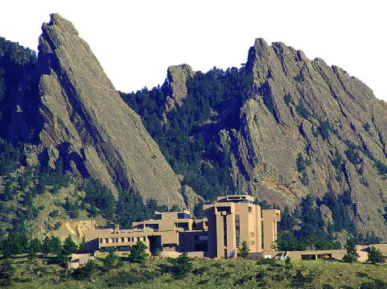
National Center for
Atmospheric Research
Weather/Climate
Societal Impacts
Pollution/Air Chemistry
Ocean/Atmosphere
Space weather/Sun

Slide 3
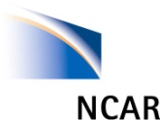

Earth Observing Laboratory
Mission:
Develop of state-of-the-art technologies for atmospheric research
Deploy instruments for scientific research projects
Data Services - providing high-quality project data for scientific advancement and discovery
Discovery – promote curiosity about earth science and educate others on atmospheric research
Notes:
These technologies include, Optical Sensing (both in situ and remote); Radio Sensing, in situ Sensing and Profiling (airborne and ground-based), Flight Level Sensing, and Advances in Data Acquisition and Processing.

Slide 4
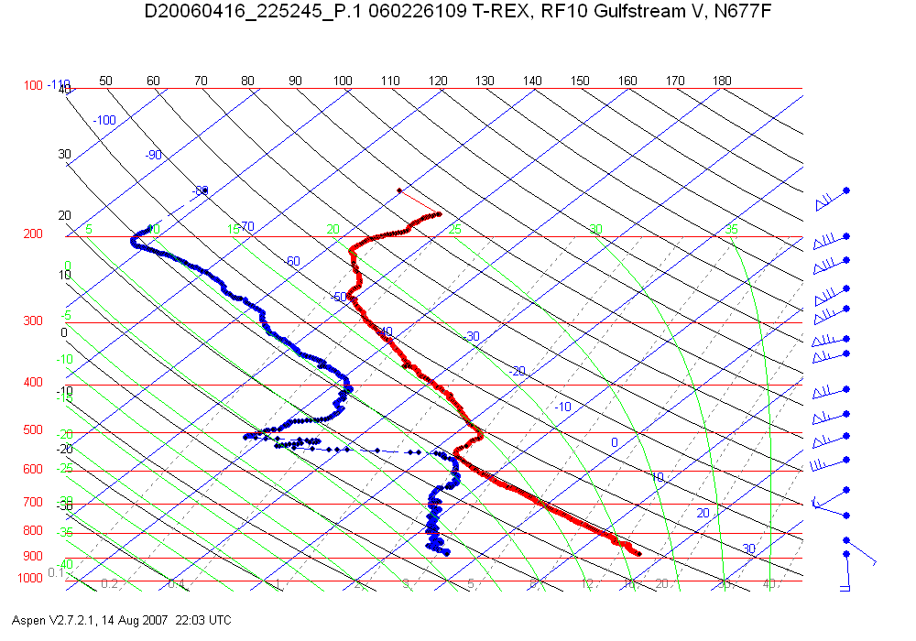
Atmospheric Profile
Wind barbs show strength and direction of wind
Space between lines
represents the
relative humidity
Dew-point Temperature (degC)
Temperature (degC)
Moist Layer with high relative humidity
Atmospheric pressure
at sea level is ~1000
millibars and decreases
with height

Slide 5
THERMOSPHERE
54 Mesopause
Altitude (mi)
MESOSPHERE
30 Stratopause
Maximum
radiosonde
height
~19 mi
STRATOSPHERE
Average
dropsonde
height
~10 mi
TROPOSPHERE
8 Tropopause
0
-120 -80 -40 0 40 80 120
Temperature (deg F)
Notes:
Commercial aircraft typically fly between 30-45K feet (5.5-8.5 miles) above surface.
Earth atmosphere is estimated to be about 1000 km thick (620 miles)
Temperature increase in the stratosphere because of the concentration of ozone in this layer which absorbs UV radiation from the sun.

Slide 6
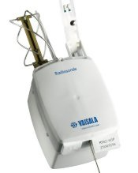
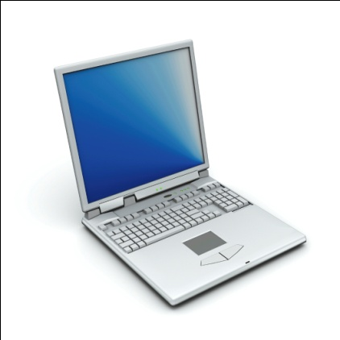
Radiosondes
GPS – 1. allows us to track radiosondes
2. provide wind measurements
Temperature &
Relative humidity
Pressure
Windy downdraft
Antenna
Notes:
When launched from CO, or in the mid west where there is a jet stream, sondes can travel approximately 60-80 miles away. Around the poles or equator they do not travel as far (~20 miles)
Transmit data at a one second resolution

Slide 7
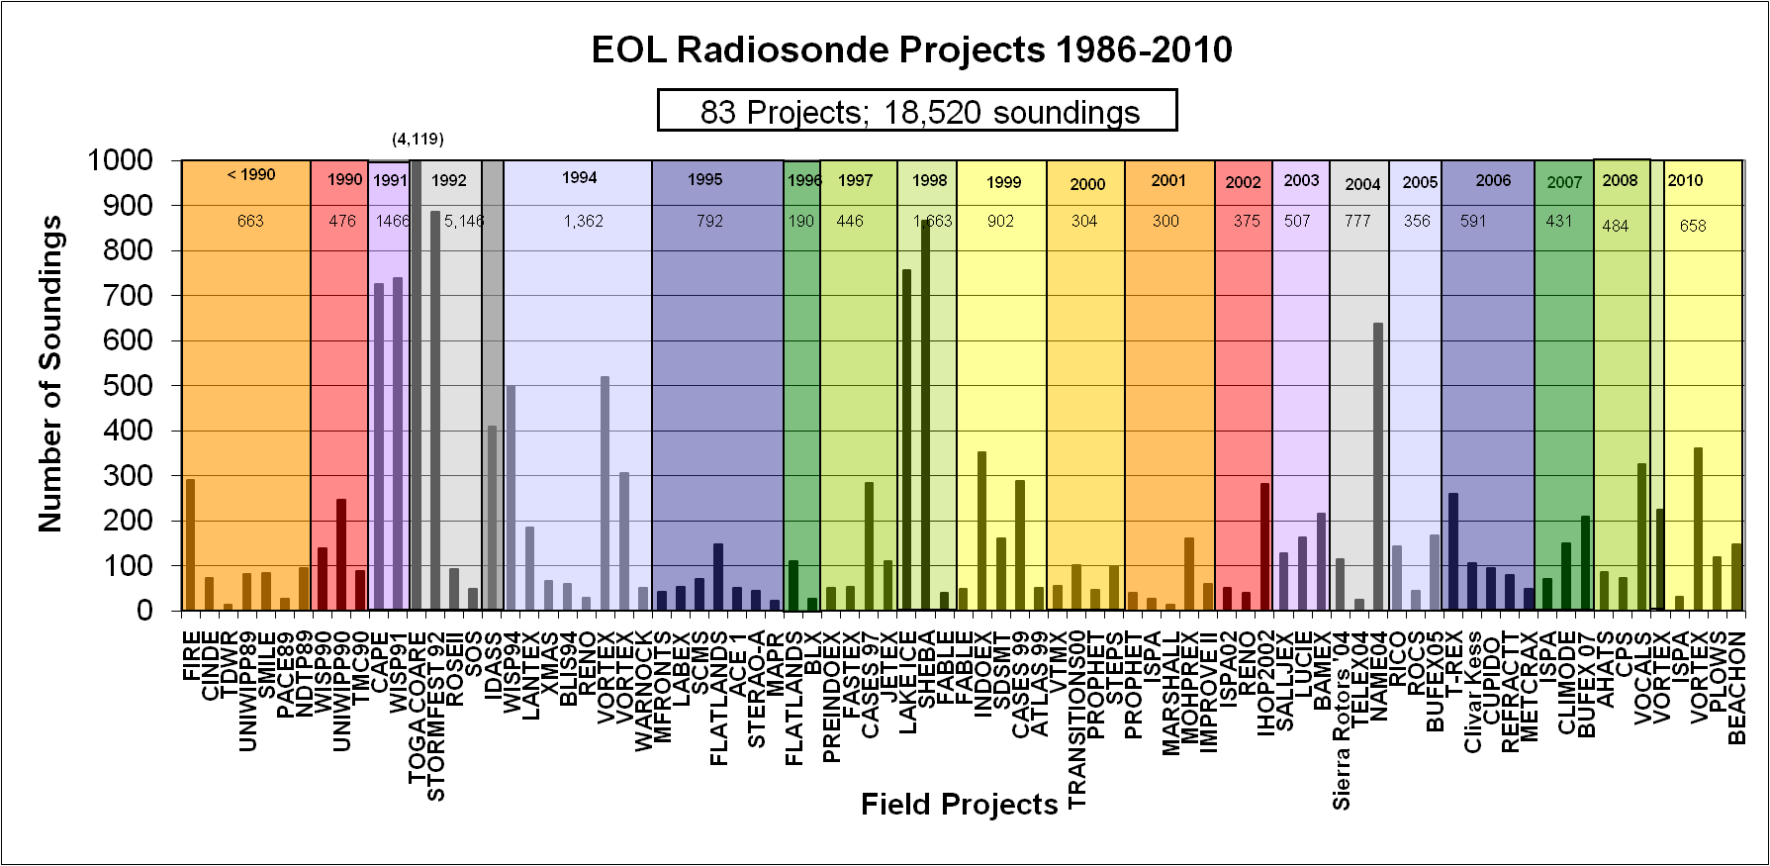
EOL projects with radiosondes

Slide 8
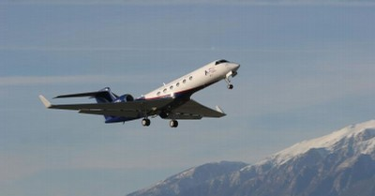
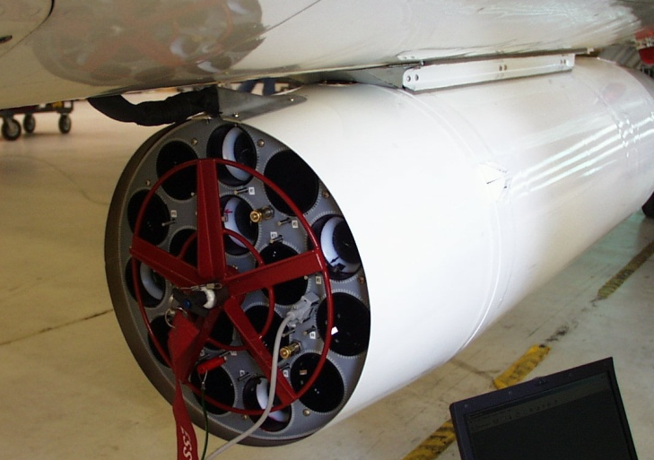
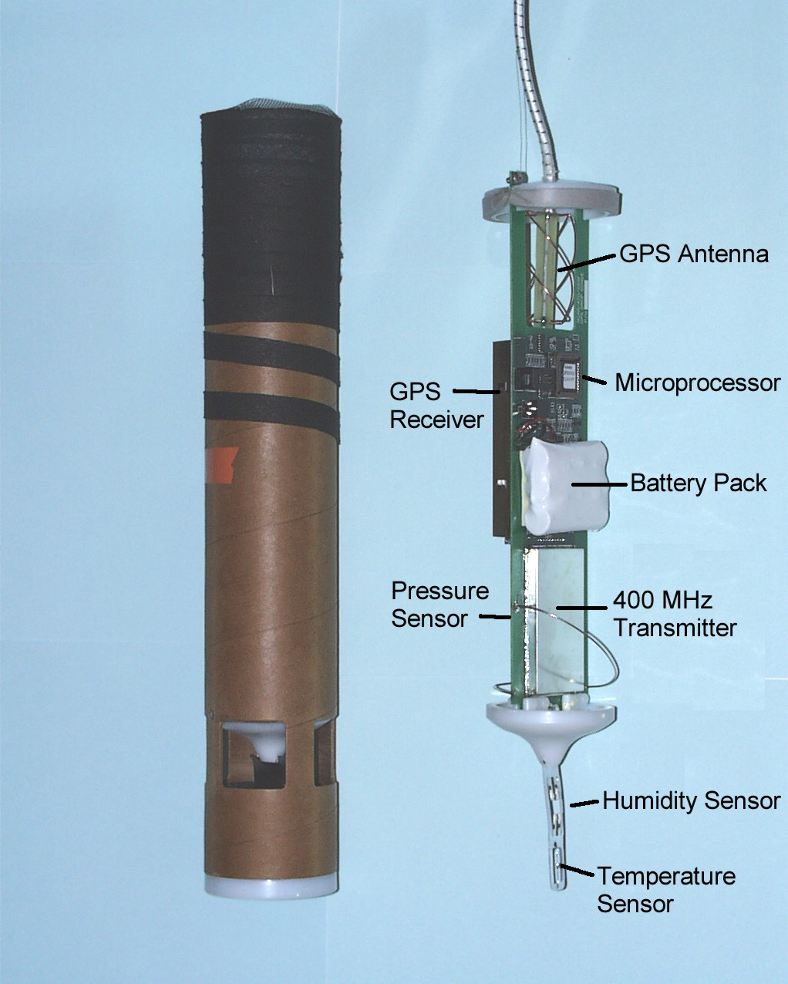
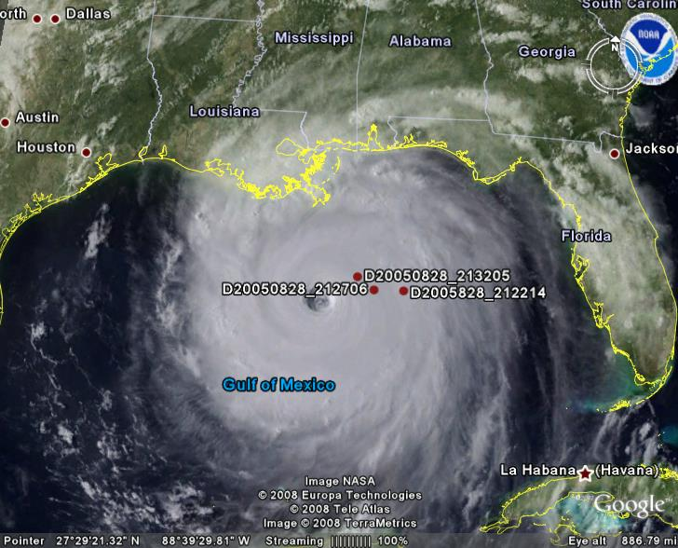
NCAR GPS Dropsondes
Licensee (Vaisala) makes ~ 5,000 per year
Currently on 21 research aircraft

Slide 9
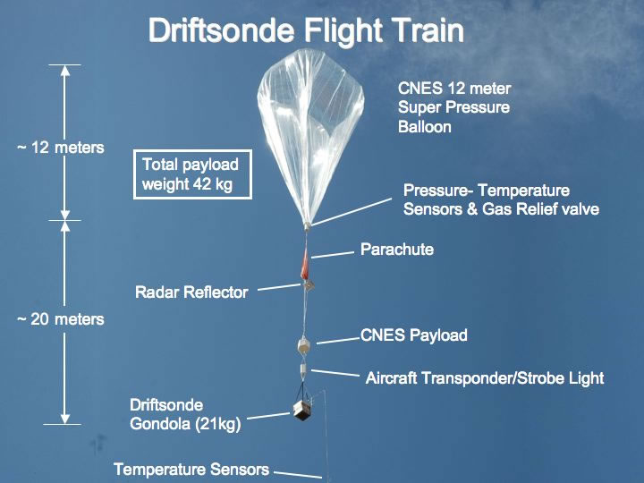
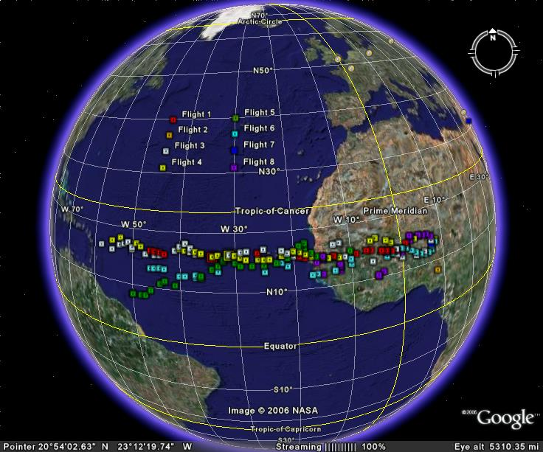
Driftsondes
Iridium LEO Satellite
Communications
Flight Altitude
125mb to 50mb (~58,000’)
Gondola
20-50 Sonde
Capacity

Slide 10
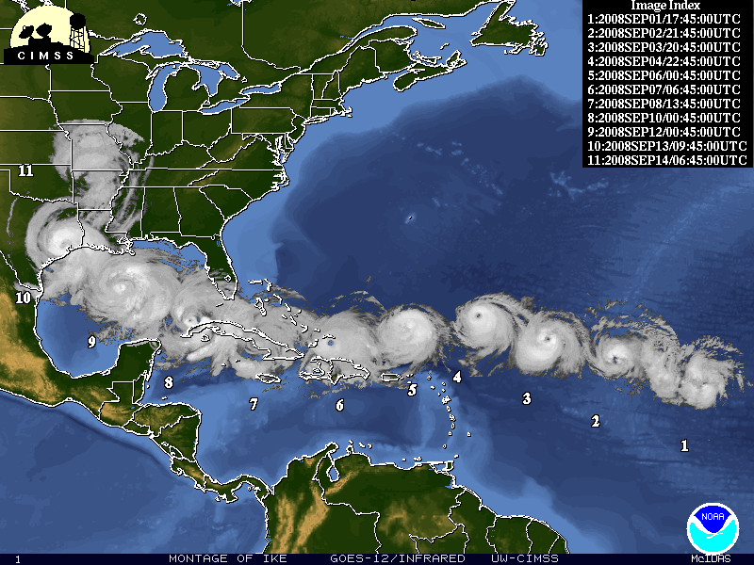
Hurricane Research
Courtesy of Dr. Chris Davis (NCAR/ASP)

Slide 11
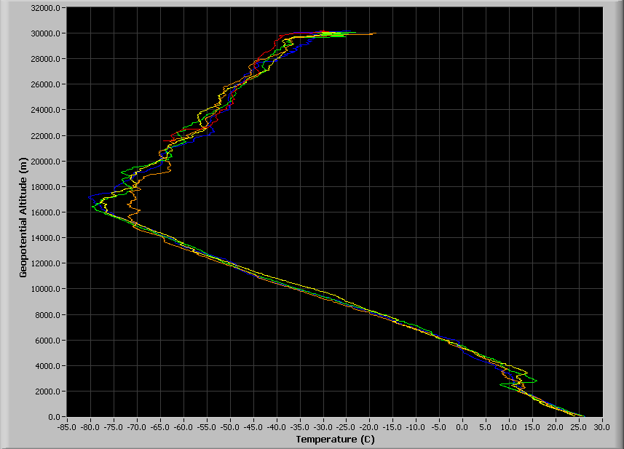
T-PARC (airborne) Sounding Systems
Driftsonde Temperature versus Altitude (4 drops) from 30km!
Nominal Driftsonde
Drop altitude
Nominal Falcon and
DOTSTAR drop altitudes
Nominal C-130
Drop altitude
Nominal P-3
Drop altitude
Courtesy of Terry Hock and Steve Cohn

Slide 12
EOL projects with Dropsondes

Slide 13
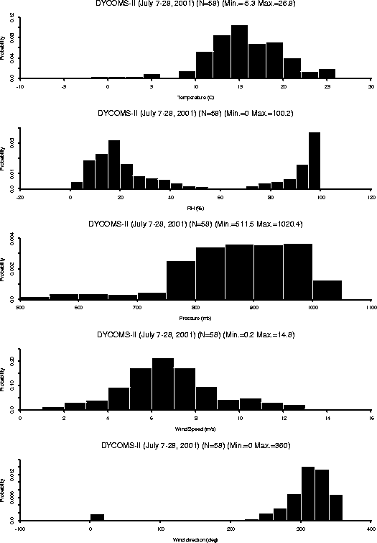
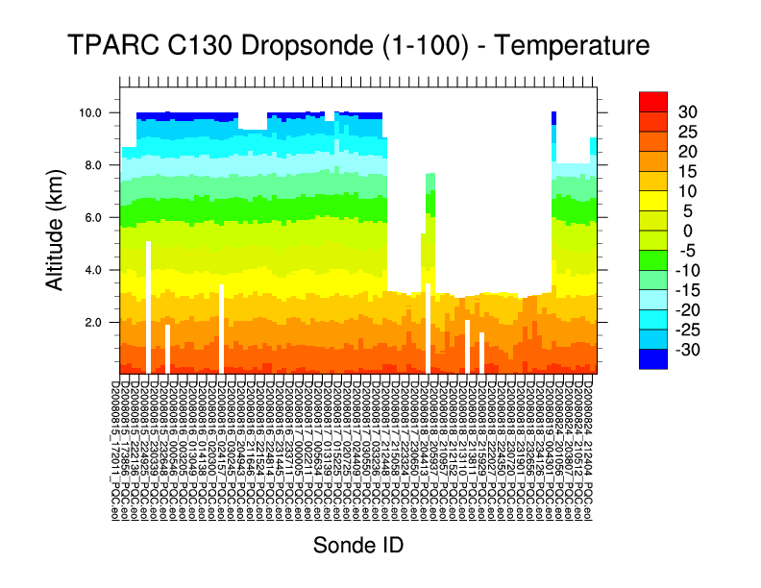
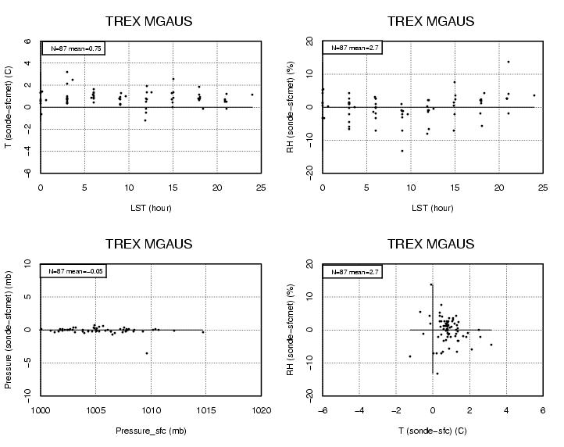
Quality Control of Radio/Dropsonde Data
In field data inspection by operator
warmer and drier sondes (sondes were launched in a parking lot, sfc met was set up in vegetation)
Individual examination raw data profiles
T
Takes into account solar angle at time of launch
and removes solar heating that could skew T.
Apply Radiation Correction
  Provides analysis tools (skew-t diagrams, xy-plot)
Removes suspect data points
RH
ASPEN
  Performs smoothing
  Batch mode for processing large datasets
Comparisons of prelaunch
and surface data
P
Histograms of PTU and Wind
wind speed
Timeseries plots of PTU and Wind
Wind direction
Visually examine QC sounding profiles
Notes:
2.
3. Surface met is used a reference to ensure radiosonde measurements are accurate
Time series plos allow us to see sondes that do not transmit to the surface, and allow us to examine the consistency of sounding during individual flight and to look at variation between multiple flights
5. Creating histograms lets us see the range and distribution of each of the parameters
Late launch detect, or file split.

Slide 14
How is this data useful?
It allows us to:
Examine changes in weather patterns
Create long term records for climate change research
Develop local severe storm, aviation, and marine forecasts
Improve weather prediction models using near real-time data assimilation
Validate satellite data
Provide feedback to EOL engineers on instrument performance

