Slide 1
Climate Forcing, Sensitivity and Feedback Processes

Slide 2
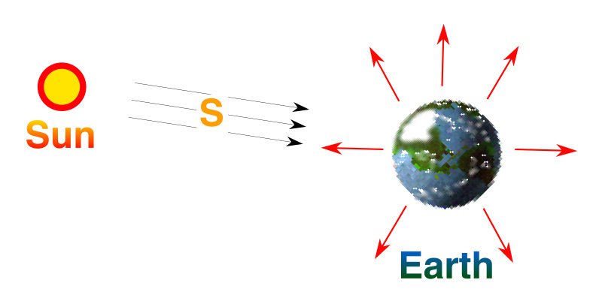
Earth’s Climate System What have we learned?
Earth is a planet
Planetary temperature is determined by
Brightness of our star
Earth-sun distance
Albedo of the planet
Composition of Earth’s atmosphere
Energy In = Energy Out
So how can climate ever change?

Slide 3
Earth’s Climate System What have we learned?
Earth’s overall temperature is determined by sunshine and albedo (-18 C)
Temperature varies dramatically with height because of greenhouse effect!
Surface temperature is much warmer (+15 C) than planetary radiation temp
O
C
O
O
H
H
Molecules that have many ways to wiggle are called “Greenhouse” molecules

Slide 4
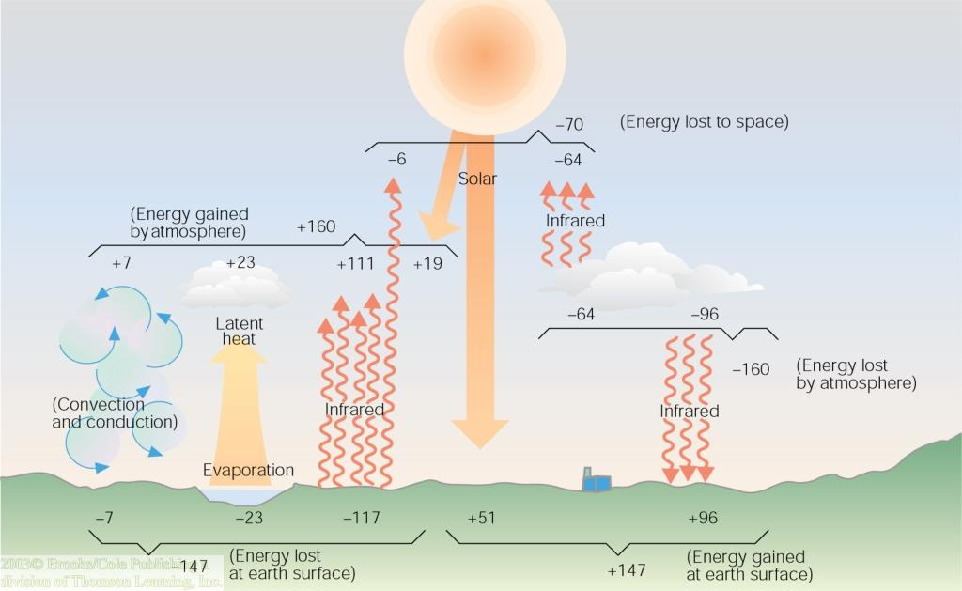
Earth’s Energy Budget What have we learned?
Surface climate depends on heating
51 units of absorbed solar
96 units of downward infrared (almost 2x sunshine)!
Surface climate depends on cooling
117 units of upward infrared
23 units of evaporation, 7 units of rising thermals

Slide 5
Earth’s Climate as a “Black Box”
S₀
T_{S}
Climate System
1367 W m⁻²
15 C
Surface Temperature Out
Sunshine
In

Slide 6
Climate Forcing, Response, and Sensitivity
DS₀
DT_{S}
Climate System
+ 1 W m⁻²
? °C
Response:
(Change in Surface Temperature)
Forcing
(change in sunshine)

Slide 7
Climate Forcing, Response, and Sensitivity
Forcing
(change in sunshine)
Response:
(Change in Surface Temperature)
“Let’s do the math …”
A 1 W m⁻² change in sunshine would produce about a 0.26 °C change in planet’s temperature

Slide 8
Climate Feedback Processes
Positive Feedbacks (amplify changes)
Water vapor
Ice-albedo
High clouds
D hi cloud
D LW
D lo cloud
DS
DT_{S}
Dvapor
Negative feedbacks (damp changes)
Longwave cooling
Low clouds
D albedo

Slide 9
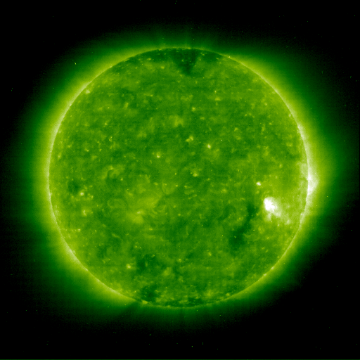
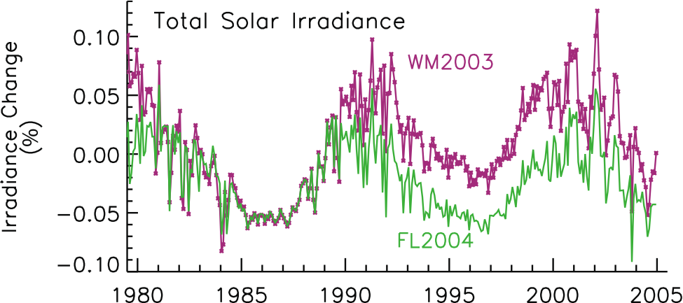
Our Variable Star
Changes of ~ 0.2% (= 2.7 W m-2) reflect 11-year sunspot cycle

Slide 10
Cycle of Solar Variability
11 Year Cycle of Magnetic Disturbances
Active sun is ~ 0.1 % brighter than quiet sun

Slide 11
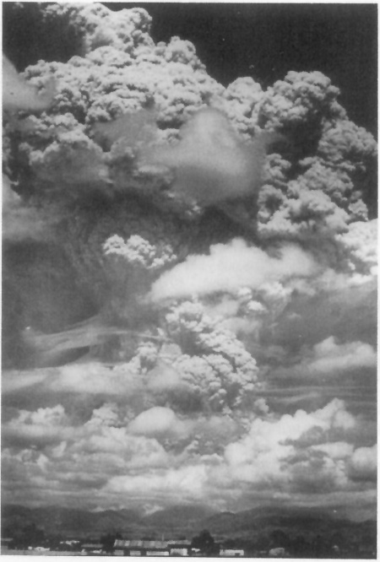
BOOM!
Volcanos release huge amounts of SO2 gas and heat
SO2 oxidizes to SO4 aerosol and penetrates to stratosphere
SO4 aerosol interacts with solar radiation
Mt. Pinatubo, 1991

Slide 12
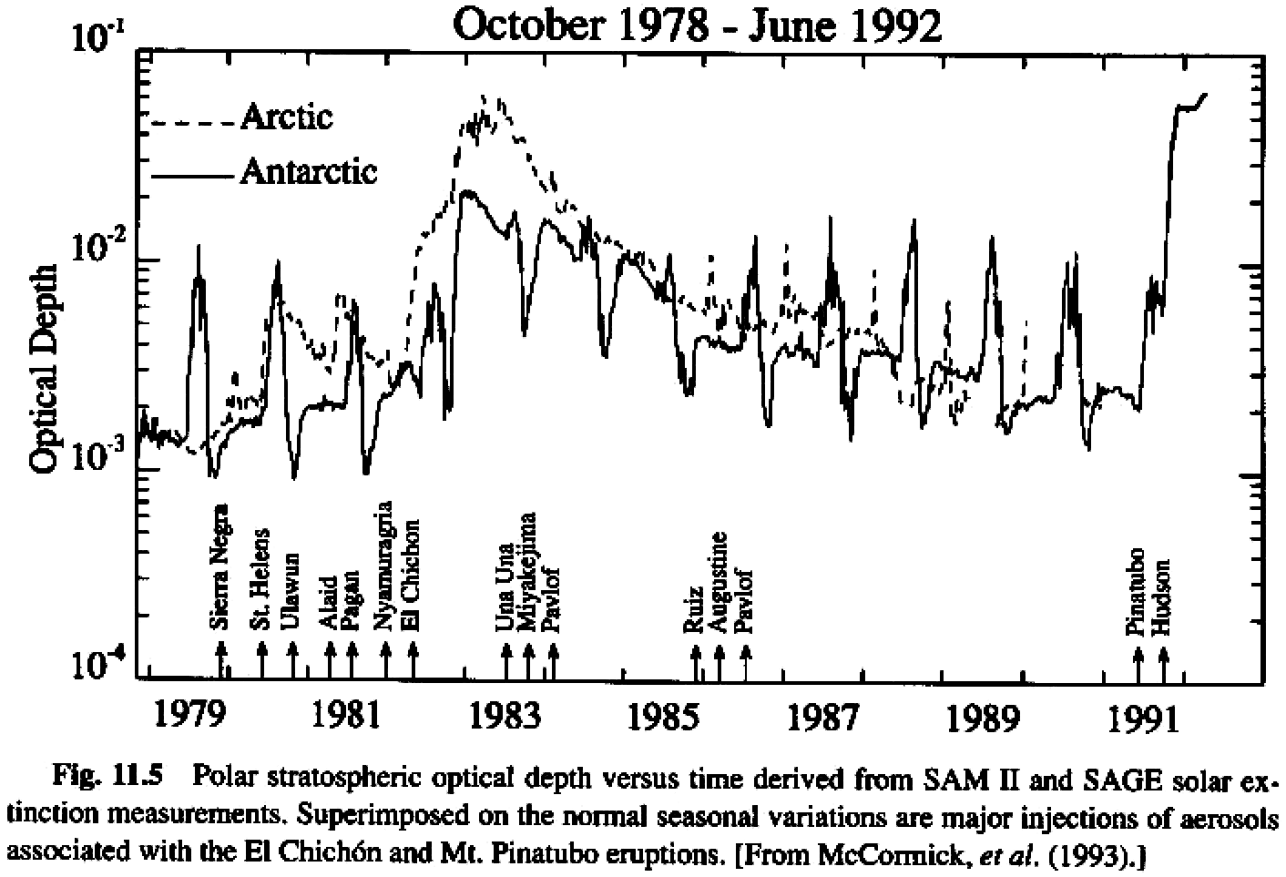
Stratospheric Aerosol Forcing

Slide 13
Aerosol

Slide 14
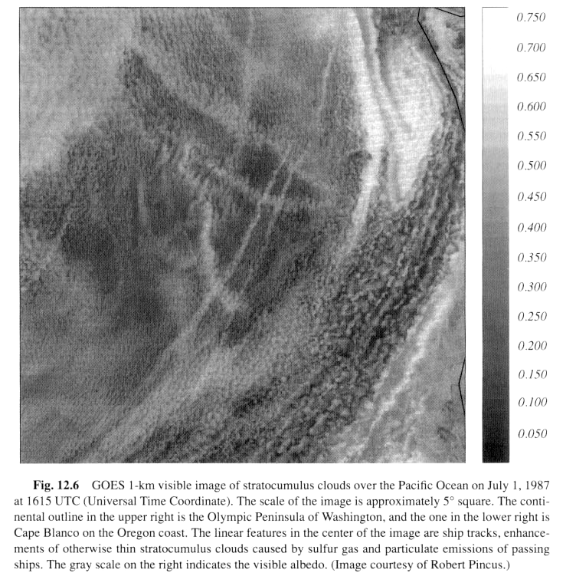
Aerosol-Cloud Albedo Feedback
Ship tracks off west coast
Aerosol serves as CCN
Makes more/smaller cloud drops
Higher albedo

Slide 15
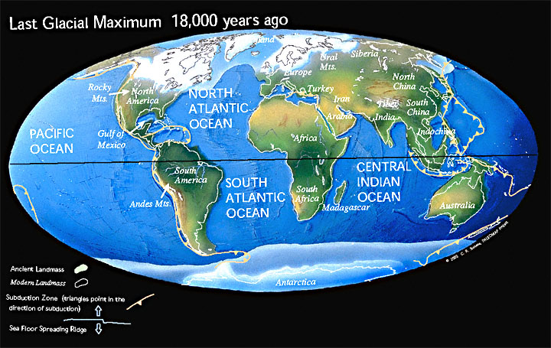
Learning from the Past

Slide 16
Estimating Total Climate Sensitivity
At the Last Glacial Maximum (~ 18k years ago) surface temp ~ 5 K colder
CO₂ was ~ 180 ppm (weaker greenhouse, 3.7 W m⁻² more OLR)
Brighter surface due to snow and ice, estimate 3.4 W m⁻² more reflected solar
Almost 3x as sensitive as suggested by Stefan-Boltzmann alone …
Other feedbacks must be going on as well

Slide 17
Greehouse Radiative Forcing
Note different scales
Modern changes comparable to postglacial, but much faster!

Slide 18
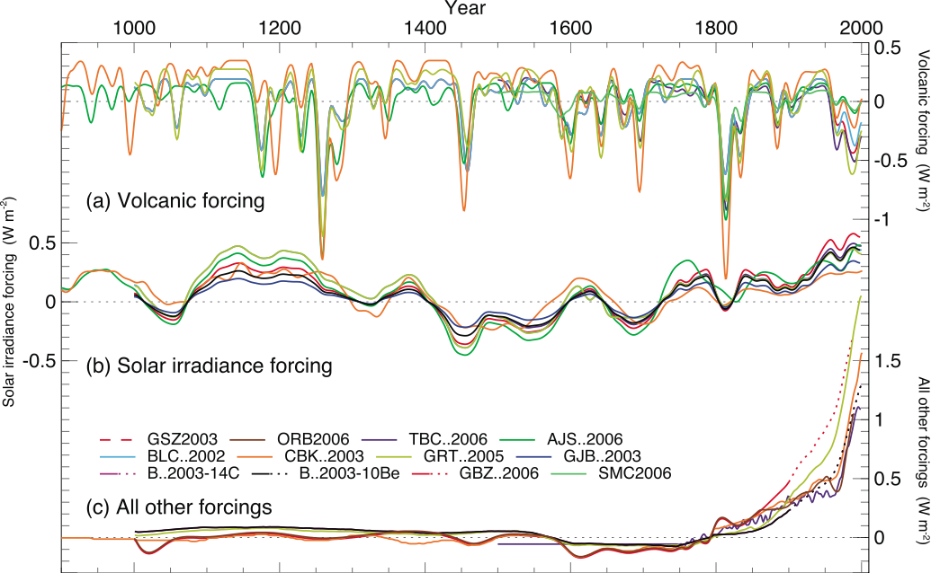
Reconstructed Radiative Forcings

Slide 19
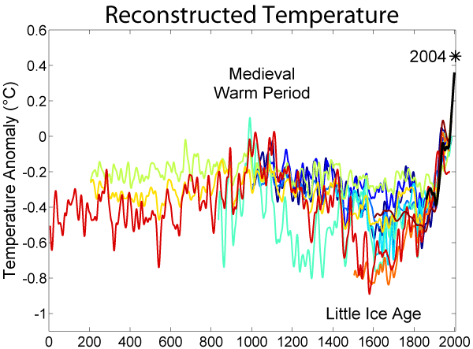
The Past 2000 Years
http://commons.wikimedia.org/wiki/File:2000_Year_Temperature_Comparison.png

Slide 20
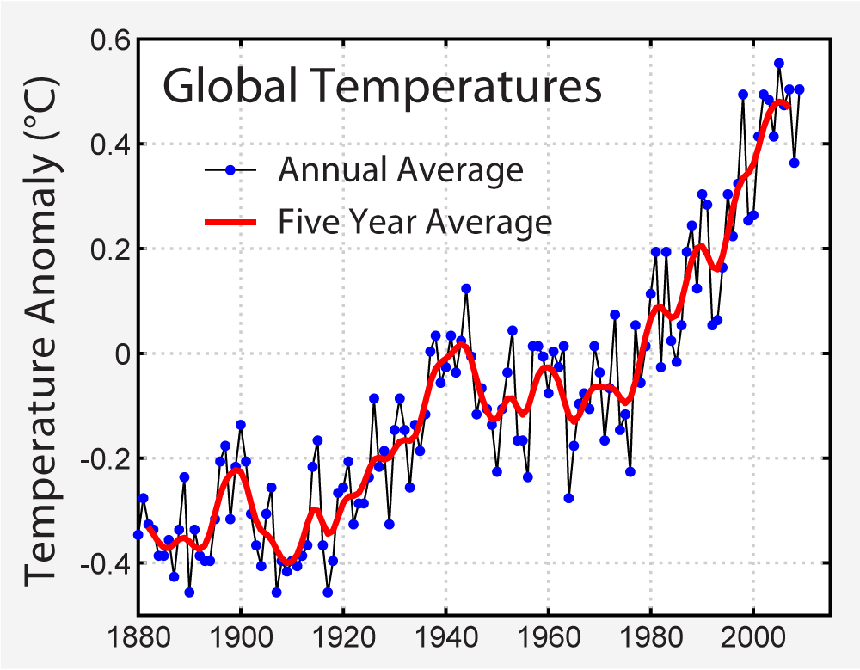
Historical Thermometer Record
http://commons.wikimedia.org/wiki/File:Instrumental_Temperature_Record.png

Slide 21
Comparison of Radiative Forcings

