Slide 1
Electromagnetic Radiation
Oscillating electric and magnetic fields propagate through space
Virtually all energy exchange between the Earth and the rest of the Universe is by electromagnetic radiation
Most of what we perceive as temperature is also due to our radiative environment
May be described as waves or as particles (photons)
High energy photons = short waves; lower energy photons = longer waves

Slide 2
Blackbodies and Graybodies
A blackbody is a hypothetical object that absorbs all of the radiation that strikes it. It also emits radiation at a maximum rate for its given temperature.
Does not have to be black!
A graybody absorbs & emits radiation equally at all wavelengths, but at a certain fraction (absorptivity, emissivity) of the blackbody rate
The energy emission rate is given by
Planck’s law (wavelength dependent emission)
Wien’s law (peak emission wavelength)
Stefan Boltzmann law (total energy)

Slide 3
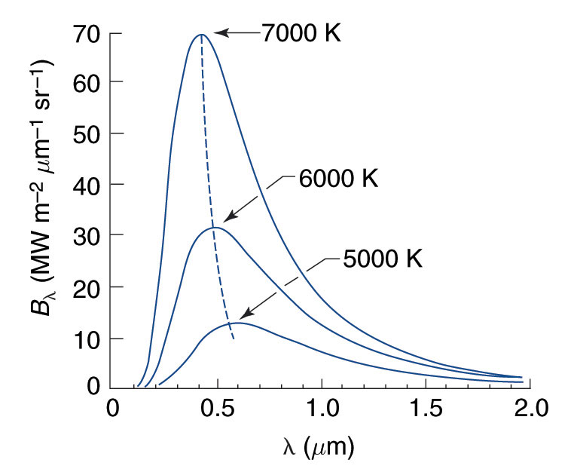
Total Blackbody Emission (Stefan-Boltzmann Law)
Integrating Planck's Law across all wavelengths, and all directions, we obtain an expression for the total rate of emission of radiant energy from a blackbody:
E* = sT⁴
This is known as the Stefan-Boltzmann Law, and the constant s is the Stefan-Boltzmann constant (5.67 x 10⁻⁸ W m⁻² K⁻⁴).
Stefan-Boltzmann says that total emission depends really strongly on temperature!
S-B is strictly true only for a blackbody. For a gray body, E = eE*, where e is called the emissivity.
In general, the emissivity depends on wavelength just as the absorptivity does, for the same reasons: e_{λ} = Ε_{λ}/Ε∗_{λ}

Slide 4
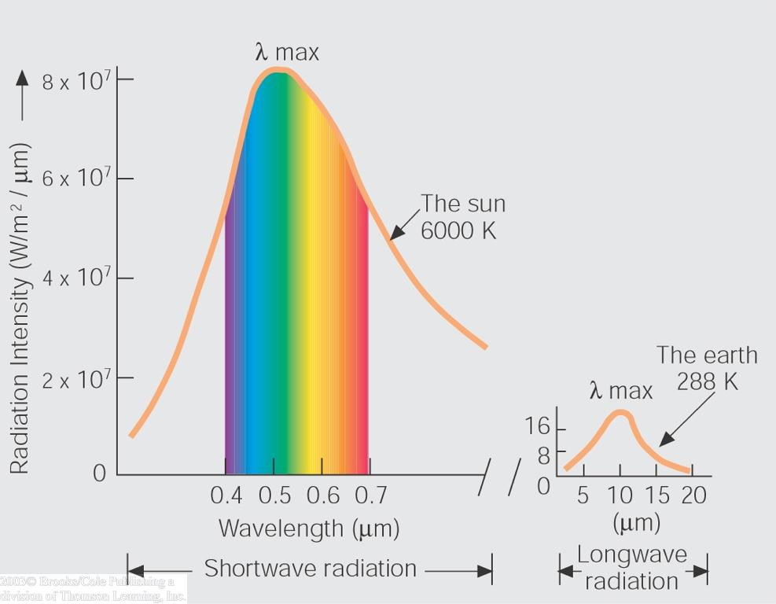
Spectrum of the sun compared
with that of the earth
The hot sun radiates at shorter (visible) wavelengths that carry more energy
Energy absorbed by the cooler earth is then re-radiated at longer (thermal infrared) wavelengths

Slide 5
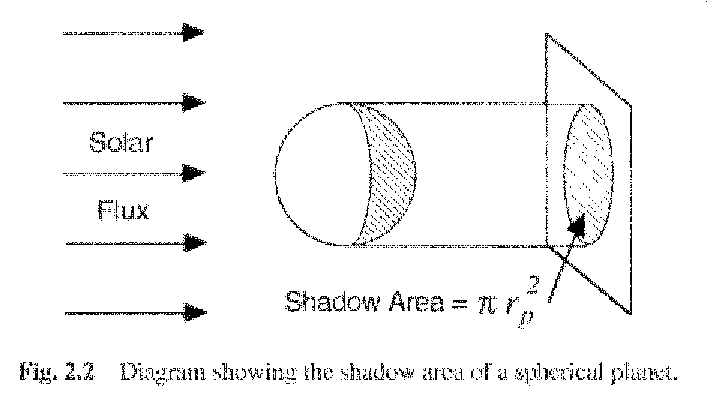
Absorption of Solar Radiation

Slide 6
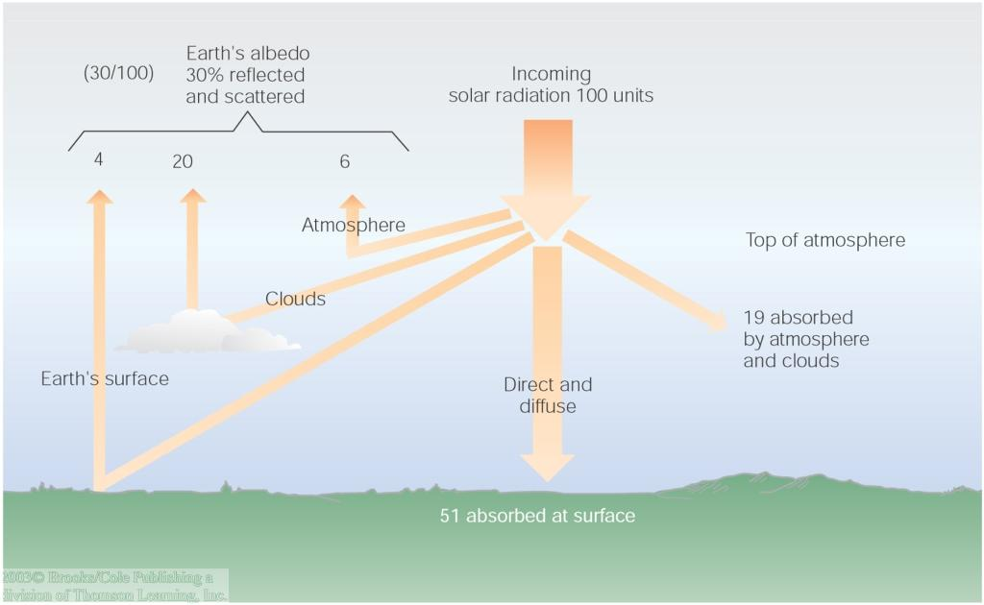
Solar Radiation
Solar radiation is scattered and reflected by the atmosphere, clouds, and earth's surface, creating an average albedo of 30%.
Atmospheric gases and clouds absorb another 19 units, leaving 51 units of shortwave absorbed by the earth's surface.

Slide 7
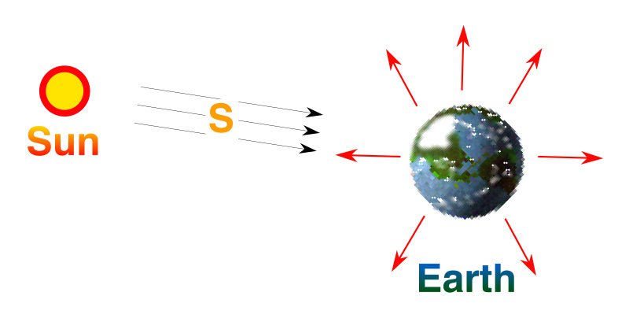
Planetary Energy Balance
Energy In = Energy Out
But the observed T_{s} is about 15° C

Slide 8
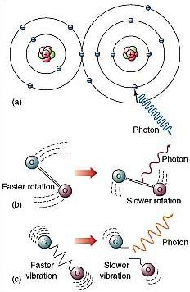
Atoms, Molecules, and Photons
Atmospheric gases are made of molecules
Molecules are groups of atoms that share electrons (bonds)
Photons can interact with molecules
Transitions between one state and another involve specific amounts of energy
IR photons change molecular vibration or rotation
UV
IR

Slide 9
Dancing Molecules and Heat Rays!
Nearly all of the air is made of oxygen (O₂) and nitrogen (N₂) in which two atoms of the same element share electrons
Infrared (heat) energy radiated up from the surface can be absorbed by these molecules, but not very well
O
O
N
N
Diatomic molecules can vibrate back and forth like balls on a spring, but the ends are identical

Slide 10
Dancing Molecules and Heat Rays!
Carbon dioxide (CO₂) and water vapor (H₂O) are different!
They have many more ways to vibrate and rotate, so they are very good at absorbing and emitting infrared (heat) radiation
O
C
O
O
H
H
Molecules that have many ways to wiggle are called “Greenhouse” molecules

Slide 11
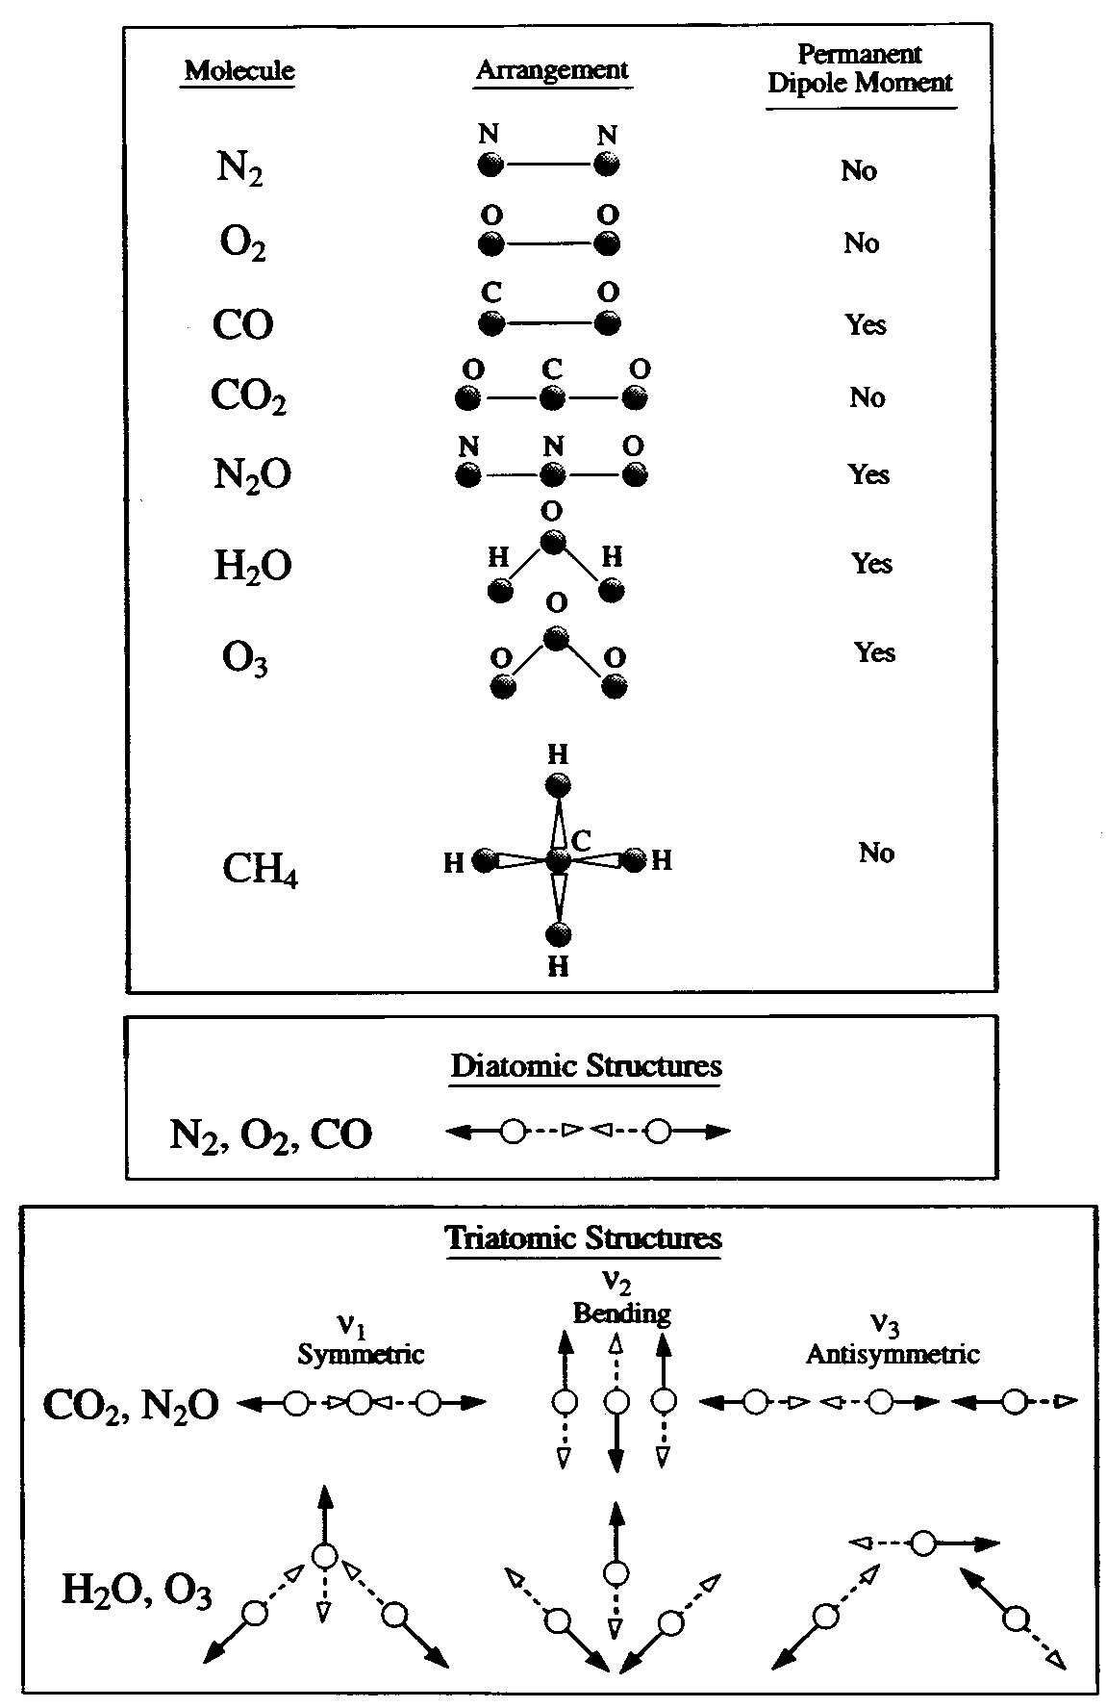
Molecular Absorbers/Emitters
Molecules of gas in the atmosphere interact with photons of electromagnetic radiation
Different kinds of molecular transitions can absorb/emit very different wavelengths of radiation
Some molecules are able to interact much more with photons than others
Molecules with more freedom to jiggle and bend in different ways absorb more types of photons
Water vapor (H₂O) and CO₂ are pretty good at this, and abundant enough to make a big difference!
These are the “greenhouse gases!”

Slide 12
Atmospheric Absorption
Solar radiation passes rather freely through Earth's atmosphere
Earth's re-emitted longwave energy either fits through a narrow “window” or is absorbed by greenhouse gases and re-radiated toward earth
Major LW absorbers:
Water vapor
CO₂
O₃
Clouds

Slide 13
Atmospheric Absorption
Triatomic modelcules have the most absorption bands
Complete absorption from 5-8 μ (H₂O) and > 14 μ(CO₂)
Little absorption between about 8 μ and 11 μ (“window”)

Slide 14
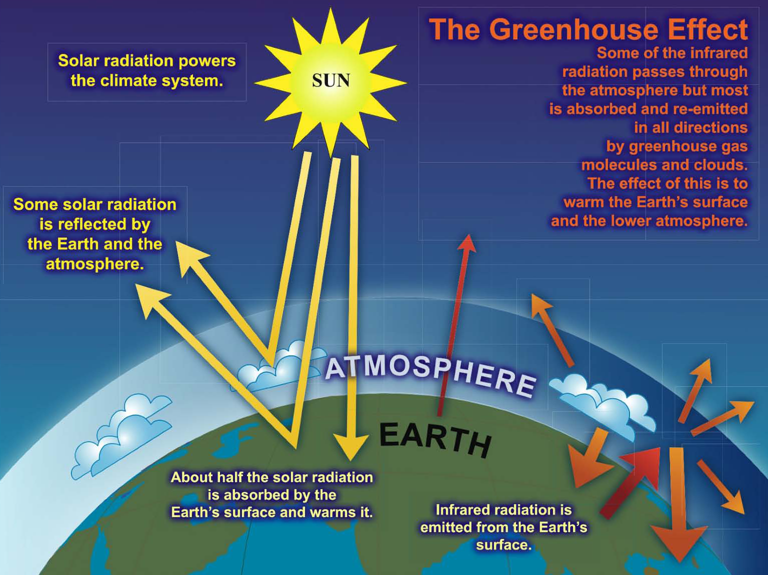

Slide 15
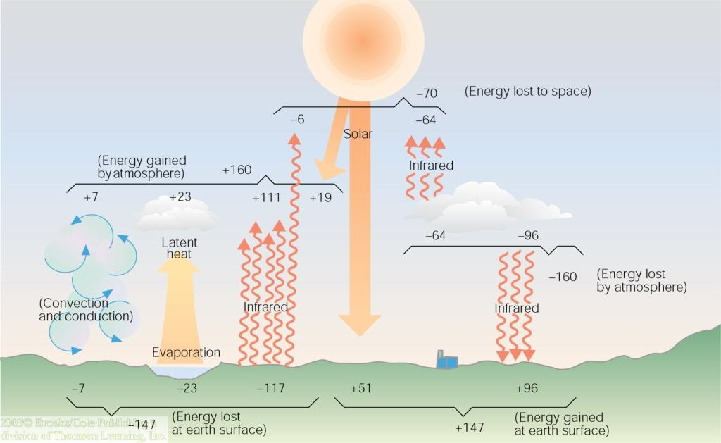
Earth-Atmosphere Energy Balance
Earth's surface absorbs the 51 units of shortwave and 96 more of longwave energy units from atmospheric gases and clouds.
These 147 units gained by earth are due to shortwave and longwave greenhouse gas absorption and emittance.
Earth's surface loses these 147 units through convection, evaporation, and radiation.

Slide 16
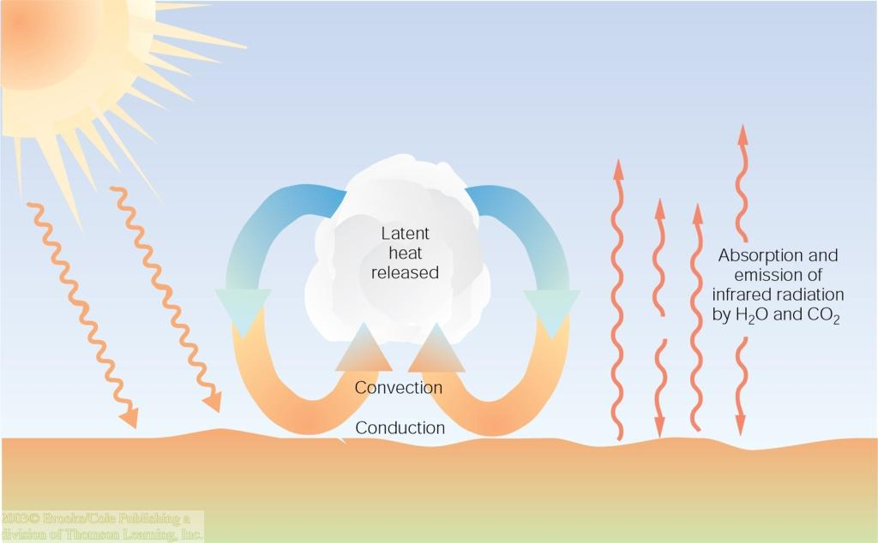
Atmosphere is Warmed from Below
Solar radiation passes first through the upper atmosphere, but only after absorption by earth's surface does it generate sensible heat to warm the ground and generate longwave energy.
This heat and energy at the surface then warms the atmosphere from below.

Slide 17
Planetary Energy Balance
Energy In = Energy Out
But the observed T_{s} is about 15° C

Slide 18
1-Layer Blackbody Atmosphere
Atmosphere of hypothetical planet is transparent in SW, but behaves as a blackbody in LW
B-B Atmosphere absorbs and emits all LW radiation
At planetary scale, total outward emission must still balance incoming solar

Slide 19
1-Layer Blackbody Atmosphere
Atmosphere must emit at Te = -18 C (both up and downward) to balance solar input at planetary scale
Surface receives exactly twice as much energy as top of atmosphere!

Slide 20
2-Layer Blackbody Atmosphere
Same “rules” as 1-layer BB atmosphere:
Transparent to SW, absorbs & emits all LW
Upper layer must still emit at Te = -18 C

Slide 21
Energy Balances by Layer
For every layer: Energy In = Energy Out
TOA
L1
L2
Surface
3 equations, 3 unknowns (T₁, T₂, T_{s})

Slide 22
2-Layer BB Atmosphere (cont’d)
Solving energy budgets for all layers simultaneously gives
0-layer: T_{s}⁴ = T_{e}⁴
1-layer: T_{s}⁴ = 2T_{e}⁴
2-layer: T_{s}⁴ = 3T_{e}⁴
In general, an n-layer B-B atmosphere will have T_{s}⁴ = (n+1)T_{e}⁴
Vertical temperature profile for 2-layer atmosphere
Surface is WAY too hot, atmosphere is WAY too cold
WHY?

Slide 23
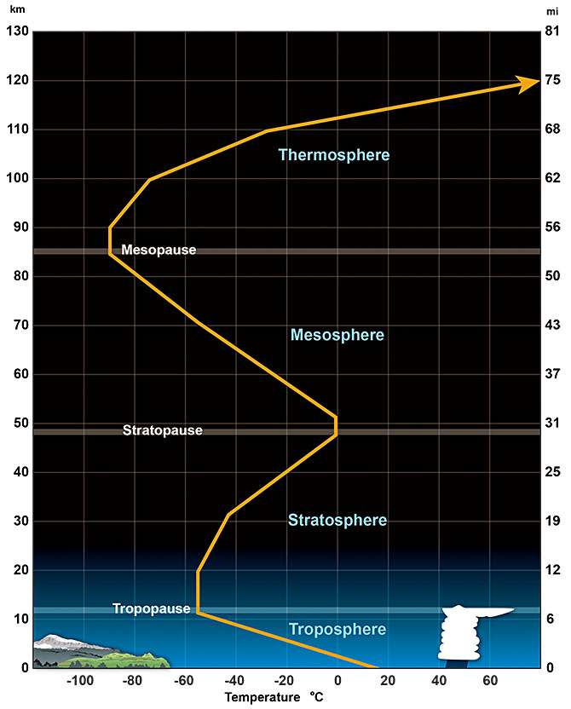
The Real Atmosphere
doesn’t have one or two or three layers, it has an infinite number of tiny layers!
has layers that aren’t thermal blackbodies, they are (approximately) graybodies
mixes (convects) when lower layers become too hot (less dense than layers above)
is heated aloft (way up there!) by absorption of solar radiation in the stratosphere and thermosphere

Slide 24
Vertical Structure is Crucial
The world is a big place, but the atmosphere is very thin, and most of it is close to the ground
About 15% of the atmosphere is below our feet
At the top of Long’s Peak, the figure is 40%
You are closer to outer space than you are to Denver!
Changes in atmospheric temperature with height are responsible for the “Greenhouse Effect,” which keeps us from freezing to death

Slide 25
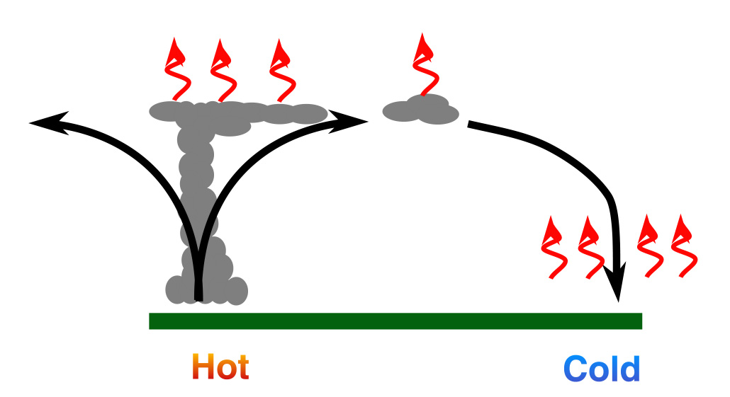
The Job of the Atmosphere is to let the energy out!
“Piles up” in tropics
“Escapes” near poles and aloft
The movement of the air (and oceans) allows energy to be
transported to its “escape zones!”

Slide 26
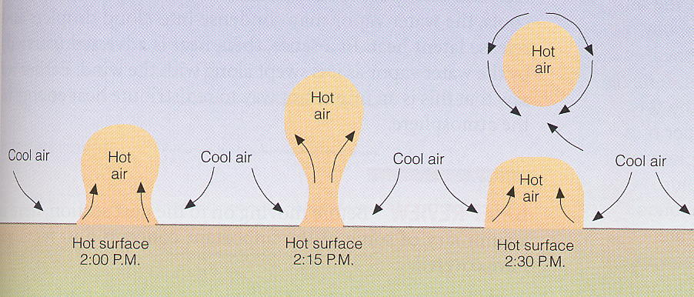
Atmospheric Heating by Convection
Sunlight warms the ground
Ground warms adjacent air by conduction
Poor thermal conductivity of air restricts heating to a few cm
Hot air forms rising air “bubbles” (thermals) leading to convection … heats the air, but cools the surface!
Mechanical mixing due to wind enhances this mode of heat transport

Slide 27
Radiative-Convective Equilibrium (a recipe)
Consider a 1-D atmosphere
Specify solar radiation at the top, emissivity of each layer
Calculate radiative equilibrium temperature for each layer
Check for static stability
If layers are unstable, mix them!
(e.g. density of lower layer is less than layer above, set both to same)
Add clouds and absorbing gases to taste
T_{n}
e_{n}
…
T₃
e₃
T₁
e₁
Manabe and Strickler (1964)

Slide 28
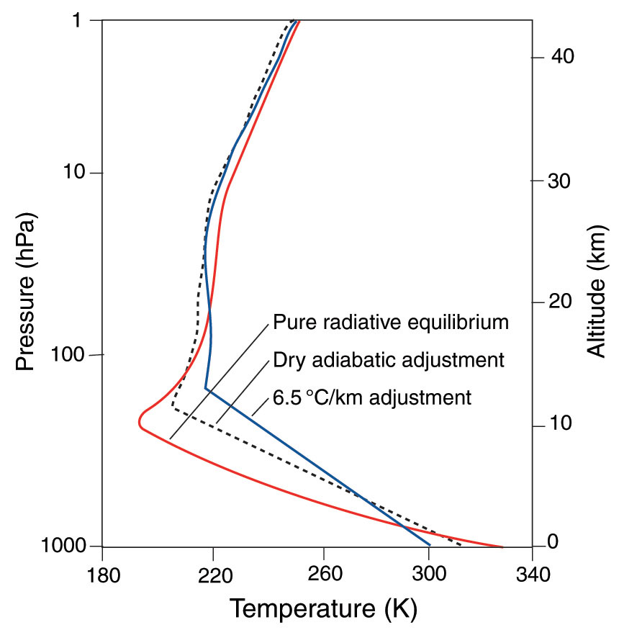
Radiative-Convective Equilibrium
Pure radiative equilibrium is way too hot at surface
Adjusting to Γ_{d} still too steep
Adjusting to observed 6.5 K km⁻¹ produces fairly reasonable profile:
Sfc temp (still hot)
Tropopause (OK)
Stratosphere (OK)

Slide 29
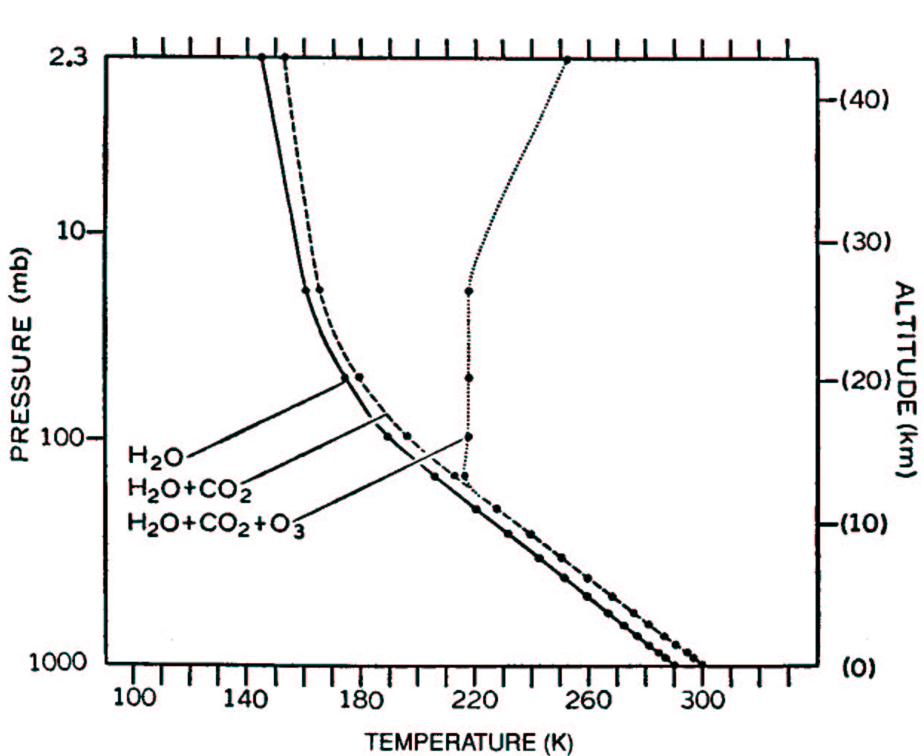
Radiative-Convective Equilibrium Effect of Different Absorbers
Water vapor alone … atmosphere is cooler
H₂O + CO₂ … almost 10 K warmer
H₂O + CO₂ + O₃ … stratosphere appears!

Slide 30
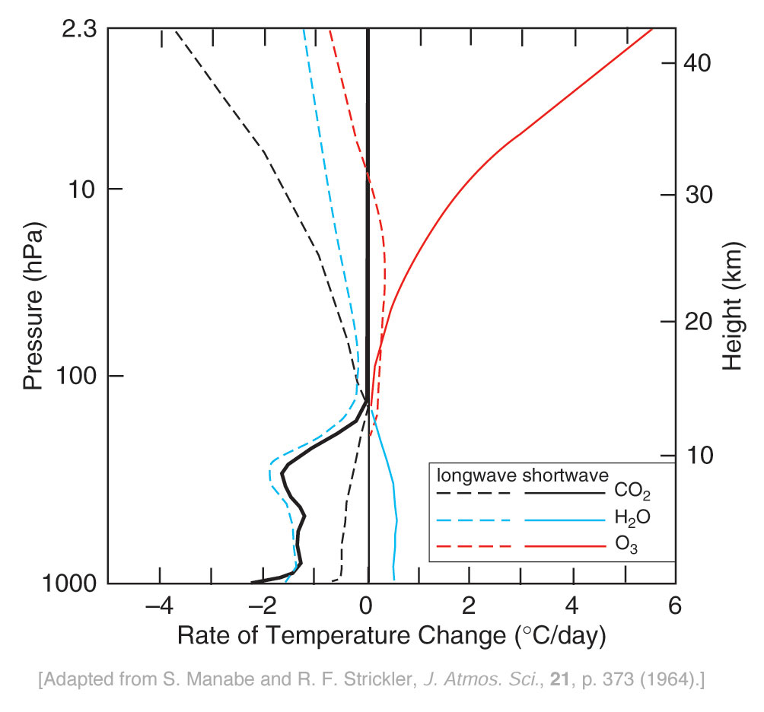
Radiative-Convective Equilibrium Radiative Heating Rates
NET
O₃
NET combines all SW and LW forcing
Heating and cooling nearly balance in stratosphere
Troposphere cools strongly (~ 1.5 K/day)
How is net tropospheric cooling balanced?

Slide 31
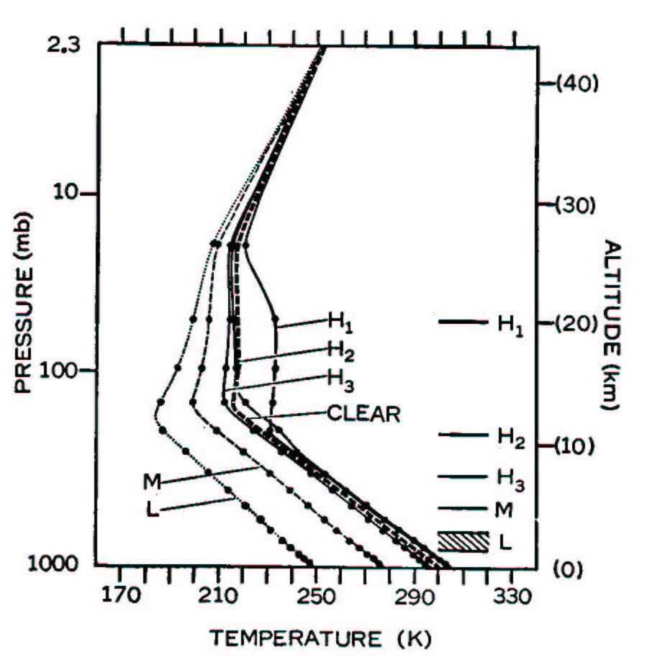
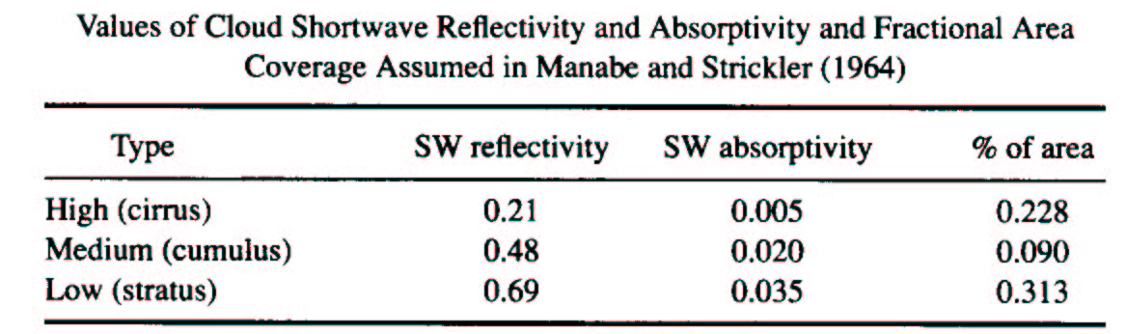
Radiative-Convective Equilibrium Effects of Clouds
Clouds absorb LW
Clouds reflect SW
Which effect “wins?”
Depends on emitting T
For low clouds, sT⁴ ~ sT_{s}⁴ , so SW effect is greater
For high clouds, sT⁴ << sT_{s}⁴ so LW effect “wins”
High clouds warm
Low clouds cool
Details are sensitive to optical properties and distributions of clouds, but remember the basic conclusion

Slide 32
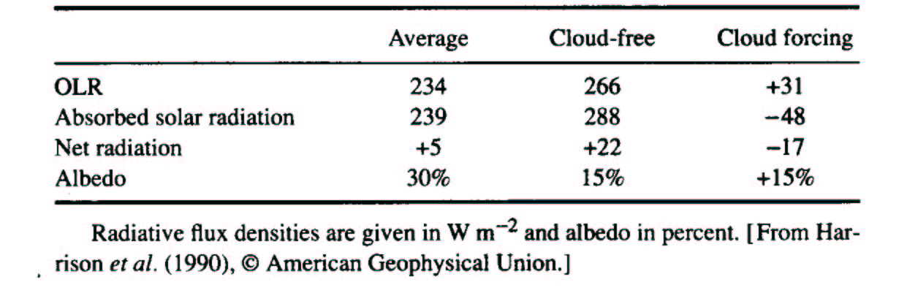
Global Mean Cloud Radiative Forcing
Clouds increase planetary albedo from 15% to 30%
This reduces absorbed solar by 48 W m⁻²
Reduced solar is offset by 31 W m⁻² of LW warming (greenhouse)
So total cloud forcing is –17 W m⁻²
Clouds cool the climate. By how much? How might this number change if cloudiness increased?

Slide 33
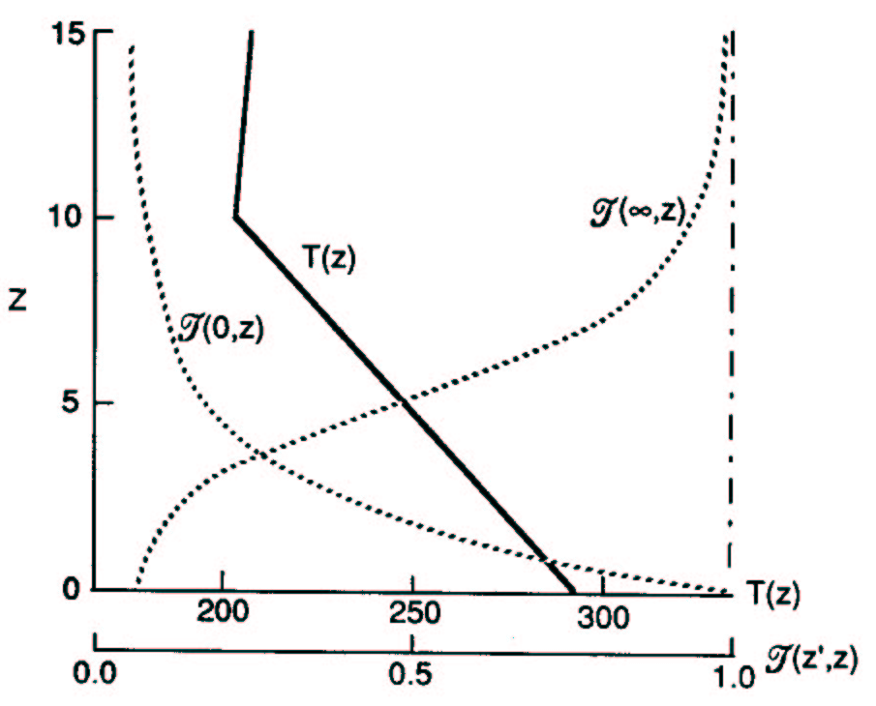
Transmission Functions and Heating
Think of upwelling and downwelling IR as weighted averages of sT⁴
The change in transmission function with height is the weighting function
Downwelling IR at surface comes from lower troposphere
Upwelling IR at TOA comes from mid-upper troposphere
This is the basis for the “greenhouse effect”
Vertical profiles of atmospheric LW transmission functions and temperature

Slide 34
