Slide 1
Climate Forcing, Sensitivity and Feedback Processes

Slide 2
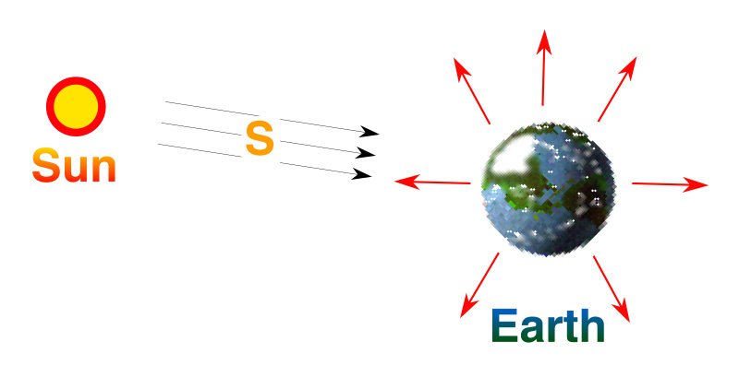
Earth’s Climate System What have we learned?
Earth is a planet
Planetary temperature is determined by
Brightness of our star
Earth-sun distance
Albedo of the planet
Composition of Earth’s atmosphere
Energy In = Energy Out
So how can climate ever change?

Slide 3
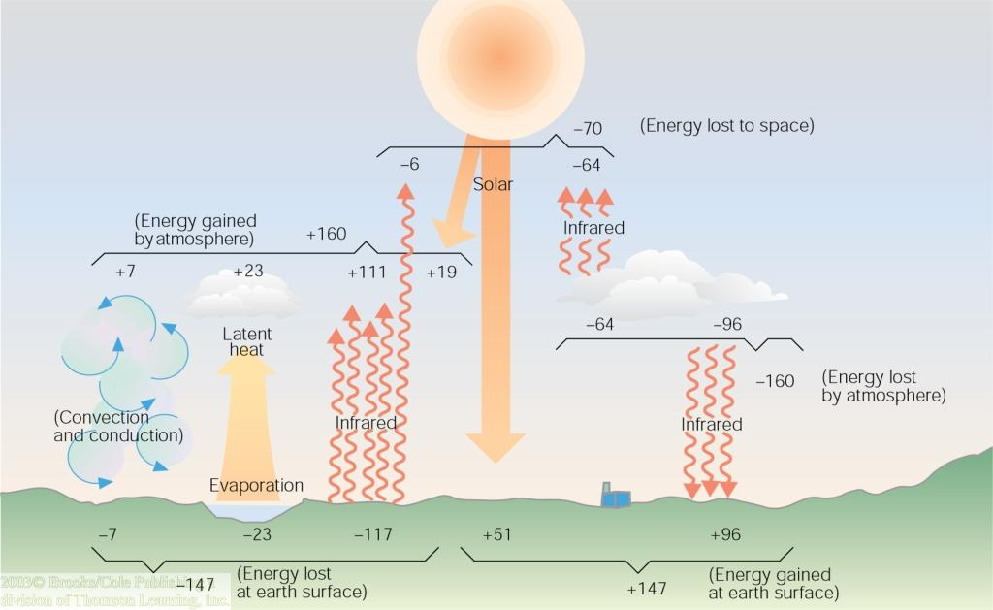
Earth’s Energy Budget What have we learned?
Surface climate depends on heating
51 units of absorbed solar
96 units of downward infrared (almost 2x sunshine)!
Surface climate depends on cooling
117 units of upward infrared
23 units of evaporation, 7 units of rising thermals

Slide 4
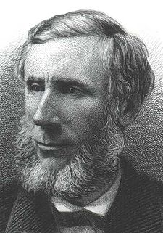
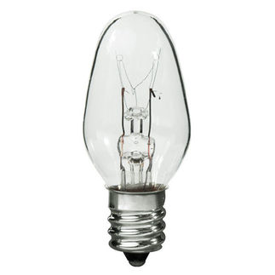
Common Sense
1 m
Doubling CO₂ would add 4 watts to every square meter of the surface of the Earth, 24/7
Doing that would make the surface warmer
This was known before light bulbs were invented!
4 Watts
1 m
John Tyndall, January 1863

Slide 5
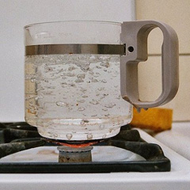
Common Myth #1
“Scientists are worried about climate change because it’s been warming up recently”
WRONG!
We’re worried because we know that when we add heat to things, they warm up

Slide 6
Earth’s Climate as a “Black Box”
S₀
T_{S}
Climate System
1367 W m⁻²
15 C
Surface Temperature Out
Sunshine
In

Slide 7
Climate Forcing, Response, and Sensitivity
DS₀
DT_{S}
Climate System
+ 1 W m⁻²
? °C
Response:
(Change in Surface Temperature)
Forcing
(change in sunshine)

Slide 8
Climate Forcing, Response, and Sensitivity
Forcing
(change in sunshine)
Response:
(Change in Surface Temperature)
“Let’s do the math …”
A 1 W m⁻² change in sunshine would produce about a 0.26 °C change in planet’s temperature

Slide 9
19th Century Climate Physics (Svante Arrhenius, 1896)
aS₀
S₀
esT_{s}⁴
atmosphere
Differentiate, apply chain rule
T_{s}
Earth
Arrhenius worked out a simple formula
for the change in surface temperature
given a change in effective atmospheric emissivity due to CO₂

Slide 10
19th Century Climate Physics (cont’d)
Plug in measured values
W m⁻²
(from satellite data)
T_{s} = 288 K
W m⁻²
(for 2 x CO₂ from radiative transfer)
For CO₂ alone (no feedback), expect about 2 °F warming for 2 x CO₂

Slide 11
Climate Feedback Processes
Positive Feedbacks (amplify changes)
Water vapor
Ice-albedo
High clouds
D hi cloud
D LW
D lo cloud
DS
DT_{S}
Dvapor
Negative feedbacks (damp changes)
Longwave cooling
Low clouds
D albedo

Slide 12
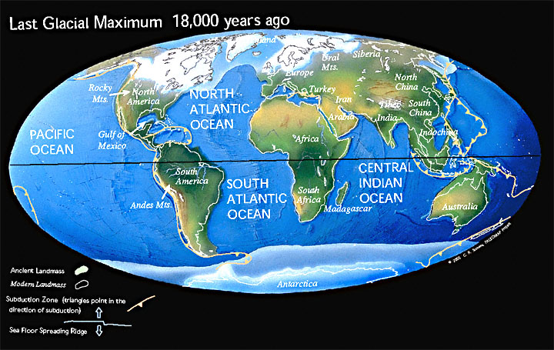
Learning from the Past

Slide 13
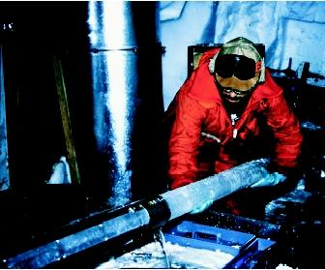
CO₂ and the Ice Ages
Over the past 420,000 years atmospheric CO₂ has varied between 180 and 280 ppm, beating in time with the last four glacial cycles
CO₂
370 ppm in 2000
ice
ice
ice
ice
Vostok (400k yr) Ice Core data (Petit et al, 1999)

Slide 14
Estimating Total Climate Sensitivity
At the Last Glacial Maximum (~ 18k years ago) surface temp ~ 5 °C colder
CO₂ was ~ 180 ppm (weaker greenhouse, 3.7 W m⁻² more LW⬆)
Brighter surface due to snow and ice, estimate 3.4 W m⁻² more reflected solar ⬆
Almost 3x as sensitive as suggested by Arrhenius in 1897 …
Other feedbacks must be going on as well

Slide 15
Review: 19th Century Physics (updated using paleo-data)
Forcing: changes in properties of atmosphere as measured by spectroscopy (4 W m⁻² per doubling of CO₂)
Feedback: both positive and negative, total response to forcing estimated from Ice Age climate data (about 0.7 °C per W m⁻²)
Response: about 2.8 °C warming for 2 x CO₂
No climate models required … just based on observations
(modern calculations agree … coincidence?)

Slide 16
CO₂ and the Modern Age
Over the past 420,000 years atmospheric CO₂ has varied between 180 and 280 parts per million, beating in time with the last four glacial cycles
Since the Industrial Revolution, CO₂ has risen very rapidly
CO₂
400 ppm in 2013
370 ppm in 2000
ice
ice
ice
ice
Vostok (400k yr) Ice Core data (Petit et al, 1999)
from measurements

Slide 17
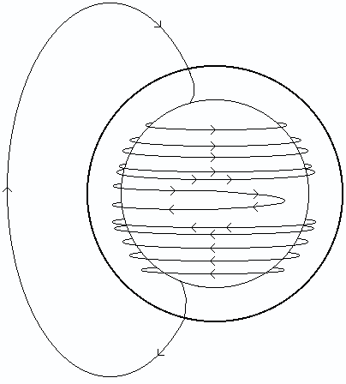
Solar Variability
Sun is an enormous spinning plasma sphere (entirely composed of charged particles)
Rotating charges induce intense magnetic fields
Fluid flow follows field (not buoyancy!)
Rapid differential rotation distorts field lines
They wrap and wrap, tighter and tighter
About every 11 years, they break down, reorganize, and start again

Slide 18
Solar Cycle

Slide 19
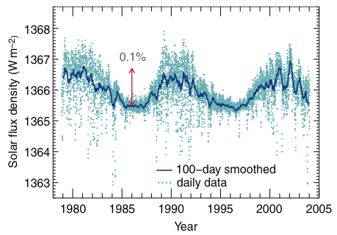
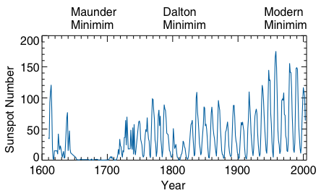
Solar Variability
11-year solar cycle associated with variations in solar “constant” of about 10 W m⁻² (~ 0.1% of total)
Variability on longer time scales is not understood
Possibly associated with Century-scale variability (“Little Ice Age”)?

Slide 20
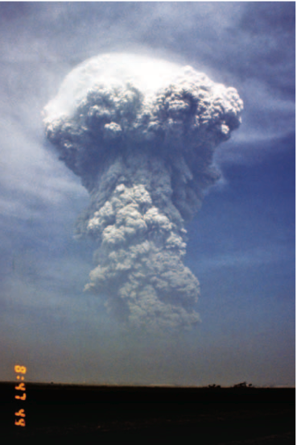
Volcanic Aerosol
Massive releases of particles and (more importantly) SO₂, lofted to tremendous heights in stratosphere
SO₂ -> H₂SO₄ aerosol in stratosphere
Can persist for months-years
Substantial shift from direct to diffuse light

Slide 21
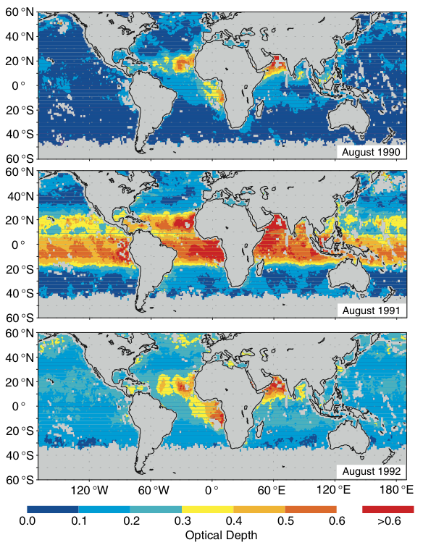
Volcanic Stratospheric Aerosol
Changes in aerosol optical depth as a result of Mt Pinatubo eruption (June 1991)
Filled tropical stratosphere quickly
Dispersed to all latitudes over ~ 1 yr
Affected climate for 2-3 years?

Slide 22
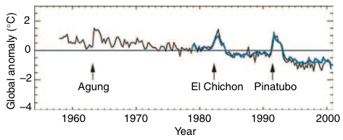
Stratospheric Aerosol & Temperatures
Big volcanoes dominate variance
What causes trend?

Slide 23
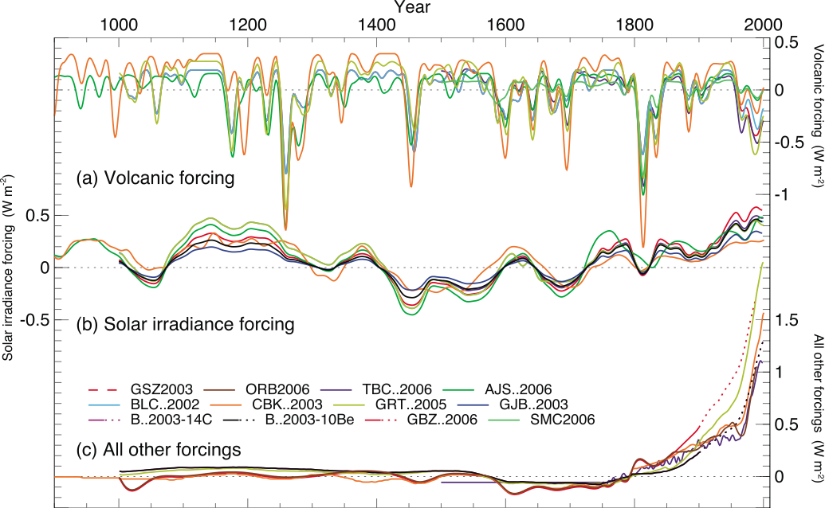
Reconstructed Radiative Forcings

Slide 24
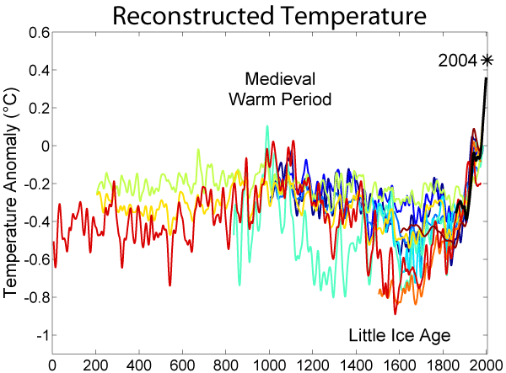
The Past 2000 Years
http://commons.wikimedia.org/wiki/File:2000_Year_Temperature_Comparison.png

Slide 25
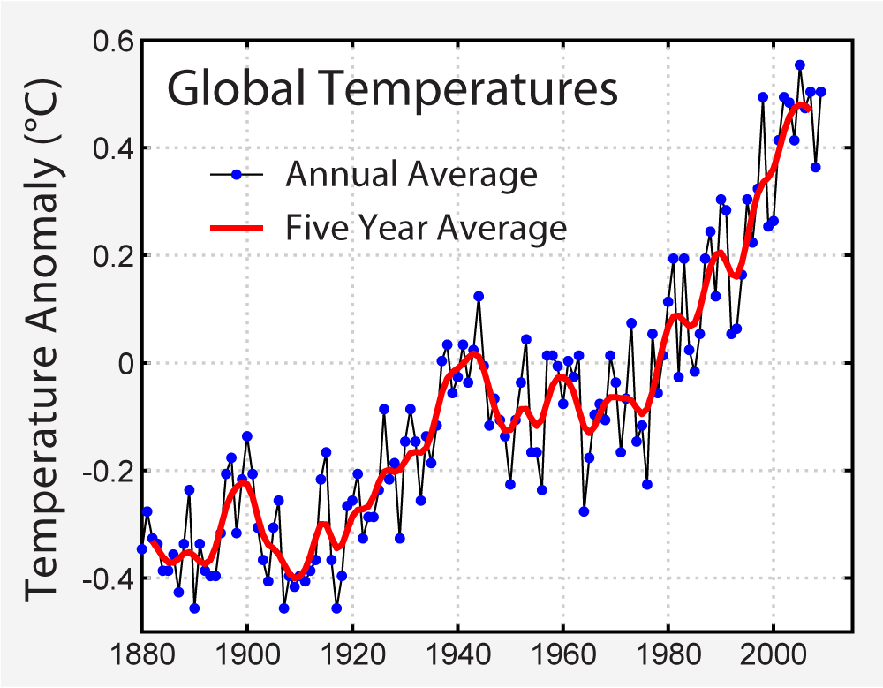
Historical Thermometer Record
http://commons.wikimedia.org/wiki/File:Instrumental_Temperature_Record.png

Slide 26
Comparison of Radiative Forcings

Slide 27
CO₂ and the Future
Over the past 420,000 years atmospheric CO₂ has varied between 180 and 280 parts per million, beating in time with the last four glacial cycles
Since the Industrial Revolution, CO₂ has risen very rapidly
If China & India develop using 19th Century technology, CO₂ will reach 900 ppm in this century
CO₂
900 ppm in 2100
395 ppm in 2013
ice
ice
ice
ice
Vostok (400k yr) Ice Core data (Petit et al, 1999)
You ain’t seen nothing yet!

