Slide 1
Equation of State (a.k.a. the “Ideal Gas Law”)
pressure (N m⁻²)
temperature (K)
density (kg m⁻³)
“gas constant” (J K⁻¹ kg⁻¹)
Direct relationship between density and pressure
Inverse relationship between density and temperature
Direct relationship between temperature and pressure

Slide 2
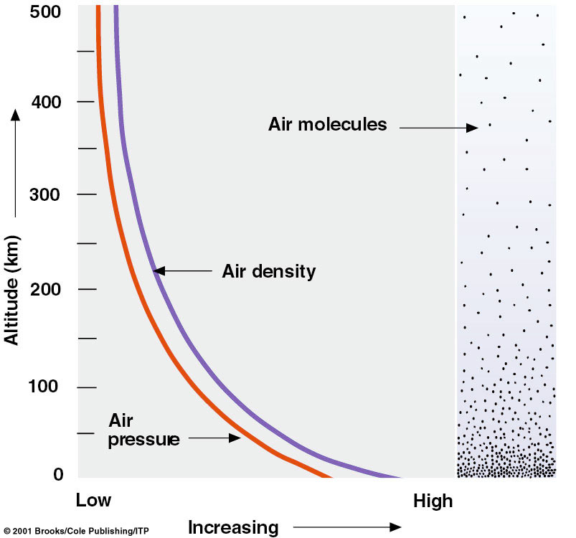
Pressure and Density
Gravity holds most of the air close to the ground
The weight of the overlying air is the pressure at any point

Slide 3
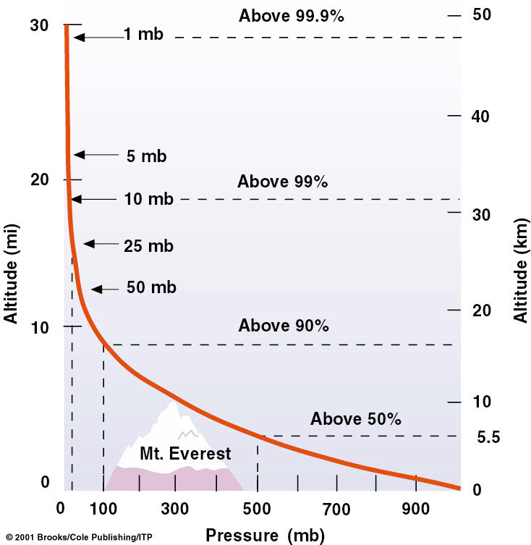
Hydrostatic Balance
What keeps air from always moving downwards due to gravity?
A balance between gravity and the pressure gradient force.
DP/ Dz = rg
The “pressure gradient force?”
Pushes from high to low pressure.
DP/ Dz
rg

Slide 4
Buoyancy
An air parcel rises in the atmosphere when its density is less than its surroundings
Let r_{env} be the density of the environment. From the Ideal Gas Law
r_{env} = P/RT_{env}
Let r_{parcel} be the density of an air parcel. Then
r_{parcel} = P/RT_{parcel}
Since both the parcel and the environment at the same height are at the same pressure
when T_{parcel} > T_{env} r_{parcel} < r_{env} (positive buoyancy)
when T_{parcel} < T_{env} r_{parcel} > r_{env} (negative buoyancy)

Slide 5
Stable and Unstable Equilibria
Conditionally Stable
Stable
Unstable
Neutral
Stable: when perturbed, system accelerates back toward equilibrium state
Unstable: when perturbed, system accelerates away from equilibrium state

Slide 6
Stability in the atmosphere
Stable
Unstable
Neutral
An Initial
Perturbation
If an air parcel is displaced from its original height it can:
Return to its original height - Stable
Accelerate upward because it is buoyant - Unstable
Stay at the place to which it was displaced - Neutral

Slide 7
Why is stability important?
Vertical motions in the atmosphere are a critical part of energy transport and strongly influence the hydrologic cycle
Without vertical motion, there would be no precipitation, no mixing of pollutants away from ground level - weather as we know it would simply not exist!
There are two types of vertical motion:
forced motion such as forcing air up over a hill, over colder air, or from horizontal convergence
buoyant motion in which the air rises because it is less dense than its surroundings

Slide 8
Trading Height for Heat (cont’d)
Suppose a parcel exchanges no energy with its surroundings … we call this state adiabatic, meaning, “not gaining or losing energy”
“Dry lapse rate”

Slide 9
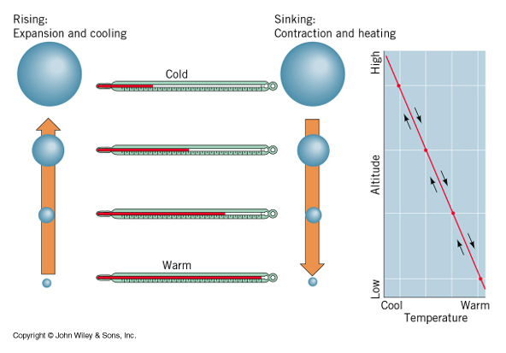
Dry Lapse Rate
10 degrees C per kilometer
Warming and Cooling due to changing pressure

Slide 10
Stability and the Dry Lapse Rate
A rising air parcel cools according to the dry lapse rate (10 C per km)
If rising, cooling air is:
warmer than surrounding air it is less dense and buoyancy accelerates the parcel upward … UNSTABLE!
colder than surrounding air it is more dense and buoyancy opposes (slows) the rising motion … STABLE!

Slide 11
Unstable Atmosphere
The atmosphere is unstable if the actual lapse rate exceeds the dry lapse rate (air cools more than 10 C/km)
This situation is rare in nature (not long-lived)
Usually results from surface heating and is confined to a shallow layer near the surface
Vertical mixing eliminates it
Mixing results in a dry lapse rate in the mixed layer, unless condensation (cloud formation) occurs

Slide 12
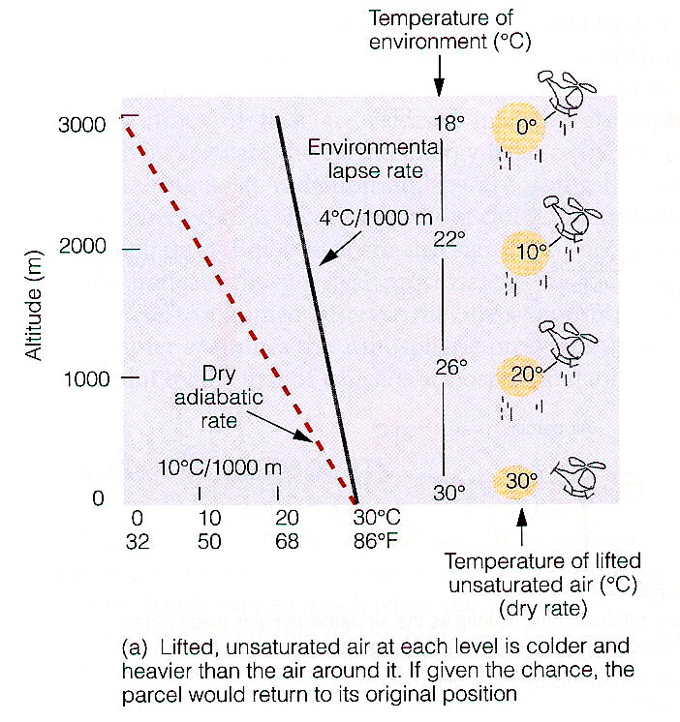
Stable Atmosphere
The atmosphere is stable if the actual lapse rate is less than the dry lapse rate (air cools less than 10 C/km)
This situation is common in nature (happens most calm nights, esp in winter)
Usually results from surface cooling and is confined to a shallow layer near the surface
Vertical mixing or surface heating eliminates it

Slide 13
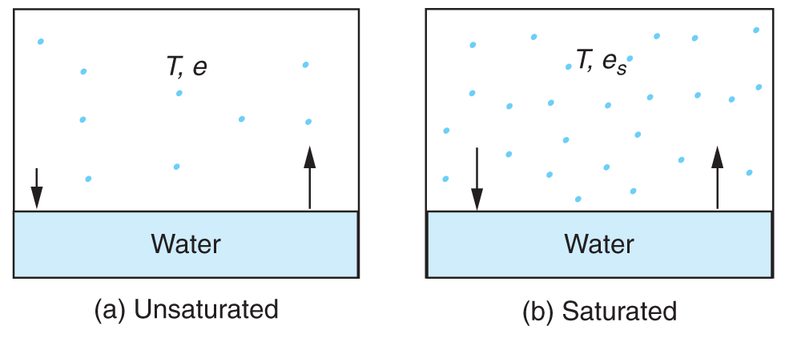
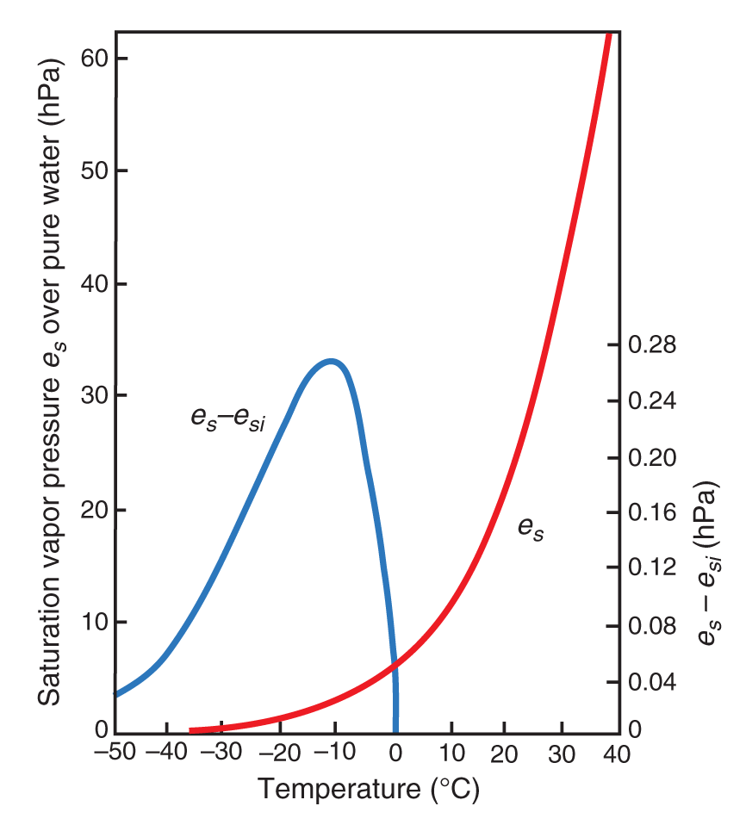
Water Vapor, Liquid Water, and Air
Water molecules make phase transitions
When vapor and liquid are in equilibrium, the air is “saturated”
Saturation vapor pressure e_{s} depends only on temperature
Dewpoint temperature T_{d} depends only on vapor pressure e

Slide 14
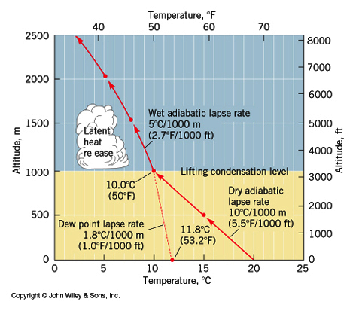
Moist Adiabatic Lapse Rate
Warming and cooling due to both changes in pressure and latent heat release
Rising air with condensing water cools more slowly with height than dry air

Slide 15
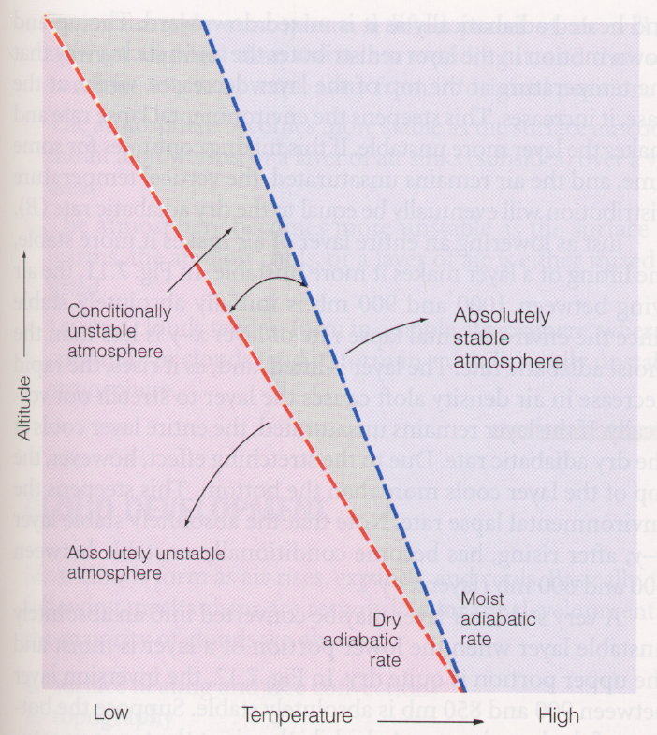
Conditionally unstable air
If the environmental lapse rate falls between the moist and dry lapse rates:
The atmosphere is unstable for saturated air parcels but stable for dry air parcels
This situation is termed conditionally unstable
This is the most typical situation in the troposphere

Slide 16
Condensation
Phase transformation of water vapor to liquid water
Water does not easily condense without a surface present
Vegetation, soil, buildings provide surface for dew and frost formation
Particles act as sites for cloud and fog drop formation

Slide 17
Cloud and fog drop formation
If the air temperature cools below the dew point (RH > 100%), water vapor will tend to condense and form cloud/fog drops
Drop formation occurs on particles known as cloud condensation nuclei (CCN)
The most effective CCN are water soluble
Without particles clouds would not form in the atmosphere!
RH of several hundred percent required for pure water drop formation

Slide 18
Cloud Droplets are Tiny!

Slide 19
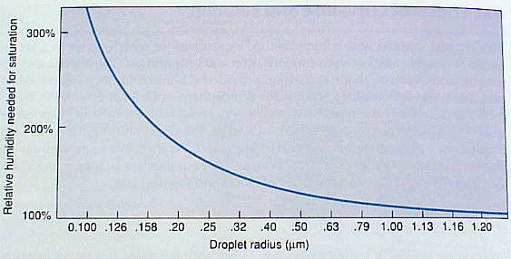
Very Small Drops Evaporate!
Surface of small drops are strongly curved
Stronger curvature produces a higher e_{sat}
Very high RH required for equilibrium with small drops
~300% RH for a 0.1 µm pure water drop
If small drops evaporate, how can we ever get large drops?!

Slide 20
Nucleation of Cloud Droplets
Formation of a pure water drop without a condensation nucleus is termed “homogeneous nucleation”
Random collision of water vapor molecules can form a small drop embryo
Collision likelihood limits maximum embryo size to < 0.01 µm
e_{sat} for embryo is several hundred percent
Embryo evaporates since environmental RH < 100.5%

Slide 21
Effects of Dissolved Stuff
Condensation of water on soluble CCN dissolves particle
Water actually condenses on many atmospheric salt particles at RH ~70%
Some solute particles will be present at drop surface
Displace water molecules
Reduce likelihood of water molecules escaping to vapor
Reduce e_{sat} from value for pure water drop
Water molecule
Solute molecule

Slide 22
Steps in Cloud/Fog Formation
Air parcel cools causing RH to increase
Radiative cooling at surface (fog)
Expansion in rising parcel (cloud)
CCN (tenths of µm) take up water vapor as RH increases
Depends on particle size and composition
IF RH exceeds critical value, drops are activated and grow readily into cloud drops (10’s of µm)

Slide 23
Cloud Condensation Nuclei
Not all atmospheric particles are cloud condensation nuclei (CCN)
Good CCN are hygroscopic (“like” water, in a chemical sense)
Many hygroscopic salt and acid particles are found in the atmosphere
Natural CCN
Sea salt particles (NaCl)
Particles produced from biogenic sulfur emissions
Products of vegetation burning
CCN from human activity
Pollutants from fossil fuel combustion react in the atmosphere to form acids and salts

Slide 24
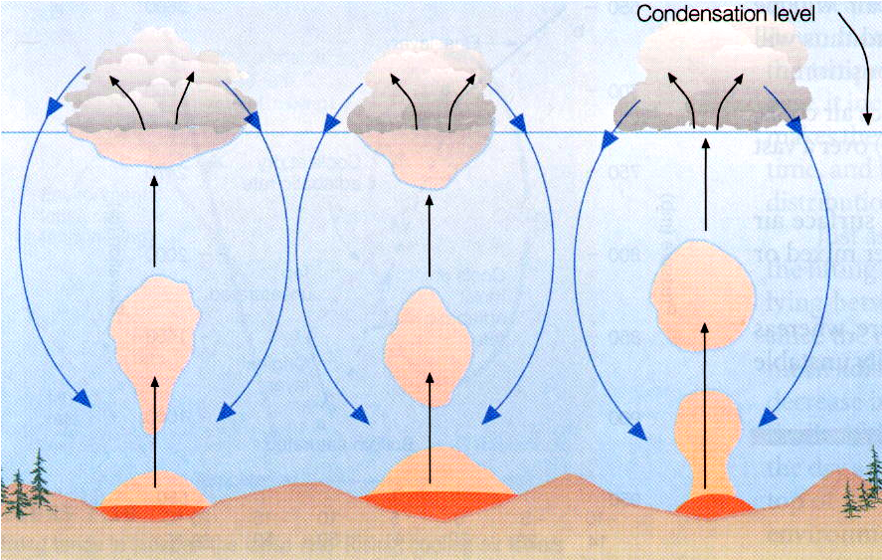
Fair weather cumulus cloud development
Buoyant thermals due to surface heating
They cool at dry adiabatic lapse rate (conserve θ)
Cloud forms when T = T_{d} (RH ~ 100%)
Sinking air between cloud elements
Rising is strongly suppressed at base of subsidence inversion produced from sinking motion associated with high pressure system

Slide 25
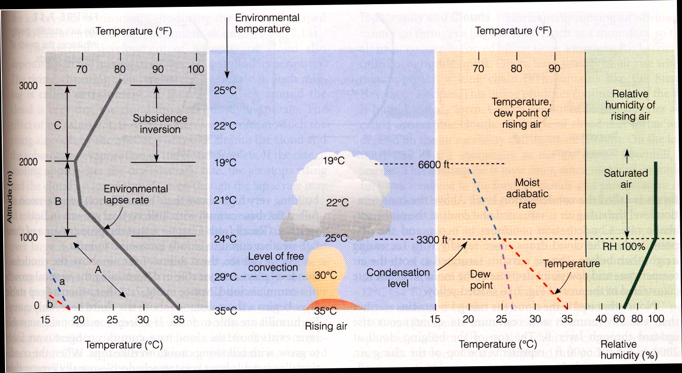
Fair weather cumulus cloud development schematic

Slide 26
What conditions support taller cumulus development ?
A less stable atmospheric (steeper lapse rate) profile permits greater vertical motion
Lots of low-level moisture permits latent heating to warm parcel, accelerating it upward

Slide 27
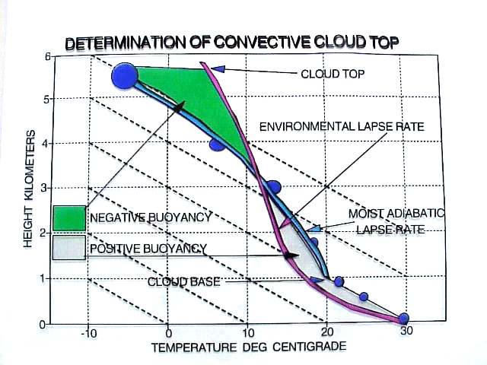

Slide 28
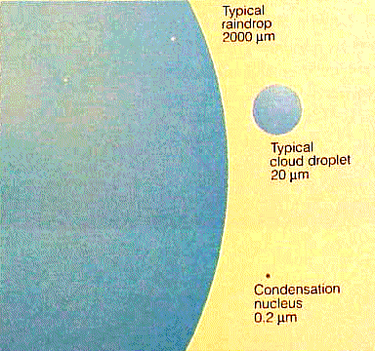
Precipitation Formation
How can precipitation form from tiny cloud drops?
Warm rain process
The Bergeron (ice crystal) process
Ice multiplication
How many 20 µm cloud drops does it take to make a 2000 µm rain drop?
V = 4/3pr³ = pd³/6
(2000/20) ³ = 1,000,000

Slide 29
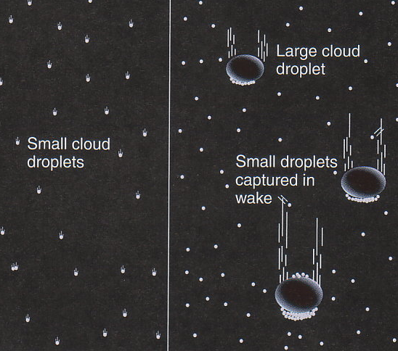
Rain formation in warm clouds (no ice)
In a supersaturated environment, activated cloud drops grow by water vapor condensation
It takes many hours for the cloud drop to approach rain drop size
Collisions between cloud drops can produce large rain drops much faster through coalescence
Collisions occur in part due to different settling rates of large and small drops
Not all collisions result in coalescence
Rain formation favored by
Wide range of drop sizes
Thick cloud
Fast updrafts

Slide 30
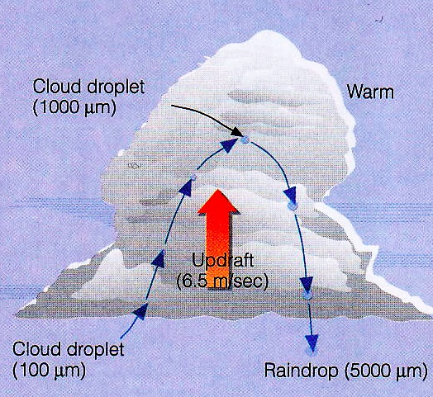
Rain formation in warm clouds
Capture of a cloud/rain drop in a cloud updraft can give it more time to grow
The drop falls at a fixed speed relative to the air, not the ground
Large drops fall faster

Slide 31
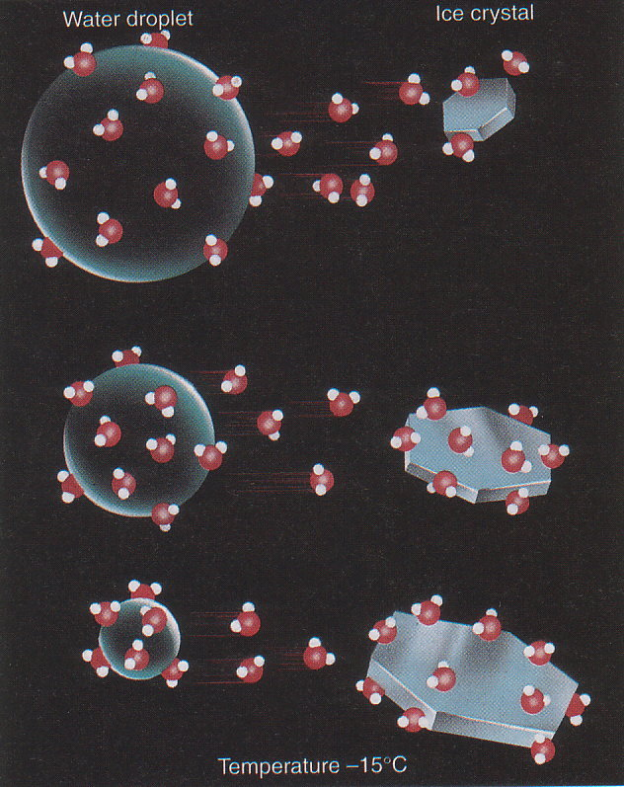
Ice crystal growth by vapor deposition (Bergeron process)
Ice binds water molecules more tightly than liquid water
For temperatures less than 0ºC, the saturation vapor pressure over ice is less than the saturation vapor pressure over super-cooled water
This leads to evaporation of water from supercooled cloud drops and deposition onto ice crystals

Slide 32
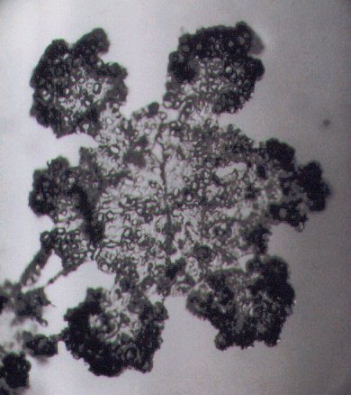
Ice crystal growth by accretion
Ice crystals fall faster than cloud drops
Crystal/drop collisions allow ice crystals to capture cloud drops
The supercooled drops freeze upon contact with the ice crystal
This process is known as accretion or riming
Extreme crystal riming leads to the formation of
Graupel
Hail

Slide 33
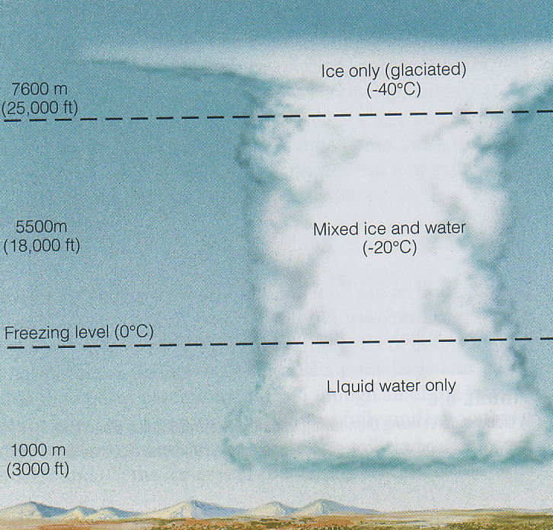
Ice Crystal Processes in Cold Clouds
Outside deepest tropics most precipitation is formed via ice crystal growth
Supercooled cloud drops and ice crystals coexist for –40º < T < 0º C
Lack of freezing nuclei to “glaciate” drops
Ice crystals can grow by
Water vapor deposition
Capture of cloud drops (accretion/riming)
Aggregation

Slide 34
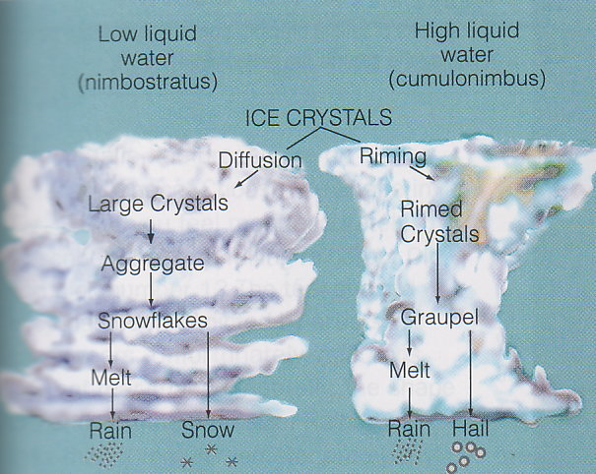
Precipitation in cold clouds
Low liquid water content promotes diffusion/deposition growth of large crystals
High liquid water content promotes riming and formation of graupel/hail
If the sub-cloud layer is warm, snow or graupel may melt into raindrops before reaching the surface (typical process for summer rain in Colorado)

Slide 35
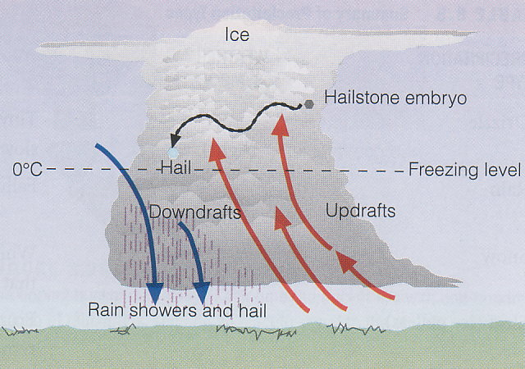
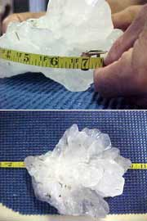
Hail
Hail can form in clouds with
High supercooled liquid water content
Very strong updrafts decoupled from downdrafts
Hailstones typically make 2-3 trips up through cloud
Opaque and clear ice layers form
Opaque represents rapid freezing of accreted drops
Clear represents slower freezing during higher water accretion rates
Layering tells about hailstone history
The largest hailstone ever recovered in the United States, a seven-inch (17.8-centimeter) wide chunk of ice almost as large as a soccer ball. It was found in Aurora, Nebraska on June 22, 2003. The hailstone lost nearly half of its mass upon landing on the rain gutter of a house

Slide 36
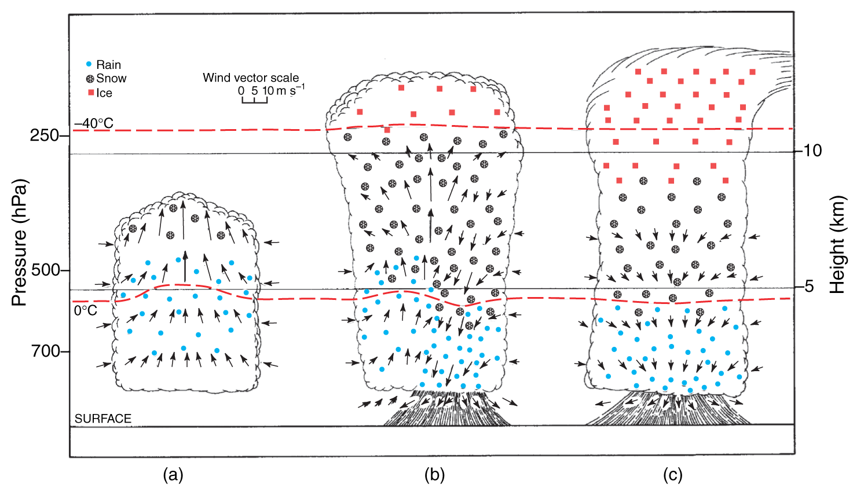
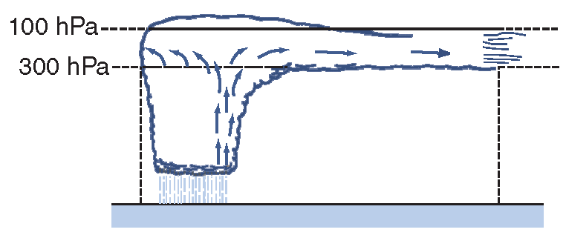
Lifecycle of a Simple Thunderstorm
Updraft
Glaciation
Rain shaft
Anvil
Collapse
Cirrus “debris”

Slide 37
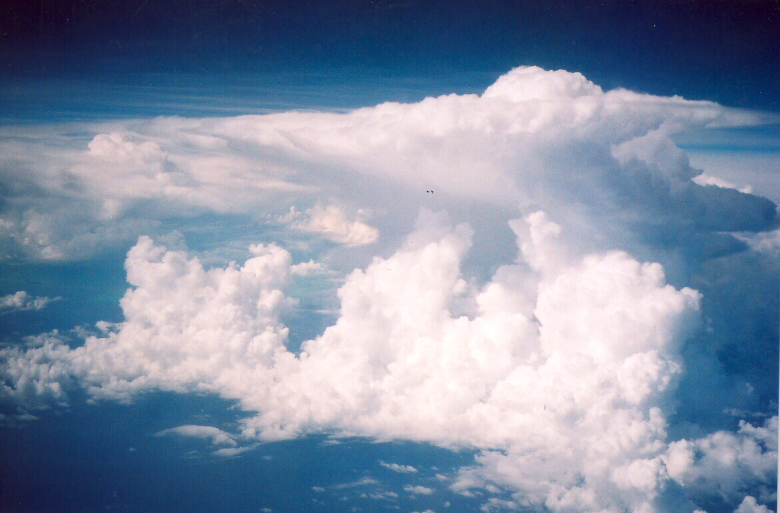
stratosphere
very dry
overshooting top
vapor + ice
anvil
liquid + vapor + ice
free troposphere
dry air entrainment
moist updrafts
liquid + vapor
boundary layer
water vapor

Slide 38
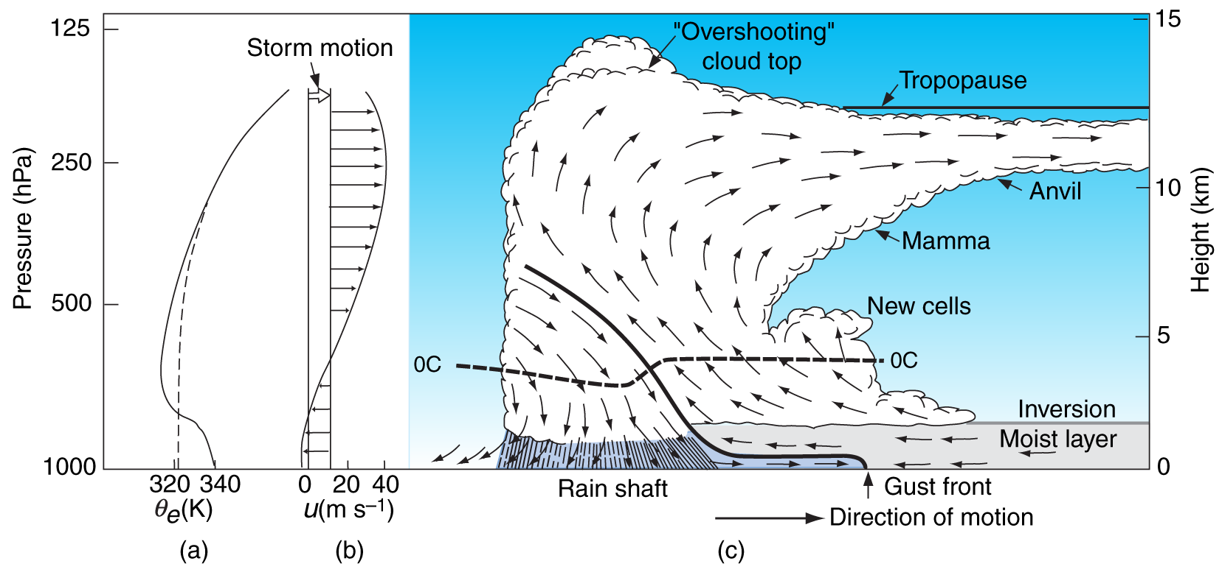
Organized Squall Line
Decoupling of updraft and downdraft due to “shear” (vertical change in horizontal wind)
Propagation by initiation of new convective cells along gust front at leading edge of cold pool

Slide 39
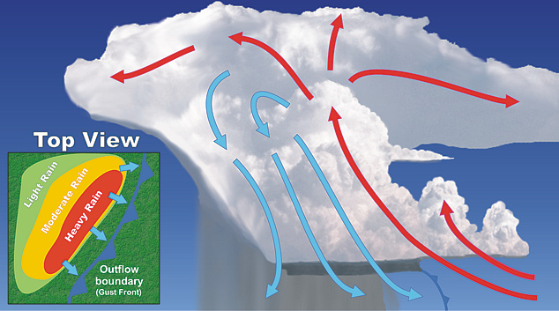
Squall Line Structure
Sequence at surface: (1) strong wind gust under rain-free cloud; (2) heavy rain; (3) tailing off to light rain

Slide 40
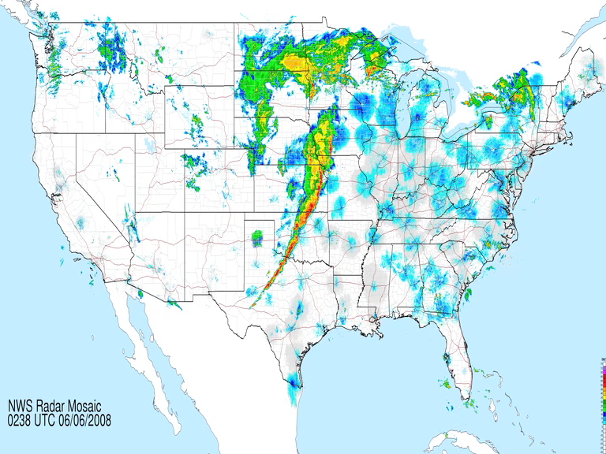
Squall Line 5 June 2008

Slide 41
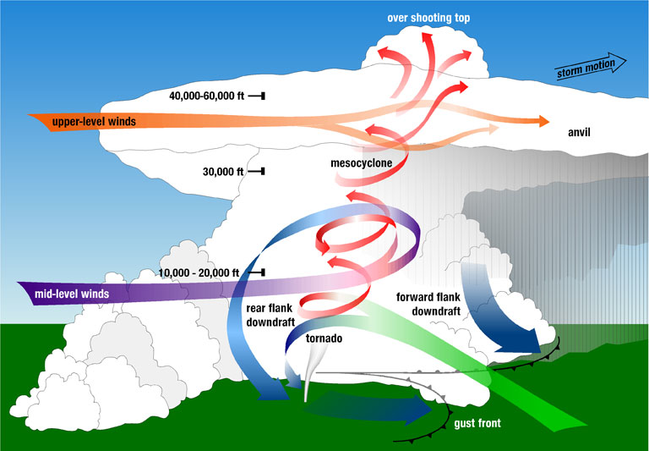
Supercell Thunderstorms

Slide 42
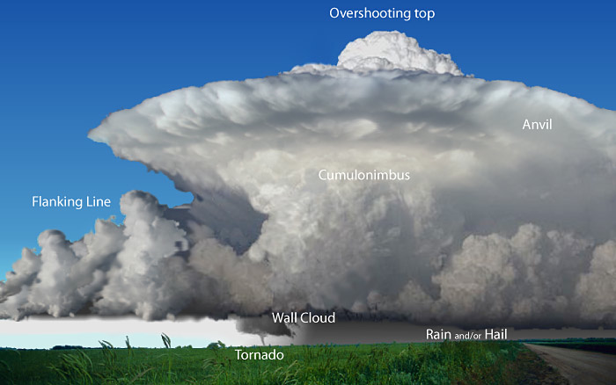
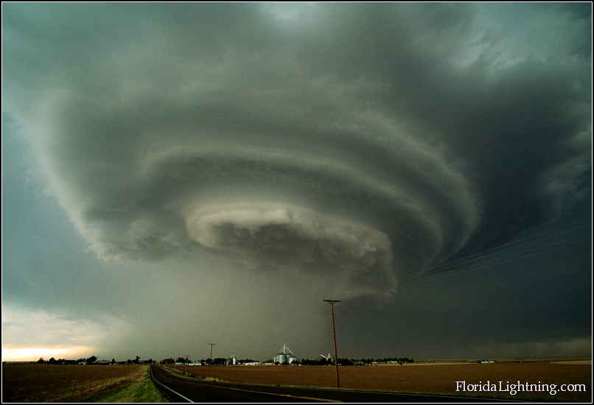
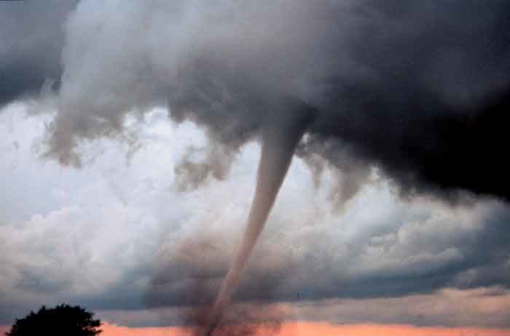
Supercell Thunderstorms
Highly-organized single-cell storms persisting for hours, responsible for nearly all tornados and damaging hail
Conditions:
Very unstable, moist environment
Winds turn clockwise with height (e.g., from south at surface, from west aloft)
Characteristics:
Storm-scale rotation
Huge updrafts to 100 mph
Wall clouds, tornados, violent downdrafts and surface gusts

Slide 43
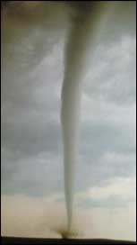
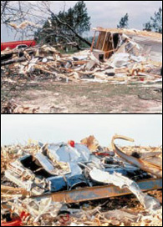
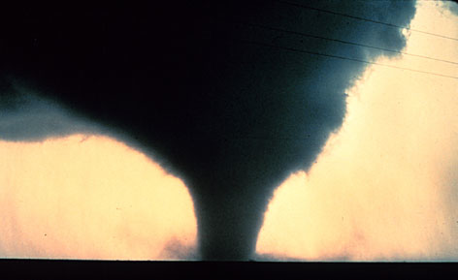
Tornados
Small but intense surface vortices produced by supercell storms
Surface winds can be > 250 mph
Average of 1000 reported per year in USA, with 80 killed and 1500 injured

Slide 44
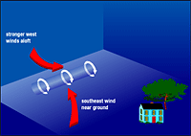
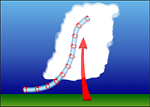
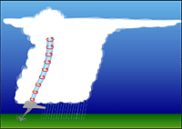
How Tornados Form: pre-existing vorticity is tilted and then stretched in a supercell thunderstorm updraft
Surface friction produces “roll vortices”
Vortex is entrained into updraft and tilted into vertical
Vortex tube is stretched in rotating updraft and intensifies

Slide 45
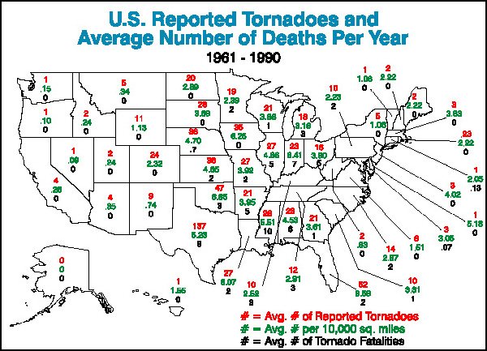
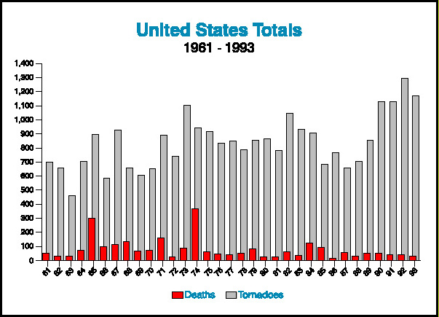
US Tornado Occurrence
Roughly 1000 tornados each year in US
Many more in US than anywhere else in the world!
Trends in reporting, but probably not trends in actual occurrence

Slide 46
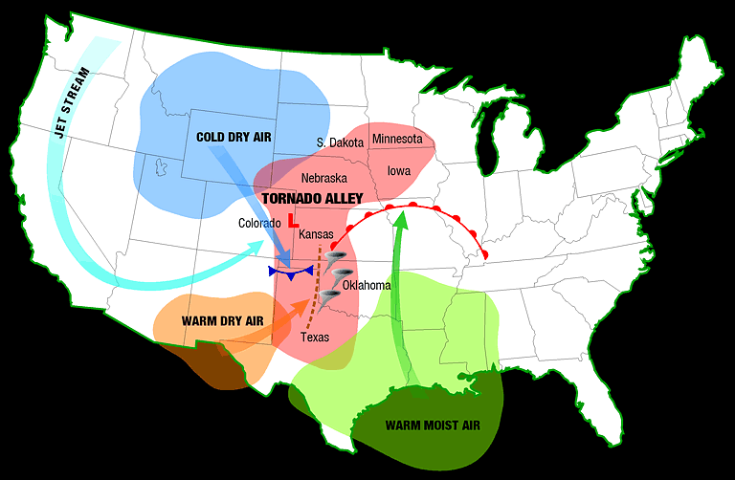
“Tornado Alley”

