Slide 1
What Makes the Wind Blow?
Three real forces (gravity, pressure gradient, and friction) push the air around
Two apparent forces due to rotation (Coriolis and centrifugal)
Large-scale flow is dominated by gravity/pressure and Coriolis … friction and centrifugal important locally

Slide 2
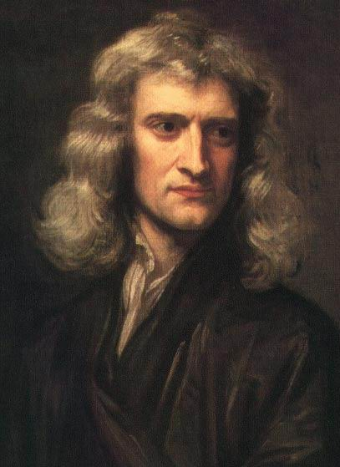
Newton
Objects stay put or move uniformly in the same direction unless acted on by a force
Acceleration is a result of the sum (net) of forces, in the vector sense

Slide 3
Forces Acting on the Air
Pressure gradient force (pushing)
Gravity (falling)
Friction (rubbing against the surface)
“Apparent” forces
The Coriolis Force
Centrifugal Force

Slide 4
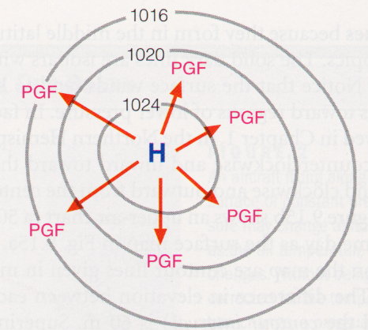
Pressure Gradient Force
Magnitude
Inversely proportional to the distance between isobars or contour lines
The closer together, the stronger the force
Direction
Always directed toward lower pressure

Slide 7
Coriolis Force
Magnitude
Depends upon the latitude and the speed of movement of the air parcel
The higher the latitude, the larger the Coriolis force
zero at the equator, maximum at the poles
The faster the speed, the larger the Coriolis force
Direction
The Coriolis force always acts at right angles to the direction of movement
To the right in the Northern Hemisphere
To the left in the Southern Hemisphere

Slide 8
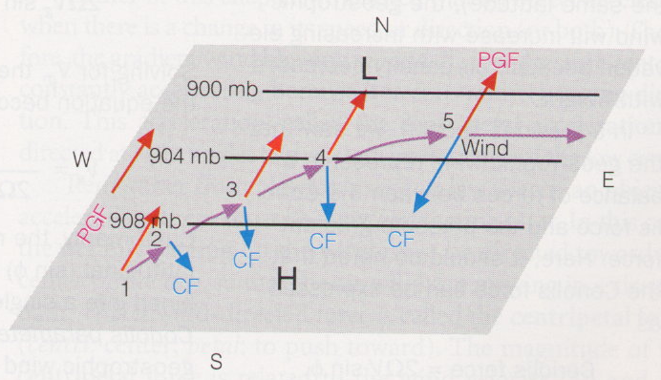
Coriolis Force
Acts to right in northern hemisphere
Proportional to wind speed

Slide 9
Centrifugal Force
When viewed from a fixed reference frame, a ball swung on a string accelerates towards to center of rotation (centripetal acceleration)
When viewed from a rotating reference frame, this inward acceleration (caused by the string pulling on the ball) is opposed by an apparent force (centrifugal force).

Slide 10
Centrifugal Force
Magnitude
depends upon the radius of curvature of the curved path taken by the air parcel
depends upon the speed of the air parcel
Direction
at right angles to the direction of movement

Slide 11
Geostrophic Balance
The “Geostrophic wind” is flow in a straight line in which the pressure gradient force balances the Coriolis force.
Lower Pressure
994 mb
996 mb
998 mb
Higher Pressure
Note: Geostrophic flow is often a good approximation high in the atmosphere (>500 meters)

Slide 12
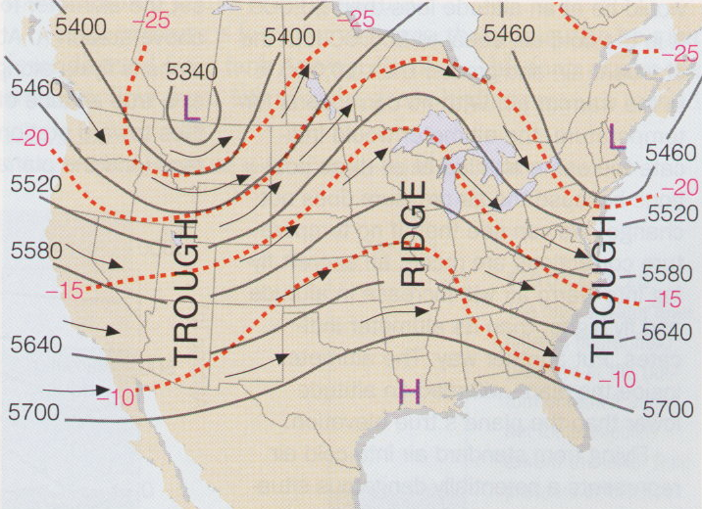
Pressure patterns and winds aloft
At upper levels, winds blow parallel to the pressure/height contours

Slide 13
Gradient Wind Balance
The “Gradient Wind” is flow around a curved path where there are three forces involved in the balance:
1. Pressure Gradient Force
2. Coriolis Force
3. Centrifugal Force
Important in regions of strong curvature (near high or low pressure centers)

Slide 14
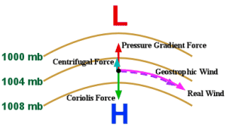
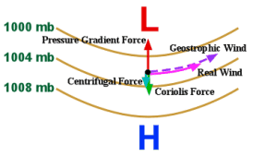
Gradient Wind Balance
Near a trough, wind slows as centrifugal force adds to Coriolis
Near a ridge, wind speeds up as centrifugal force opposes Coriolis

Slide 15
Friction is Important Near Earth’s Surface
Frictional drag of the ground slows wind down
Magnitude
Depends upon the speed of the air parcel
Depends upon the roughness of the terrain
Depends on the strength of turbulent coupling to surface
Direction
Always acts in the direction exactly opposite to the movement of the air parcel
Important in the turbulent friction layer (a.k.a. the “planetary boundary layer”)
~lowest 1-2 km of the atmosphere
Flow is nearly laminar aloft, friction negligible!

Slide 16
Three-Way Balance Near Surface (Pressure + Coriolis + Friction)
Friction can only slow wind speed, not change wind direction
Near the surface, the wind speed is decreased by friction, so the Coriolis force is weaker & does not quite balance the pressure gradient force
Force imbalance (PGF > CF) pulls wind in toward low pressure
Angle at which wind crosses isobars depends on turbulence and surface roughness
Average ~ 30 degrees

Slide 17
Geostrophic Wind Plus Friction
Lower Pressure
994 mb
996 mb
998 mb
Higher Pressure
Wind doesn’t blow parallel to the isobars, but is deflected toward lower pressure;
this happens close to the ground where terrain and vegetation provide friction

Slide 18
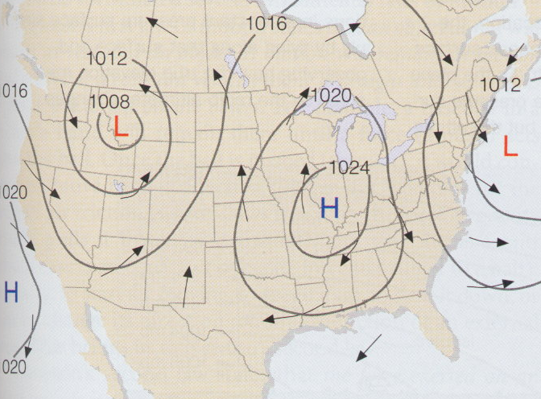
Surface Pressure Patterns and Winds
Near the surface in the Northern Hemisphere, winds blow
counterclockwise around and in toward the center of low pressure areas
clockwise around and outward from the center of high pressure areas

Slide 19
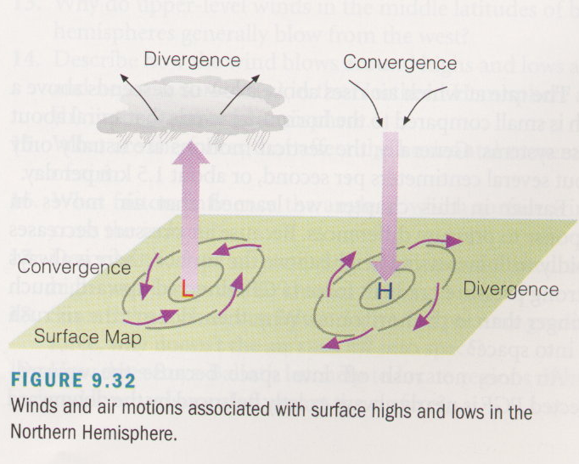
Converging Wind, Vertical Motion, and Weather!
Surface winds blow
In toward center of low pressure (convergence)
Out from center of high pressure (divergence)
Air moves vertically to compensate for surface convergence or divergence
Surface convergence leads to divergence aloft
Surface divergence leads to convergence aloft

Slide 20
Global and Synoptic Scale Circulation Systems
Poleward energy transport on a rotating sphere
Hadley cells and Ferrel cells
Polar vortex and midlatitude jet streams
Midlatitude cyclones as waves

Slide 21
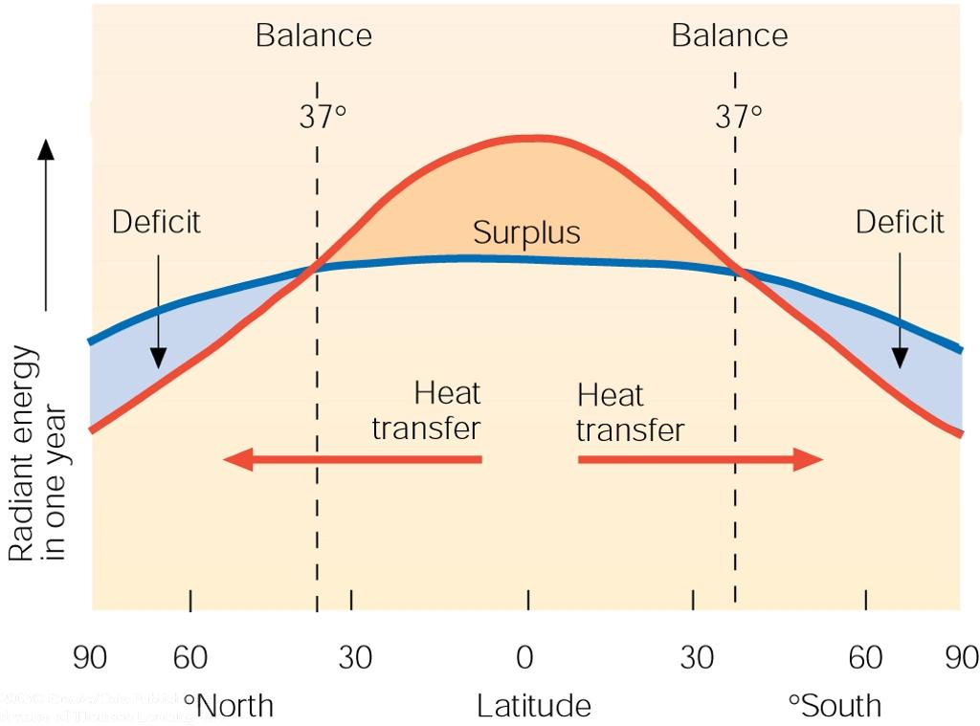
The circulations of the atmosphere and oceans are ultimately driven by solar and longwave radiation imbalances

Slide 22
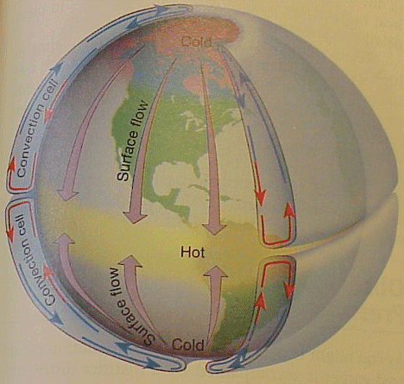
If the Earth didn’t rotate, it would be easy for the flow of air to balance the energy
Thermal convection leads to formation of convection cell in each hemisphere
Energy transported from equator toward poles
Surface wind in Colorado would always blow from the North

Slide 23
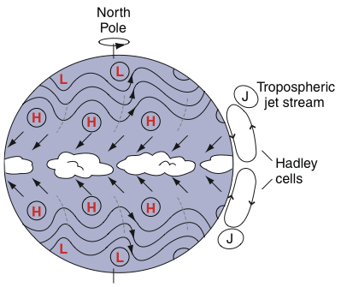
Wind Patterns on the Rotating Earth
Deep thermally direct convective cells confined to tropics
Condensation heating in rising branch of Hadley Cell lifts the center of mass of the atmosphere (converts latent to potential energy)
Downhill slope toward winter pole produces jet streams in middle latitudes
Jet is unstable to small perturbations, breaks down in waves
wavy westerlies
ITCZ
easterly Trade Winds

Slide 24
Key Features of Global Circulation
Hadley cell (thermally direct cell)
- driven by N-S gradient in heating
- air rises near equator and descends near 30 degrees
- explains deserts; trade winds; ITCZ
Ferrel Cell (indirect thermal cell)
- driven by heat transports of eddies
- air rises near 60 degrees and descends near 30 degrees
- explains surface westerlies from 30-60
Weak winds found near
Equator (doldrums)
30 degrees (horse latitudes)
Boundary between cold polar air and mid-latitude warmer air is the polar front

Slide 25
Today’s Circulation

Slide 26
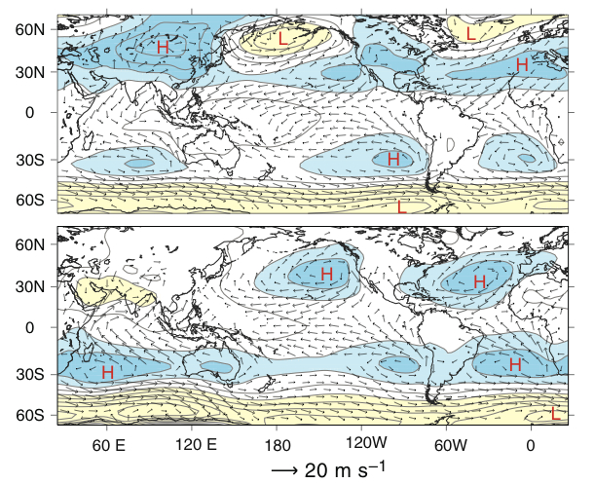
Surface Winds and Pressure
January
July

Slide 27
Understanding the Atmospheric Circulation
1. Driven by differential solar heating between the equator and poles. Atmospheric general circulation acts to move heat poleward.
2. In Hadley cell, warmer air rises and moves poleward. Equator-to-pole Hadley cell is impossible in the presence of rotation
3. In the Northern Hemisphere, air is deflected to the right as it moves; in the Southern Hemisphere, it is deflected toward the left.
- rotation produces trade winds; surface westerlies in NH; upper tropospheric jets.
4. Ferrel cell is the “zonal mean” response to poleward heat and momentum fluxes by eddies. It runs backwards! Transports heat the wrong way!

