Slide 1
Atmospheric Circulation in a nutshell
Hot air rises (rains a lot) in the tropics
Air cools and sinks in the subtropics (deserts)
Poleward-flow is deflected by the Coriolis force into westerly jet streams in the temperate zone
Jet streams are unstable to small perturbations, leading to huge eddies (storms and fronts) that finish the job

Slide 2
Jet Streams
Subtropical Jet is zonal mean response to poleward flow in upper branch of Hadley Cell
Polar front jet is response to pole-equator temperature difference

Slide 3
Extratropical Storms are Eddies in the Jet Stream
Momentum is transferred from the earth to the atmosphere in the trade wind belt.
Momentum is transferred from the atmosphere to the earth in the midlatitudes.
If the earth is always trying to slow down the midlatitude westerlies, why don’t they weaken and disappear over time?
- Eddies (storms) transfer momentum poleward in the upper troposphere.
- This momentum transfer weakens the Hadley circulation, but drives the Ferrel cell.

Slide 4
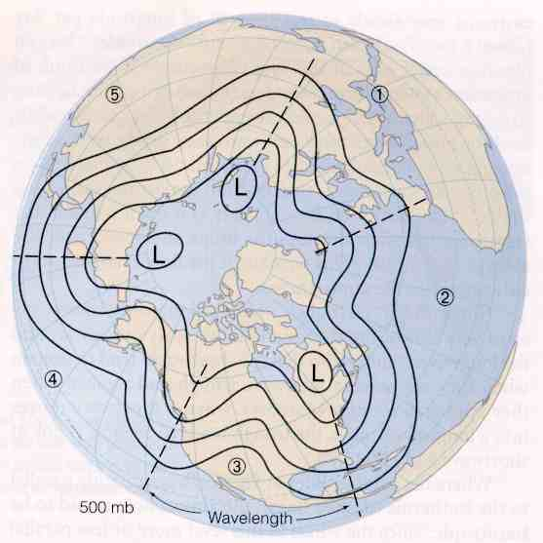
Waves on the polar vortex
Hemispheric westerlies typically organized into 4-6 “long waves”
Wind blows through them, but the waves themselves propagate slowly or not at all

Slide 5
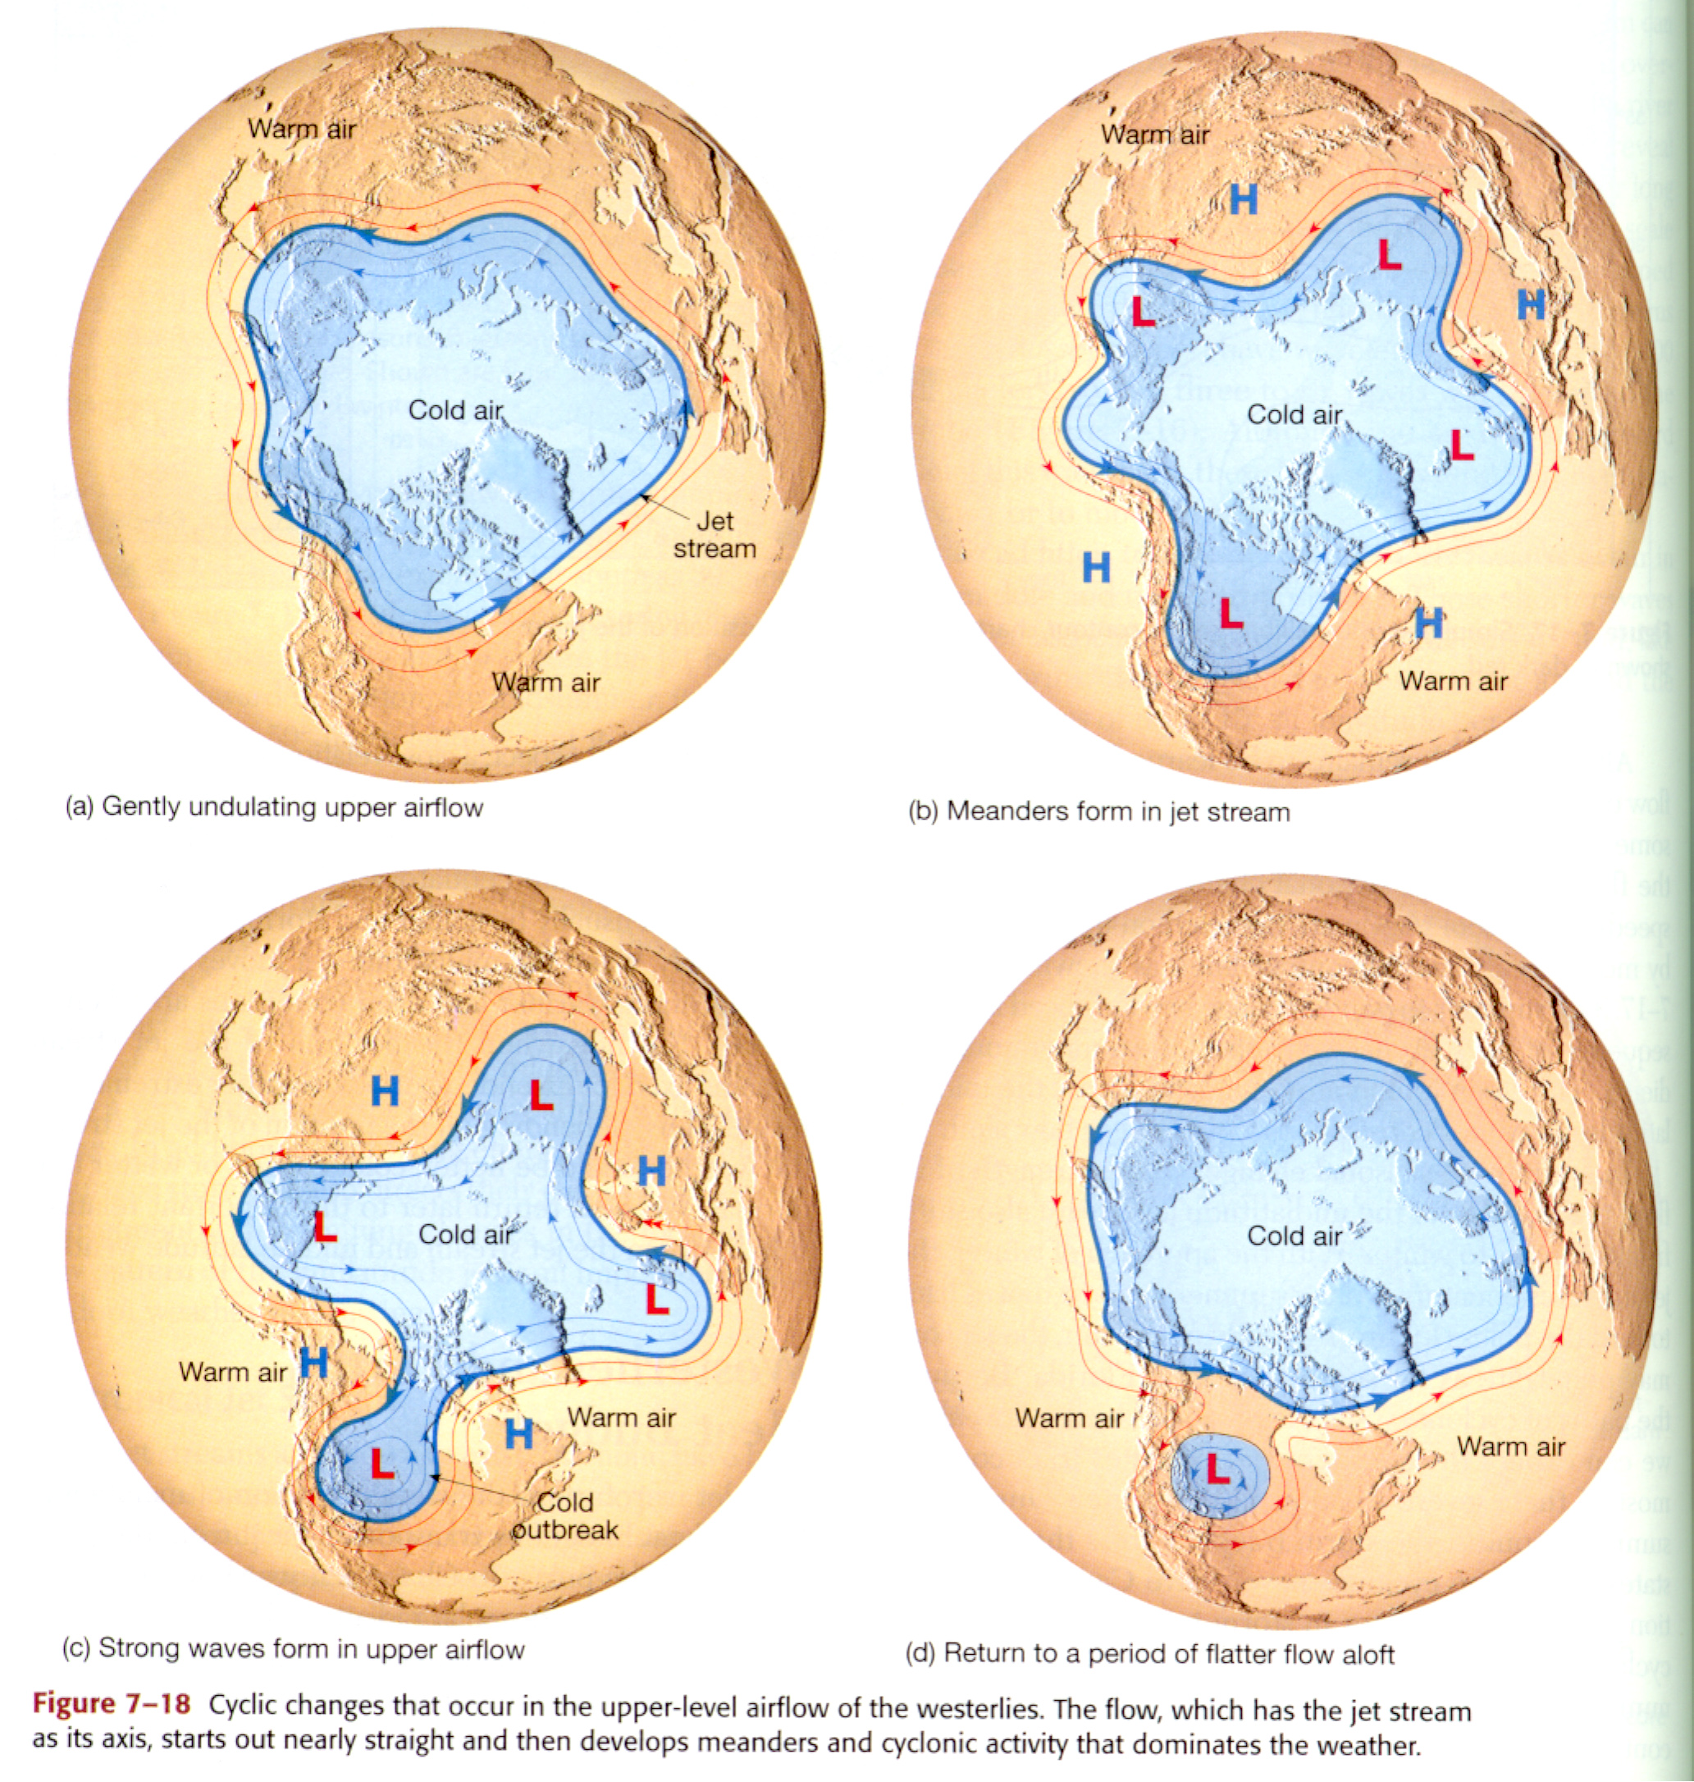
Planetary Waves and Poleward Energy Transport

Slide 6
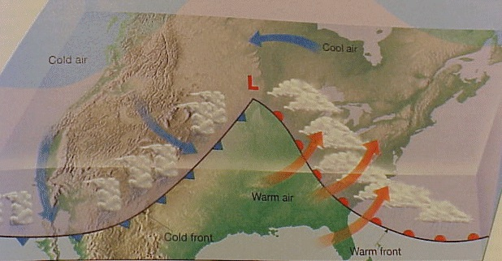
Midlatitude Cyclones
Equator-to-pole temperature gradient tilts pressure surfaces and produces westerly jets in midlatitudes
Waves in the jet induce divergence and convergence aloft, leading to surface highs and lows
Surface circulations amplify the wave by transporting heat to the north and south around the surface low
Resulting “cyclones” are crucial to the transport of energy through the middle latitudes
Lowers center of mass of atmosphere

Slide 7
Convergence and Divergence
What initiates “cyclogenesis?”
Low
When upper-level divergence is stronger than lower-level convergence, more air is taken out at the top than is brought in at the bottom. Surface pressure drops, and the low intensifies, or “deepens.”
High
500 mb height

Slide 8
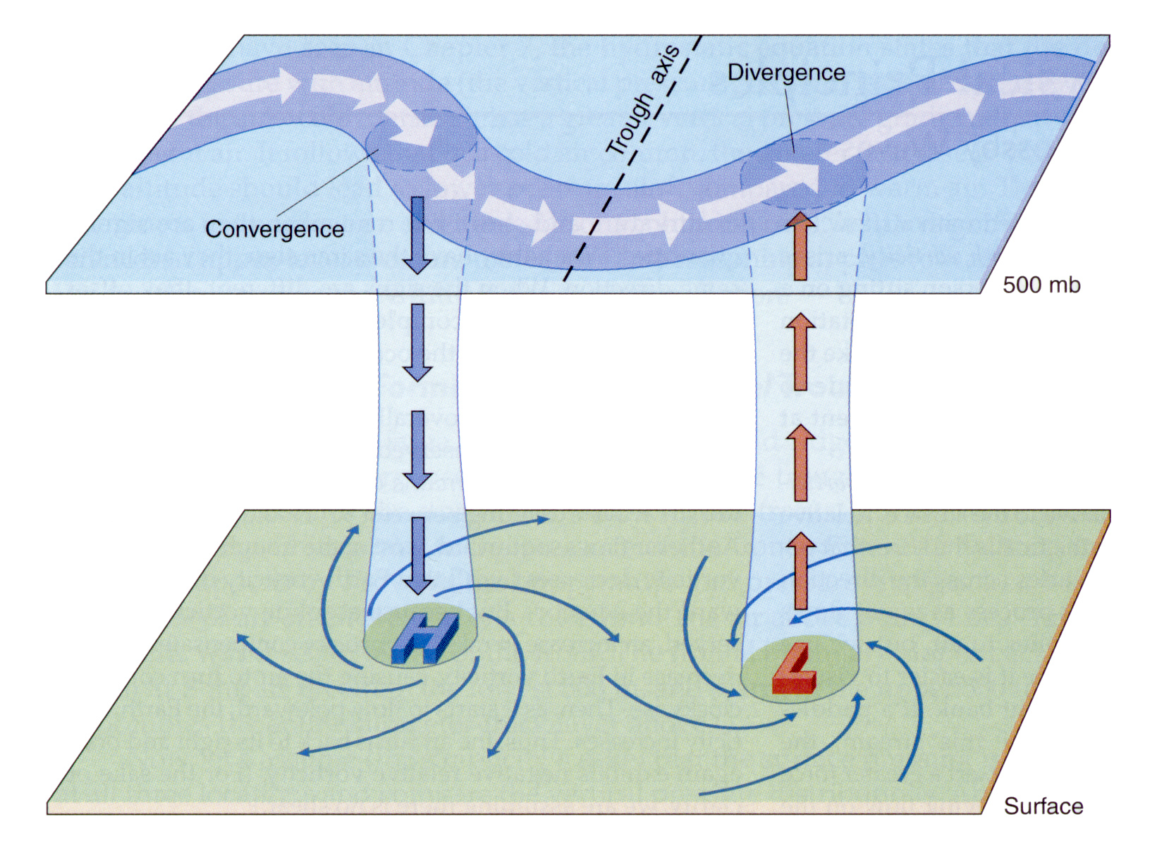
Divergence, Spin, and Tilt
Maximum upper level convergence and divergence are between ridges and troughs
Phase of developing wave “tilts” to the west with height

Slide 9
Before the Storm
Vertical cross-section looking North
Imagine a jet-stream wiggle passes overhead
Where will surface low develop?
Low
DIV
High
east

Slide 10
Birth of a Storm
Surface winds respond to surface pressure gradient … transport cold air southward behind the low and warm air northward ahead of low
This amplifies the upper level trough and ridge
Enhances upper-level divergence
High
Low
High
Low
DIV
DIV
cool
warm
Low
east

Slide 11
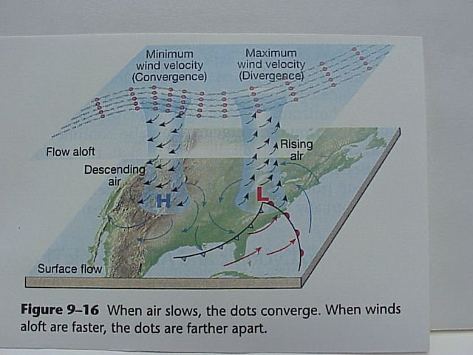

Slide 12
How to “Grow” a Storm
Upper level shortwave passes
Upper level divergence -> sfc low
Cold advection throughout lower troposphere
Cold advection intensifies upper low
Leads to more upper level divergence
Temperature advection is key!

Slide 13
Fronts
A Front - is the boundary between air masses; normally
refers to where this interface intersects the
ground (in all cases except stationary fronts, the
symbols are placed pointing to the direction of
movement of the interface (front)
Warm Front
Cold Front
Stationary Front
Occluded Front

Slide 14
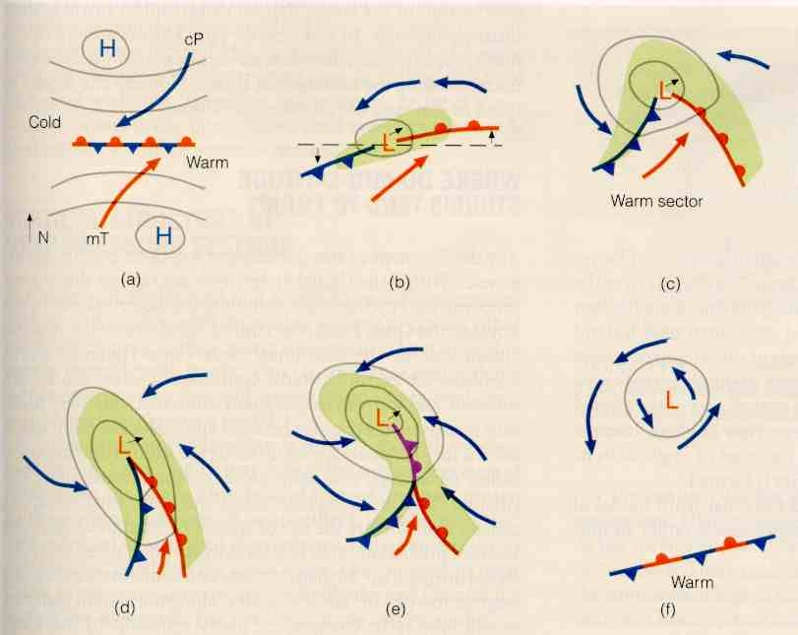
Lifecycle of a Midlatitude Cyclone
Stationary front
Open wave
Incipient cyclone
Green shading indicates precipitation
Takes several days to a week, and moves 1000’s of km during lifecycle
Mature stage
occlusion
dissipating

Slide 15
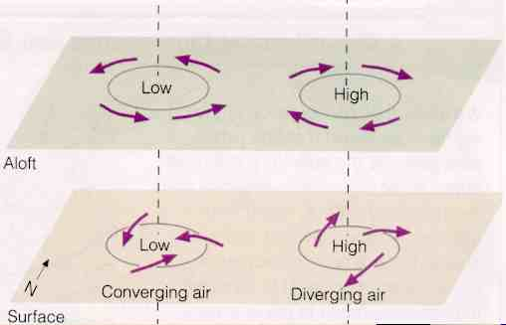
What maintains the surface low?
Imagine a surface low forming directly below upper level low
Surface convergence “fills in” the low
Surface divergence “undermines” the high

Slide 16
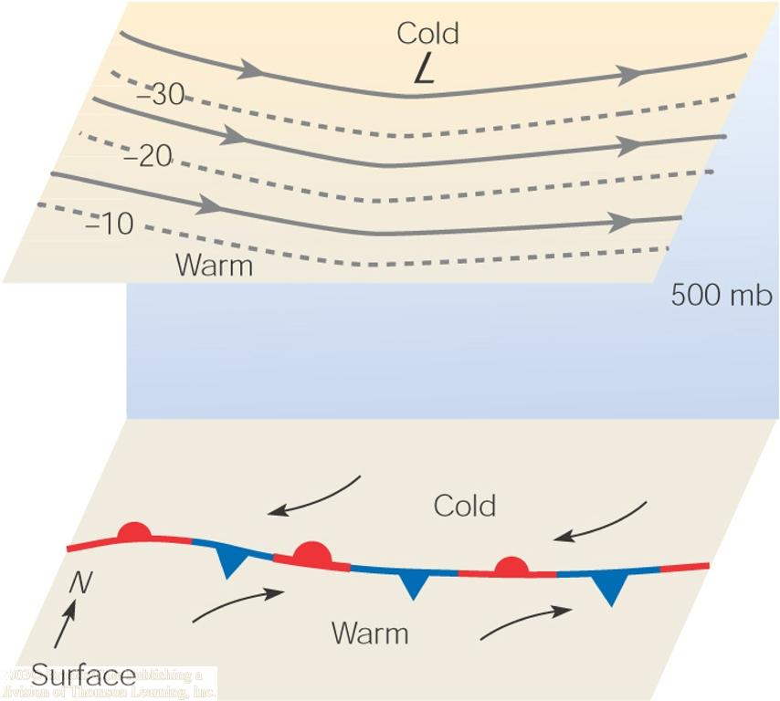
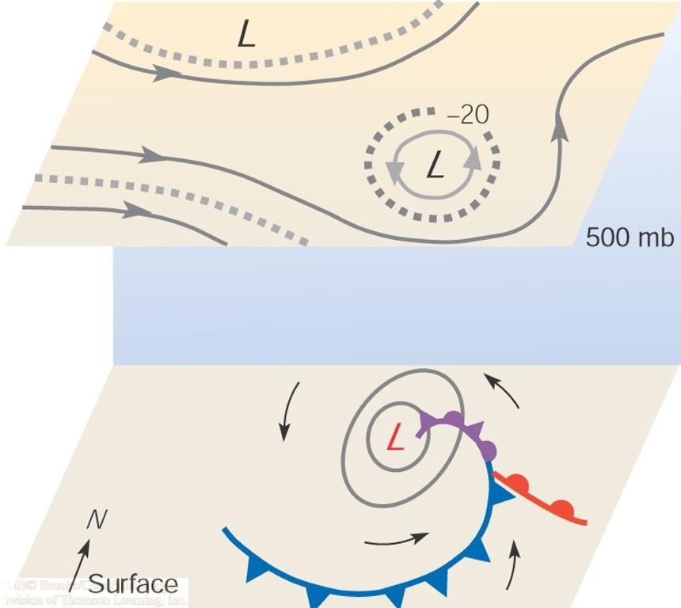
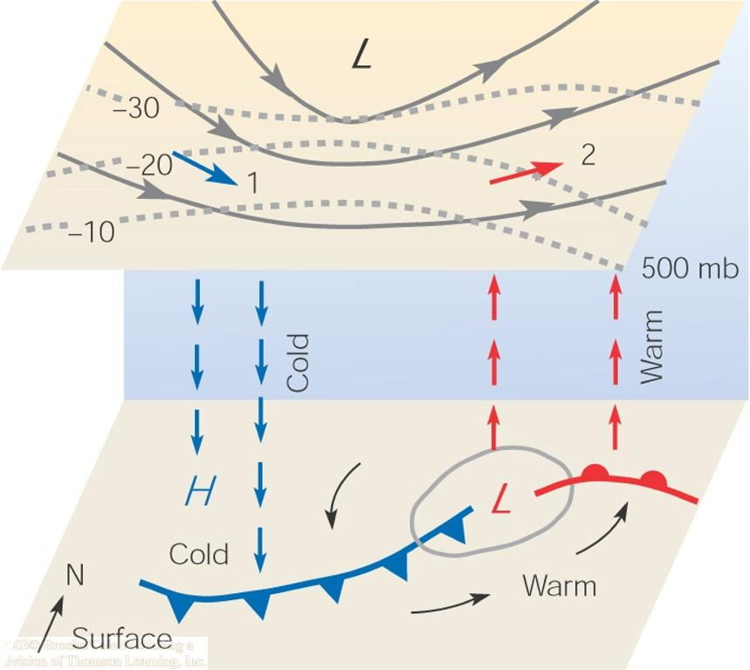
Storm Development

Slide 17
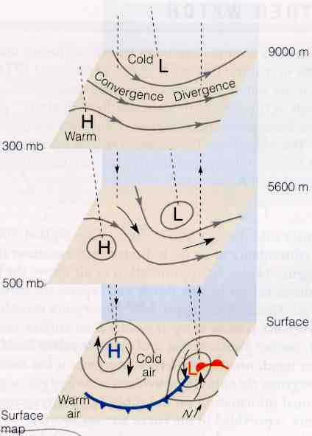
Actual vertical structure
Upper level low is tilted westward with height with respect to the surface.
UPPER LEVEL DIVERGENCE INITIATES AND MAINTAINS A SURFACE LOW.

Slide 18
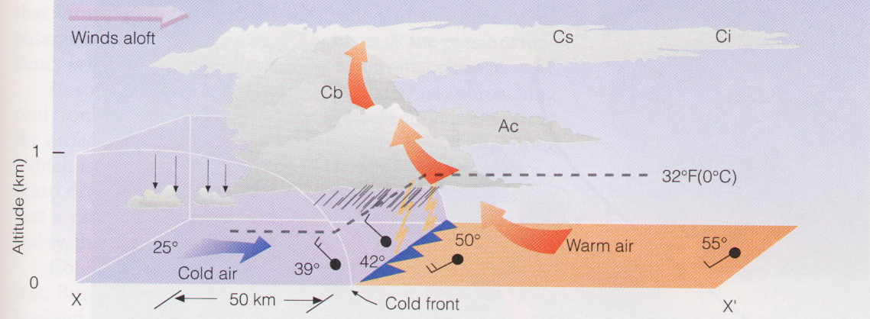
Cold Front Structure
Cold air replaces warm; leading edge is steeper due to friction at the ground
Strong vertical motion and unstable air forms cumule clouds (thunderstorms!)
Upper level winds blow ice crystals downwind creating cirrus and cirrostratus

Slide 19
Warm Front Structure
In an advancing warm front, warm air rides up over colder air at the surface; slope is not usually very steep
Lifting of the warm air produces stratus clouds and precipitation well in advance of boundary
At different points along the warm/cold air interface, the precipitation will experience different temperature histories as it falls to the ground

Slide 20
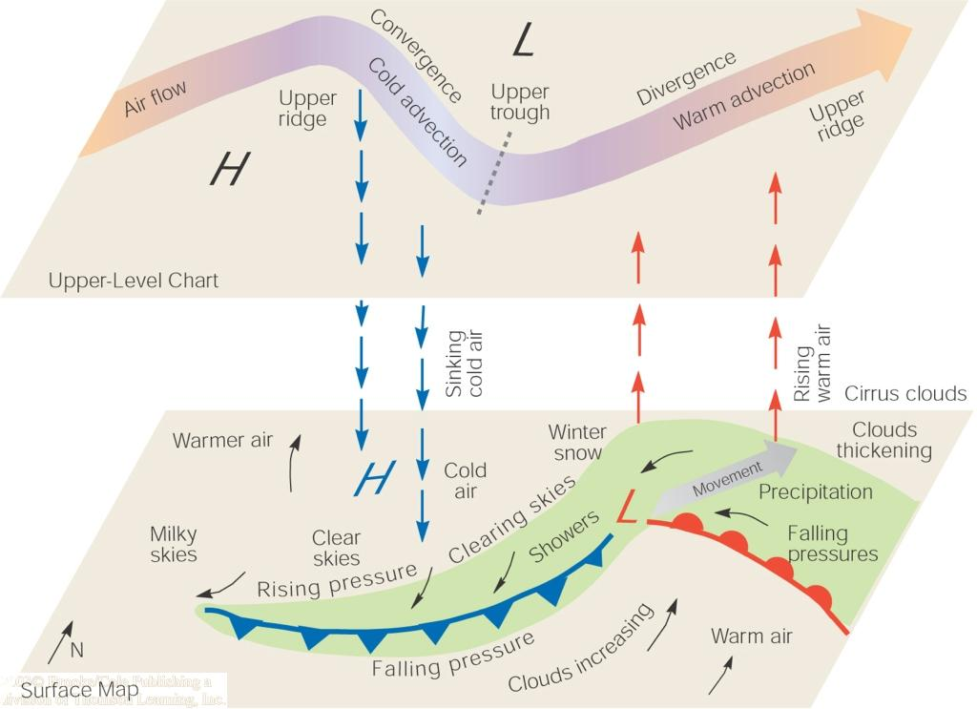
Summary of Cyclone Weather
Roles of convergence and divergence aloft
Pattern of clouds, precipitation, and temperatures on the ground

Slide 21
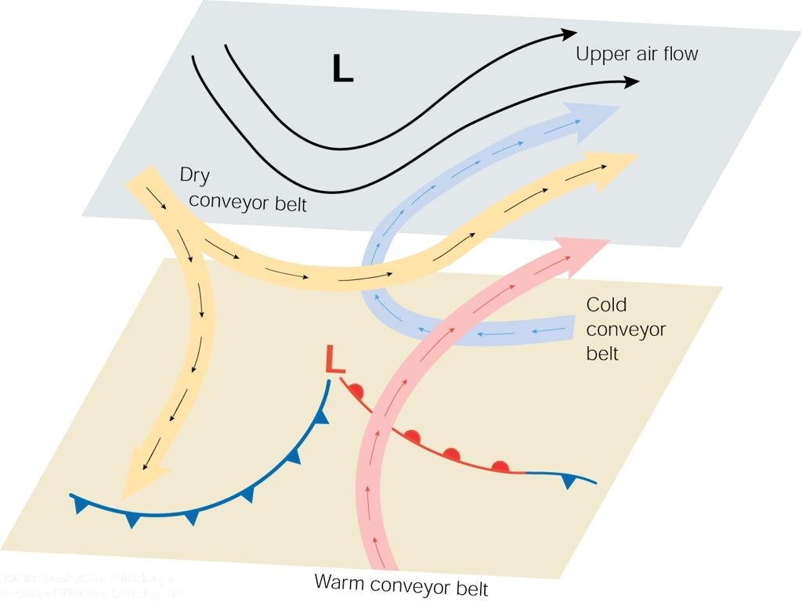
“Conveyor Belts”
This model describes rising and sinking air along three “conveyor belts”
A warm conveyor belt rises with water vapor above the cold conveyor belt which also rises and turns.
Finally the dry conveyor belt descends bringing clearer weather behind the storm.

Slide 22
Follow the Energy!
Midlatitude storms release gravitational potential energy arising from the temperature differences found in the different air masses north and south of the polar front
Cold, dense air pushes warmer, less dense air up and out of the way
“Up warm, down cold”
These storms let the atmosphere lower its center of mass … “air falling down”

Slide 23
The Big Picture
The general circulation transports energy upward and poleward to balance radiational losses to space
The Earth’s rotation complicates this!
The Hadley cell imports water vapor and condenses it to lift the tropical atmosphere, tilting pressure surfaces toward the poles
The resulting polar vortex is unstable, producing waves in the jets that allow energy transport across the midlatitudes (and which also control winter weather!)

