Slide 1
Climate Change: Adaptation and Mitigation
Please read the following (available from class website)
“A Plan to Keep Carbon in Check” by Robert Socolow and Steve Pacala, Scientific American, 2006
“Can we Bury Global Warming,” by Robert Socolow, Scientific American, 2005
“Building a Green Economy,” by Paul Krugman, New York Times Magazine, 2010
Hot Flat, and Crowded, Chapter 2, by Thomas Friedman, 2008

Slide 2
What we Know for Sure
CO2 molecules absorb & re-emit thermal radiation (Tyndall, 1863)
Doubling the number of CO2 molecules would add 4 W m⁻² to the surface 24/7 (Arrhenius, 1896)
If China and India industrialize with coal, CO2 will approach 400% preindustrial by 2100
Additional CO2 will continue adding heat to Earth’s surface for thousands of years

Slide 3
What We’re Not So Sure About
When and in precisely what ways the climate will change, especially locally
The economic, political, and social consequences of these changes
What to do about all of this

Slide 4
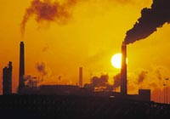
The Global Carbon Cycle
About half the CO₂ released by humans is absorbed by oceans and land
Atmosphere
“Missing” carbon is hard to find among large natural fluxes
775 + 4/yr
~120
~90
~90
~120
8 GtC/yr
Ocean
Land
Humans
38,000
2000

Slide 5
Where Has All the Carbon Gone?
Into the oceans
Solubility pump (CO₂ very soluble in cold water, but rates are limited by slow physical mixing)
Biological pump (slow “rain” of organic debris)
Into the land
CO₂ Fertilization (plants eat CO2 … is more better?)
Nutrient fertilization (N-deposition and fertilizers)
Land-use change (forest regrowth, fire suppression, woody encroachment … but what about Wal-Marts?)
Response to changing climate (e.g., Boreal warming)

Slide 6
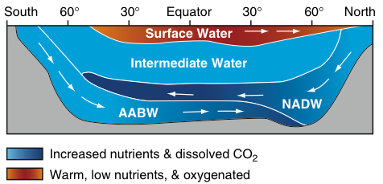
Vertical Structure of the Oceans
sfc
4 km
Warm buoyant “raft” floats at surface
Cold deep water is only “formed” at high latitudes
Very stable, hard to mix, takes ~ 1000 years!
Icy cold, inky black, most of the ocean doesn’t know we’re here yet!

Slide 7
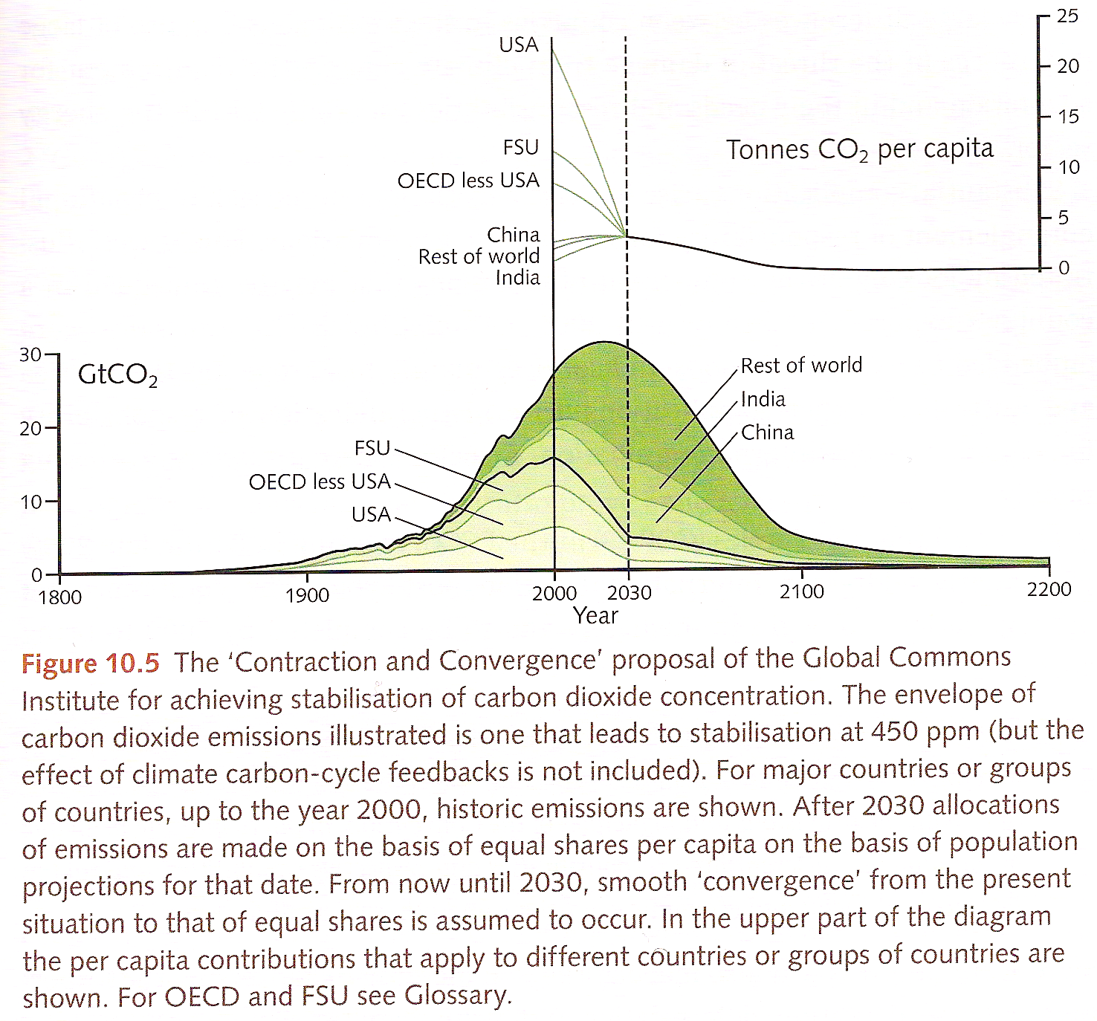
Climate Change Mitigation
Stabilizing CO₂ at 450 ppm would be really hard!

Slide 8
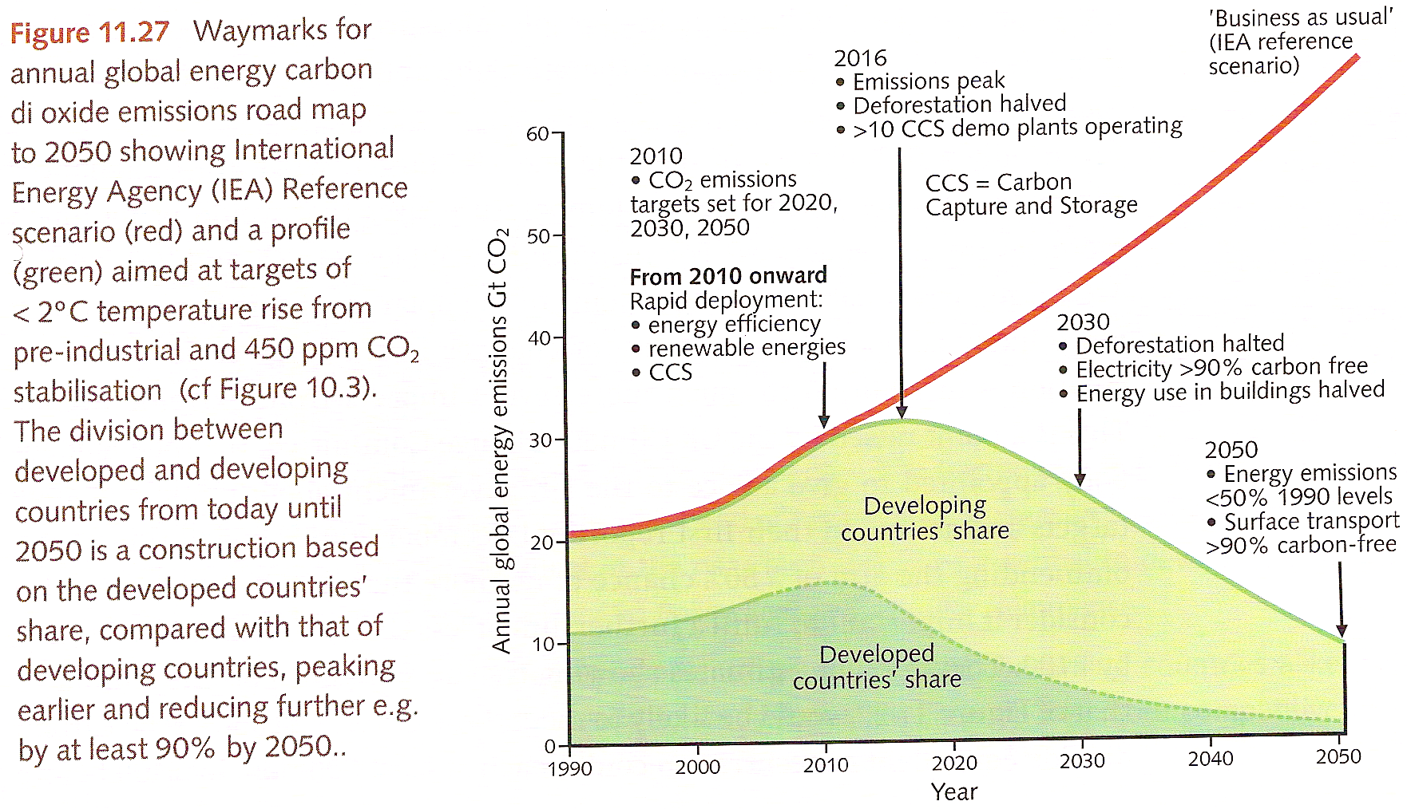
Paths to 450 ppm

Slide 9
CO₂ “Budget” of the Atmosphere
Fossil Fuel
Burning
8
ATMOSPHERE
billion
tons go in
4
billion tons added every year
800
billion tons carbon
Ocean
Land Biosphere (net)
2
+
2
=
4
billion tons go out
Rob Socolow and Steve Pacala http://www.princeton.edu/wedges/ Climate Mitigation Initiative, Princeton University

Slide 10
How Far Do We Choose to Go?
ATMOSPHERE
“Doubled” CO₂
1200
(570)
Today
800
(380)
Pre-Industrial
600
(285)
Glacial
400
(190)
Billions of tons of carbon
billions of tons carbon
(
)
ppm
Past, Present, and Potential Future
Carbon Levels in the Atmosphere

Slide 11
Historical Emissions
Billions of Tons Carbon Emitted per Year
16
8
Historical
emissions
0
1950
2000
2050
2100
Notes:
11

Slide 12
The “Stabilization Triangle”
Billions of Tons Carbon Emitted per Year
16
Current path = “ramp”
Stabilization Triangle
Interim Goal
8
Historical
emissions
Flat path
1.6
0
1950
2000
2050
2100
Notes:
12

Slide 13
“Stabilization Wedges”
Billions of Tons Carbon Emitted per Year
16 GtC/y
16
Current path = “ramp”
Eight “wedges”
Goal: In 50 years, same
global emissions as today
8
Historical
emissions
Flat path
1.6
0
1950
2000
2050
2100
http://www.princeton.edu/wedges/
Notes:
13

Slide 14
What is a “Wedge”?
A “wedge” is a strategy to reduce carbon emissions that grows in 50 years from zero to 1.0 GtC/yr. The strategy has already been commercialized at scale somewhere.
1 GtC/yr
Total = 25 Gigatons carbon
50 years
Cumulatively, a wedge redirects the flow of 25 GtC in its first 50 years. This is 2.5 trillion dollars at $100/tC.
A “solution” to the CO₂ problem should provide at least one wedge.

Slide 15
Helpful (?) “Rules of Thumb” for Emissions vs Climate
1 Wedge = 1 GtC/yr in 2050 = 50 fewer GtC by 2100 = 100 ppm less atmospheric CO2
Average warming ~ 3 C per doubling of CO2 (note logarithmic scale!)
Wedges help logarithmically … last wedge helps a lot more than first wedge!
Business as usual CO2 ~ 1000 ppm by 2100 ~ 4x preindustrial ~ 6 C warming ~ 10 F
Central North America gets ~ 1.5x - 2x global average warming (on land, NH, some snow)

Slide 16
Bottom Line: Wedges and Warming
Average Warming (in C) = 3 * log₂(CO₂/280)
= 3 * log₁₀(CO₂/280) / log₁₀(2)
Each wedge ~ 100 ppm less atmospheric CO₂
Do the math …
1st wedge reduces warming by ~ 0.46 C
2nd wedge reduces warming by another ~ 0.51 C
3rd wedge reduces warming another 0.58 C
4th wedge reduces warming by another 0.67 C
5th wedge reduces warming by another 0.79 C

Slide 17
Fifteen Wedges in 4 Categories
Energy Efficiency &
Conservation (4)
16 GtC/y
Fuel Switching
(1)
Renewable Fuels
& Electricity (4)
Stabilization
Stabilization
Triangle
Triangle
CO₂ Capture
& Storage (3)
8 GtC/y
Forest and Soil Storage (2)
2007
2057
Nuclear Fission (1)
http://www.princeton.edu/wedges/
Notes:
17

Slide 18
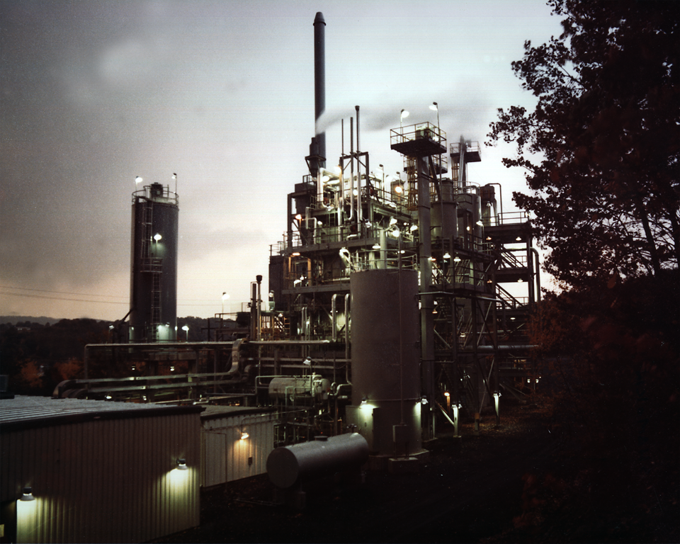
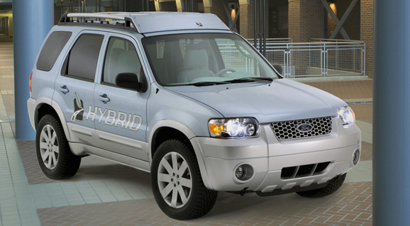
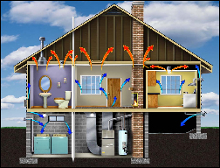
Photos courtesy of Ford Motor Co., DOE, EPA
Efficiency
Produce today’s electric capacity with double today’s efficiency
Double the fuel efficiency of the world’s cars or halve miles traveled
Average coal plant efficiency is 32% today
There are about 600 million cars today, with 2 billion projected for 2055
Use best efficiency practices in all residential and commercial buildings
E, T, H / $
Replacing all the world’s incandescent bulbs with CFL’s would provide 1/4 of one wedge
Sector s affected:
E = Electricity, T =Transport, H = Heat
Cost based on scale of $ to $$$
Notes:
“E,T, H” = can be applied to electric, transport, or heating sectors, $=rough indication of cost (on a scale of $ to $$$)

Slide 19
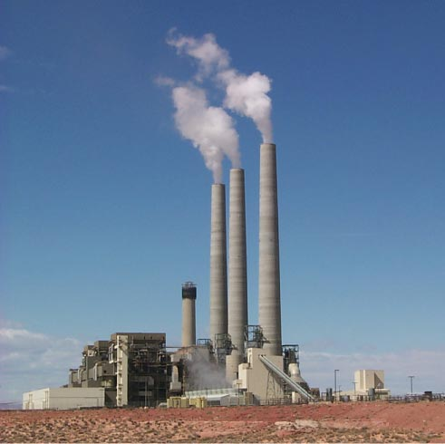
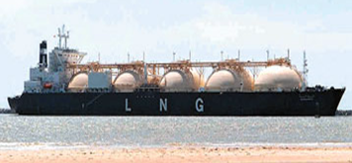
Fuel Switching
Substitute 1400 natural gas electric plants for an equal number of coal-fired facilities
Photo by J.C. Willett (U.S. Geological Survey).
A wedge requires an amount of natural gas equal to that used for all purposes today
E, H / $
Notes:
“E,H” = can be applied to electric or heating sectors, $=rough indication of cost (on a scale of $ to $$$)
Effort needed for 1 wedge:
Build 1400 GW of capacity powered by natural gas instead of coal (60% of current fossil fuel electric capacity)
Requires an amount of natural gas equal to that used for all purposes today
So a slice is 50 LNG tanker discharges/day by 2054 @200,000 m3/tanker, or
one new “Alaska” pipeline/year @ 4 Bscfd.
Detailed Description: NATURAL GAS TURBINES ARE BEING DEVELOPED TO PRODUCE ELECTRICITY IN A SIMPLE, LOW COST ENVIRONMENTALLY FRIENDLY WAY. DOE'S NATIONAL ENERGY TECHNOLOGY LABORATORY (NETL) INITIATED THE ADVANCED TURBINE SYSTEMS (ATS) PROGRAM AND HAS PARTNERED WITH INDUSTRY TO PRODUCE A NEW GENERATION OF HIGH EFFICIENCY GAS TURBINES FOR CENTRAL STATION ELECTRICITY PRODUCTION, USING CLEAN BURNING NATURAL GAS.
700 1-GW baseload coal plants (5400 TWh/y) emit 1 GtC/y.
Natural gas: 1 GtC/y = 190 Bscfd
Yr 2000 electricity:
Coal : 6000 TWh/y; Natural gas: 2700 TWh/y.

Slide 20
Natural Gas is Mostly Methane (CH₄)
Methane is a much more powerful emitter of heat than CO₂
Emits nearly 100x more heat than CO₂ at a given temperature
Lasts only about 12 years, then breaks down to CO₂ + H₂O
C
H
H
H
H
Currently 200 times less CH₄ than CO₂ in the atmosphere

Slide 21
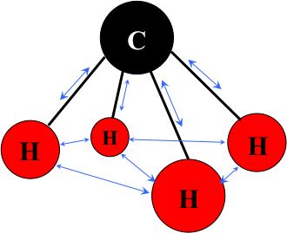
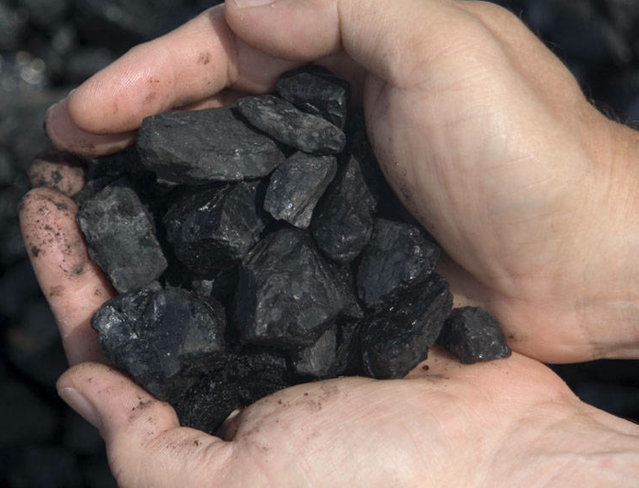
Gas Contains More Energy Per Carbon Than Coal
Most of the energy in natural gas is in C-H bonds
Most of the energy in coal is in C-C bonds
Electricity from gas emits only half as much CO₂ as from coal!

Slide 22
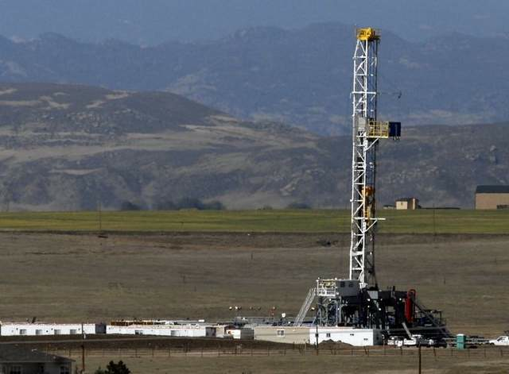
Electricity from Gas Instead of Coal Might Help Slow the Growth of CO₂
Building 1400 gigawatt electric power stations burning gas instead of coal would reduce CO₂ emissions as much as doubling the gas mileage of all the world’s vehicles!

Slide 23
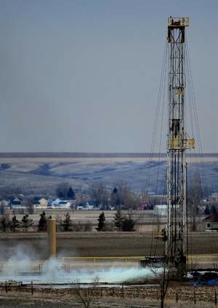
BUT …
Gas leaks during drilling, fracking, completion, production, transport, refining, or electrical generation put CH₄ into the atmosphere
Each molecule of CH₄ in the air emits 100x more heat than CO₂
Leakage of just 3.4% cancels the climate benefit of gas!

Slide 24
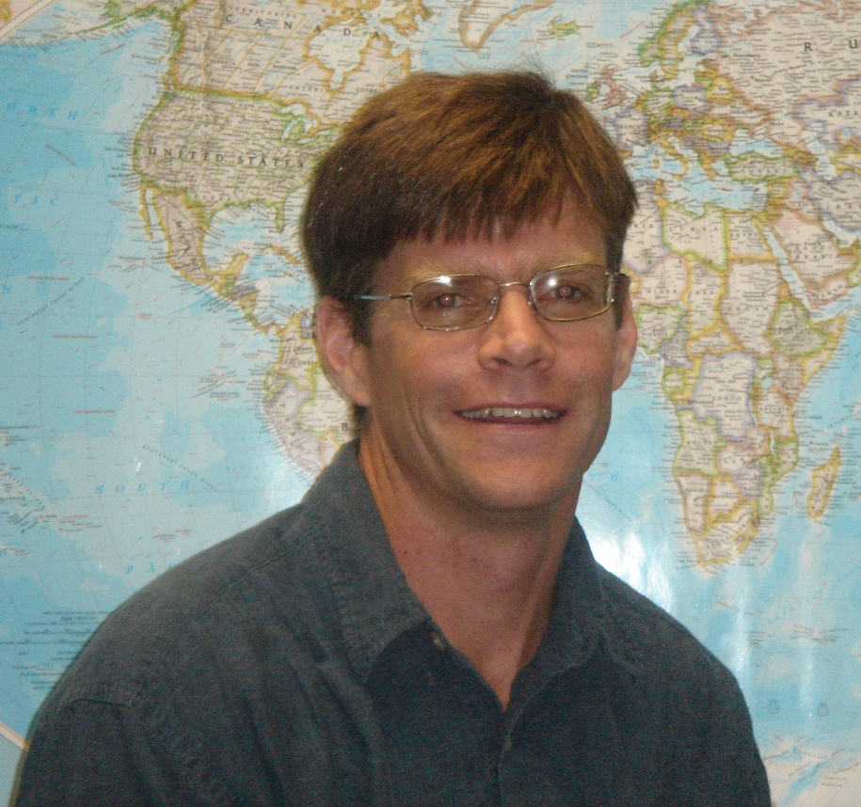
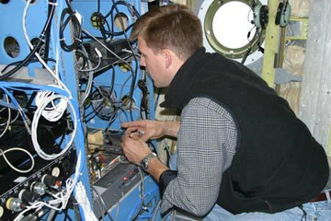
Current Leakage is Way too High!
Colm Sweeney, NOAA ESRL
EPA estimates that industry-wide leakage rate is 2.4%
but recent data from Utah show leakage rates over 7%
Recent measurements from aircraft over NE Colorado show leakage rates of about 9%

Slide 25
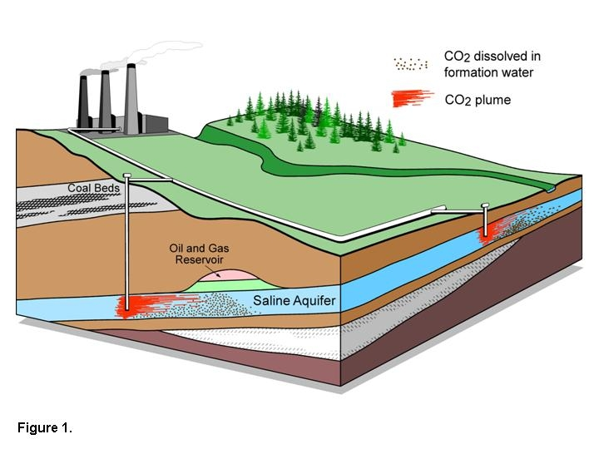
Carbon Capture & Storage
Implement CCS at
800 GW coal electric plants or
1600 GW natural gas electric plants or
180 coal synfuels plants or
10 times today’s capacity of hydrogen plants
Graphic courtesy of Alberta Geological Survey
There are currently three storage projects that each inject 1 million tons of CO₂ per year – by 2055 need 3500.
E, T, H / $$
Notes:
“E,T, H” = can be applied to electric, transport, or heating sectors, $=rough indication of cost (on a scale of $ to $$$)

Slide 26
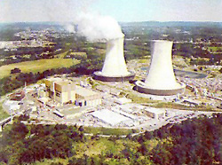
Nuclear Electricity
Triple the world’s nuclear electricity capacity by 2055
Graphic courtesy of NRC
The rate of installation required for a wedge from electricity is equal to the global rate of nuclear expansion from 1975-1990.
E/ $$
Notes:
“E” = can be applied to electric sector, $$=rough indication of cost (on a scale of $ to $$$)
Plutonium (Pu) production by 2054, if fuel cycles are unchanged: 4000 t Pu (and another 4000 t Pu if current capacity is continued).
Compare with ~ 1000 t Pu in all current spent fuel, ~ 100 t Pu in all U.S. weapons.
5 kg ~ Pu critical mass.

Slide 27
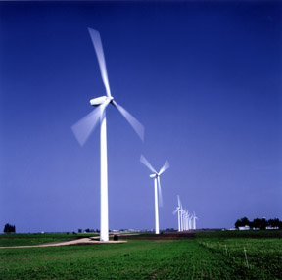
Wind Electricity
Install 1 million 2 MW windmills to replace coal-based electricity,
OR
Use 2 million windmills to produce hydrogen fuel
Photo courtesy of DOE
A wedge worth of wind electricity will require increasing current capacity by a factor of 30
E, T, H / $-$$
Notes:
“E,T, H” = can be applied to electric, transport, or heating sectors, $-$$=rough indication of cost (on a scale of $ to $$$)

Slide 28
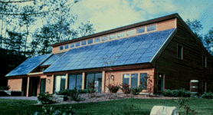
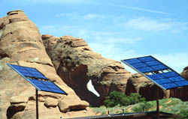
Solar Electricity
Install 20,000 square kilometers for dedicated use by 2054
Photos courtesy of DOE Photovoltaics Program
A wedge of solar electricity would mean increasing current capacity 700 times
E / $$$
Notes:
“E” = can be applied to electric sector, $$$=rough indication of cost (on a scale of $ to $$$)

Slide 29
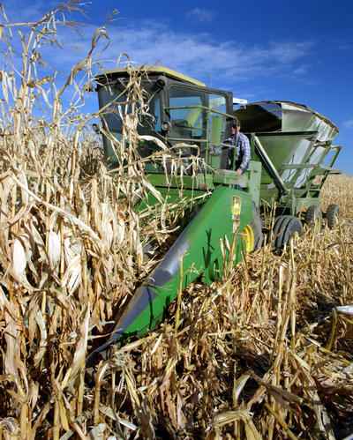
Biofuels
Scale up current global ethanol production by 30 times
Using current practices, one wedge requires planting an area the size of India with biofuels crops
T, H / $$
Photo courtesy of NREL
Notes:
“T, H” = can be applied to transport or heating sectors, $$=rough indication of cost (on a scale of $ to $$$)

Slide 30
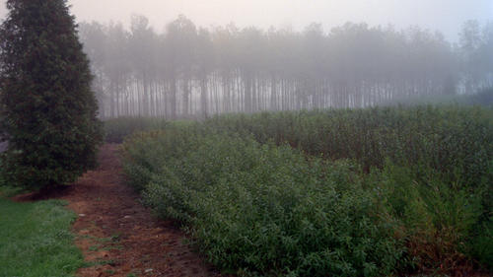
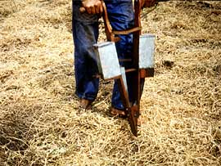
Eliminate tropical deforestation
OR
Plant new forests over an area the size of the USA
OR
Use conservation tillage on all cropland
Natural Sinks
Conservation tillage is currently practiced on less than 10% of global cropland
B / $
Photos courtesy of NREL, SUNY Stonybrook, United Nations FAO
Notes:
“B” = biostorage sector, $=rough indication of cost (on a scale of $ to $$$)

Slide 31
Wedges Summary
For stabilization of emissions (not CO₂) pick any 8 of these 15

Slide 32
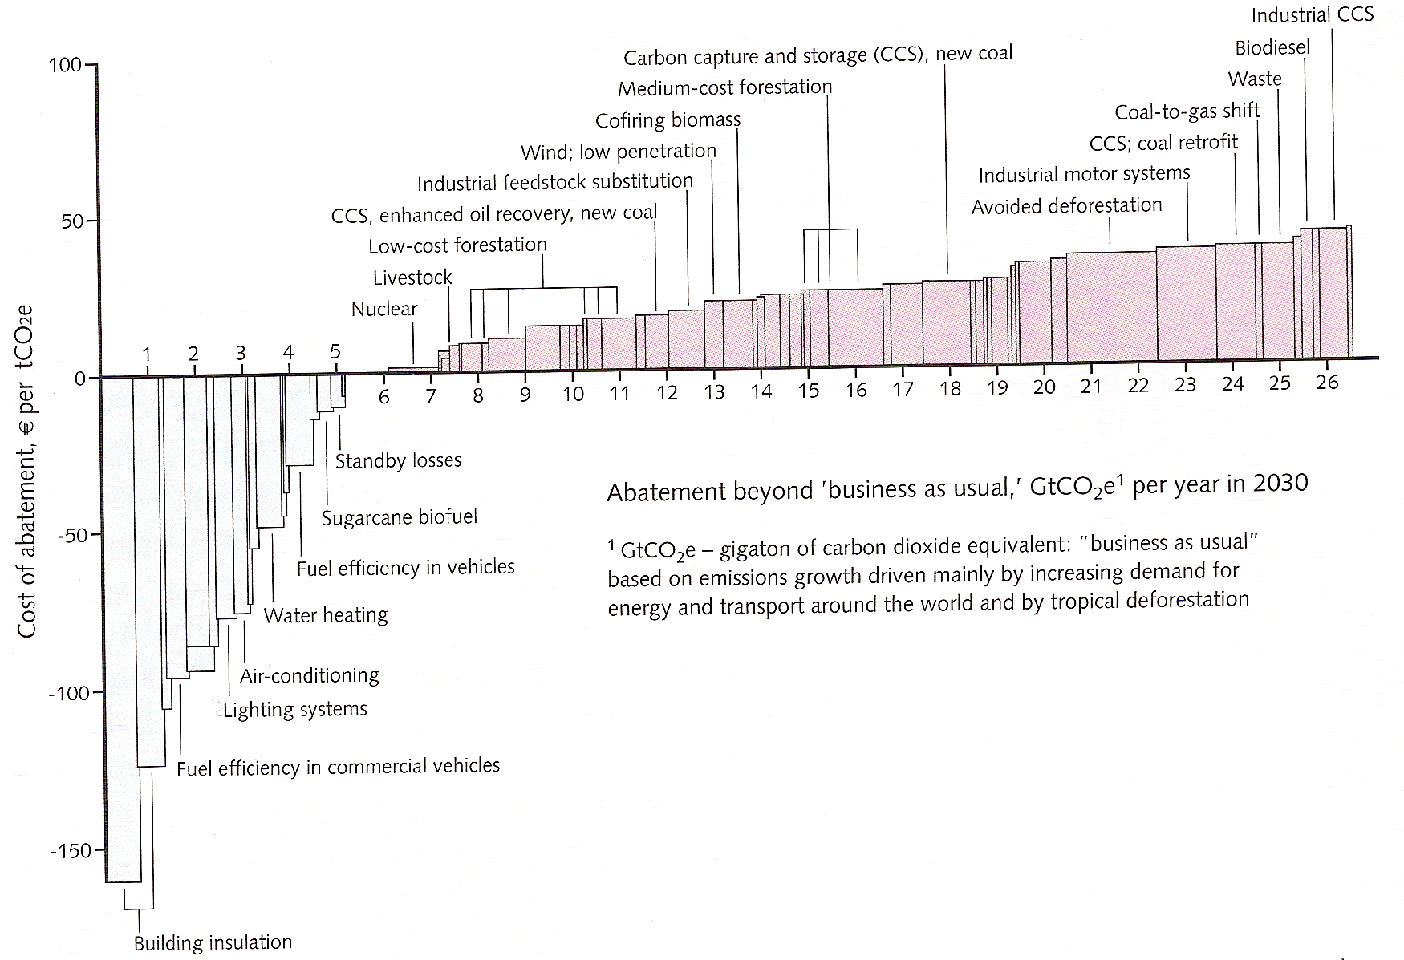
Mitigation Costs and Savings
Meets stabilization at 450 ppm trajectory
Savings from efficiency largely offset new costs
Emissions reduction in 2030 (tons of CO2e)
Cost per ton of CO2e
Alternative technologies (cost > $0)
Efficency (cost < $0)
McKinsey & Company report, 'Pathways to a low-carbon economy - Version 2 of the Global Greenhouse Gas Abatement Cost Curve.'

Slide 33
Free Market Solutions
A new industrial revolution won’t happen because people want to “do the right thing”
The government can’t just pass a law and create a new global energy economy, any more than they could 200 years ago
If low-carbon-footprint goods and services cost less than “dirtier” ones, people will buy them

Slide 34
A Policy Spectrum
“command and control”
“market capitalism”
direct subsidy
“cap and trade”
“tax and rebate”

Slide 35
Imagine it’s 1800, and you’re in charge …
Somebody presents you with a grand idea for transforming the world economy:
Dig 8 billion tons of carbon out of the ground every year
Build a system of pipelines, supertankers, railroads, highways, and trucks to deliver it to every street corner on the planet
Build millions of cars every year, and millions of miles of roads to drive them on
Generate and pipe enough electricity to every house to power lights & stereos & plasma TVs
… “and here’s the itemized bill …”

Slide 36
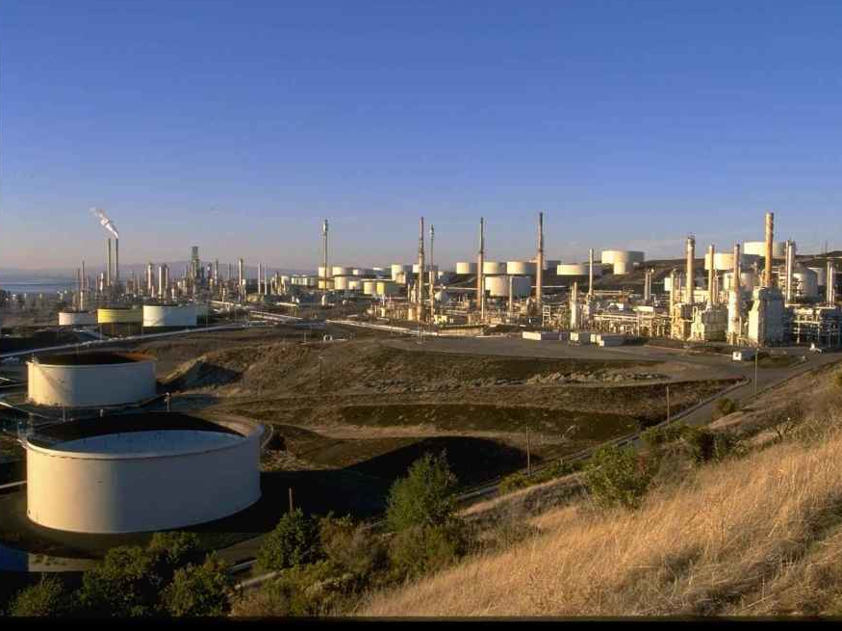
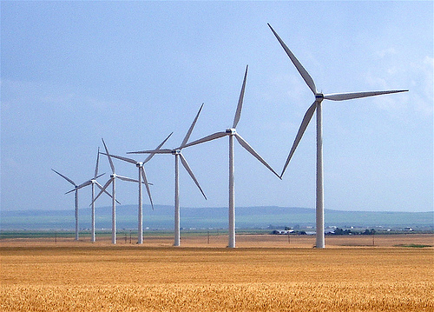
Thinking about Co$t$
Our global society built that very system
We didn’t all go broke building it …
We got rich beyond the avarice of kings!
Now we get to do it again!
How?

Slide 37
Choose Your Future
Many academics believe:
“Modern economy is possible only through the subsidy of cheap fossil energy. When we stop burning coal we’ll freeze in the dark!”
I prefer:
“Modern wealth results from ingenuity and hard work. Before we run out of oil, we’ll invent better technologies for the 21st Century.
The future is bright.”

