Slide 1
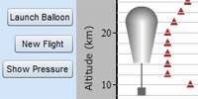
Virtual Ballooning at the
CMMAP/Little Shop of Physics
“Science of Weather & Climate”
Course for Educators
July 2014
SciEd.UCAR.edu

Slide 2
This Slide Set Includes:
Basic “quick start guide” instructions for using the Virtual Ballooning simulation
Background info and images about layers of Earth’s atmosphere
Info and images about the atmospheres of Venus, Mars and Titan
Images about ballooning on other worlds
SciEd.UCAR.edu

Slide 3
Links Roundup
The Virtual Ballooning software and other resources (images, web pages, movies) used in all three of the courses being offered by CMMAP and the Little Shop of Physics in July 2014 are available online at:
https://scied.ucar.edu/events/cmmap-summer-courses-2014
SciEd.UCAR.edu

Slide 4
New: Planetary Atmospheres
Section of Web Site
We’ve just begun work on a series of web pages describing the atmospheres of other planets and moons. So far, there is just one simple page; we’ll be adding more in the coming months… with links to them from this page:
https://scied.ucar.edu/planetary-atmospheres
Until then, this PowerPoint has some slides later on with notes (sorry if they’re a bit cryptic at times) and fun pictures… sort of a rough draft of the forthcoming web pages.
SciEd.UCAR.edu

Slide 5
Other Resources of Ours that
You Might Find Useful
Games – including the Clouds Memory Game
Interactives/Simulations – including Air Parcel
Atmosphere layer pages: Troposphere, Stratosphere, Mesosphere, Thermosphere, Exosphere
Weather-related Classroom Activities
Cloud Image Gallery
SciEd.UCAR.edu

Slide 6
Directions for Virtual Ballooning
The virtual ballooning software is available online for free at:
https://scied.ucar.edu/virtual-ballooning
The software requires Flash – sorry, the current version doesn’t run on an iPad.
A teacher’s activity guide is available at:
https://scied.ucar.edu/activity/virtual-ballooning-explore-atmosphere-activity
… as is a student worksheet:
https://scied.ucar.edu/activity/1769/student
The next few slides provide a “quick start guide”.
SciEd.UCAR.edu

Slide 7
Virtual Ballooning Directions (continued)
ask for 3 volunteers each to be chief scientist for one balloon flight
demo the first flight yourself; try setting the "Altitude Recording Interval" to 2 km using the slider on the left; leave the other slider "Start Recording Altitude" at 1 km
click the Launch Balloon button
discuss how the temperature decreases with altitude
click the Show Pressure button; discuss how air pressure decreases with altitude; then click that button again to return to the temperature graph
SciEd.UCAR.edu

Slide 8
Virtual Ballooning Directions (continued)
ask one of your 3 volunteers to choose settings for the next flight; have them select different values for "Start Recording Altitude" and/or "Altitude Recording Interval" with the sliders, and then click "New Flight" and "Launch Balloon”
do likewise with 2 more flights with your remaining volunteers in charge
your volunteers should be trying to "fill in the story" with each successive flight; wisely choosing the altitudes at which they collect data to fill in the graph, taking into account places where they discover change is happening quickly
SciEd.UCAR.edu

Slide 9
Virtual Ballooning Directions (continued)
hopefully, they will discover the troposphere (where temperature is decreasing), the stratosphere (increasing temperature) and the lower reaches of the mesosphere (temperature is decreasing again)
Optional: if they don't do great on the first 4 flights - you can say that NASA or NSF decided to fund them for 4 more flights; hit the new game button then select save data to get more flights but keep your first round data; then fill in missing sections in the 4 new flights
SciEd.UCAR.edu

Slide 10
Virtual Ballooning on Other Worlds
Now you've been trained on Earth; let's have you fly a ballooning mission on another world to learn about its atmosphere.
click the Settings button towards the lower left
select a different world from the "Which World?" popup menu which currently shows Earth. Titan is the most interesting; Mars is a bit dull
run through a series of balloon flights as was done previously for Earth
SciEd.UCAR.edu

Slide 11
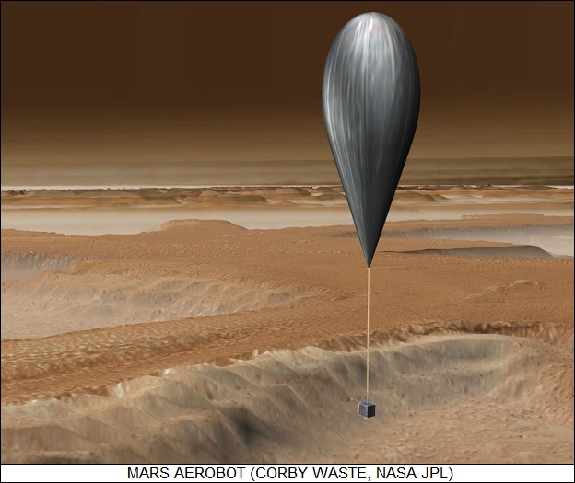
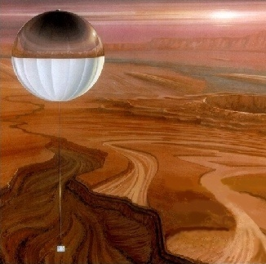
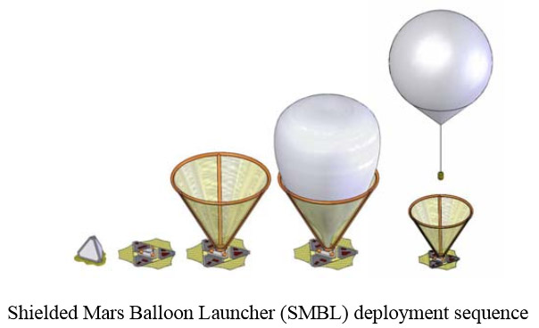
Ballooning on Mars
SciEd.UCAR.edu

Slide 12
Atmosphere of Mars
Very thin, almost entirely carbon dioxide, a bit cold by Earthly standards
Aerobraking
Dust can play a large role in atmospheric heating; global dust storms; dust in atmosphere absorbs much of incoming sunlight, preventing it (and energy) from reaching the surface, but warming (and expanding) the atmosphere
No real stratosphere (little or no ozone), so boring temperature profile; just keeps cooling (troposphere topped by mesosphere) until thermosphere at 100 km altitude
SciEd.UCAR.edu

Slide 13
Atmosphere of Mars 2
Large air pressure difference between highest and lowest spots; Olympus Mons volcano and Hellas Basin; Hellas might be a logical place for initial human colonies (humans could get by with a relatively light-weight pressure suit and air tanks; not need a full-blown space suit; damaged suit would be much less of a danger)
Large seasonal air pressure difference; polar ice cap (mix of water ice and carbon dioxide ice – dry ice) sublimates and freezes, significantly altering amount of CO2 in atmosphere, hence global air pressure
Clouds (water ice and CO2 ice), dust devils
SciEd.UCAR.edu

Slide 14
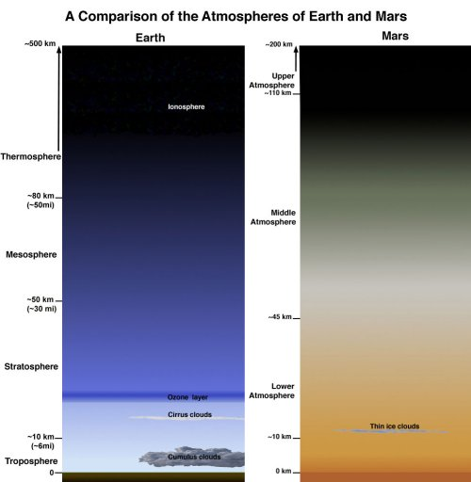
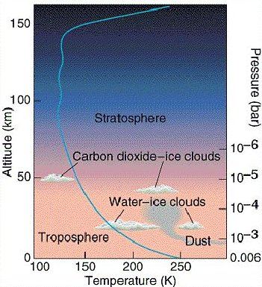
Mars atmosphere
Thermosphere
Mesosphere
SciEd.UCAR.edu

Slide 15
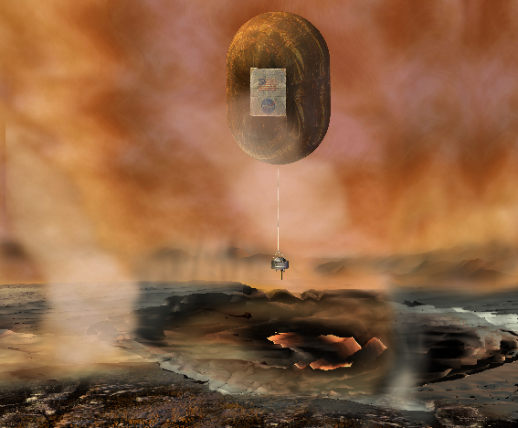
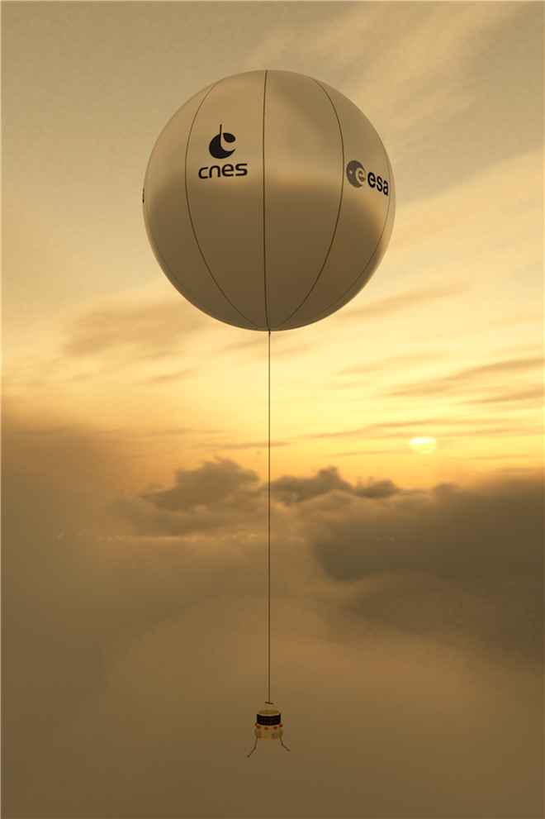
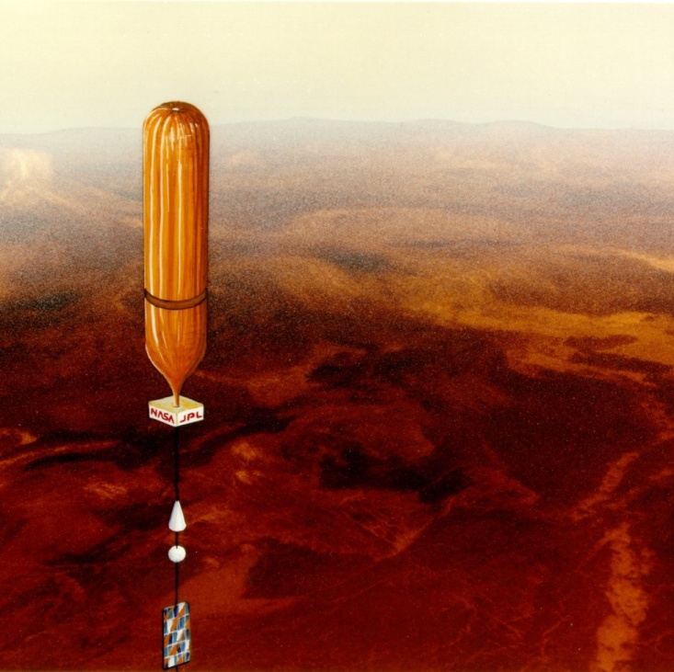
Ballooning on Venus
SciEd.UCAR.edu

Slide 16
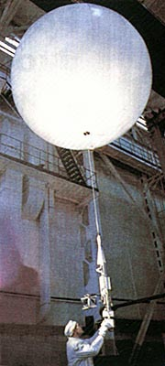
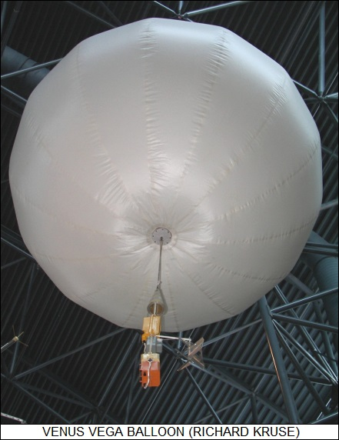
Ballooning on Venus
Humans have actually flown balloons on Venus!
Soviet Vega probes in 1985.
en.wikipedia.org/wiki/Vega_program#Balloon
SciEd.UCAR.edu

Slide 17
Atmosphere of Venus
EXTREMELY dense and high pressure; like deep ocean; 80x Earth pressure?
EXTREMELY hot; melt lead; hundreds of degrees; super greenhouse effect and close to Sun (but hotter than Mercury, which is closer but has essentially no atmosphere)
Almost entirely carbon dioxide; very, very dry
Thick clouds, cannot see surface from spacecraft or Earth (at least not with visible light)
Sulfuric acid clouds!
SciEd.UCAR.edu

Slide 18
Atmosphere of Venus 2
Despite extremely harsh conditions, humans have flown balloons on Venus!
At a certain height in Venusian atmosphere (50 km) conditions are surprisingly Earth-like; air pressure and temperature; most Earth-like conditions in the solar system; finding that layer is a good activity in the Virtual Ballooning simulation
People have proposed (distant future) floating cities or outposts at that height in Venusian atmosphere; breathable air would be buoyant (mostly nitrogen, lighter than CO2) – living spaces would also be balloons!
SciEd.UCAR.edu

Slide 19
Atmosphere of Venus 3
Some scientists have speculated that microbial life could exist in the clouds of Venus
Venus MAY have had a much cooler climate and vast oceans in the past; if life evolved, it might still be found in the clouds long after the planet’s surface became inhospitable
Scientist have found bacteria in the stratosphere in Earth’s atmosphere, so there is a precedent for life high in the air
Superrotating atmosphere – goes around planet much faster than planet spins
SciEd.UCAR.edu

Slide 20
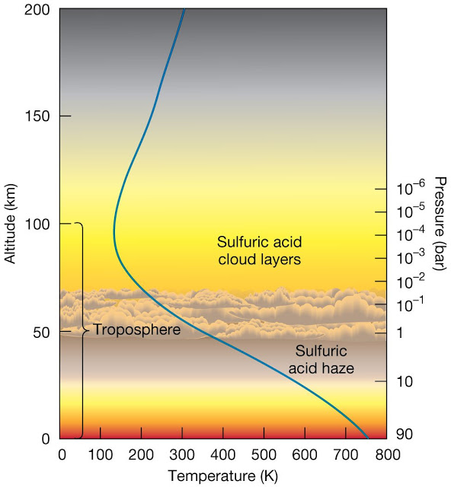
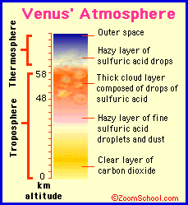
Venus atmosphere
SciEd.UCAR.edu

Slide 21
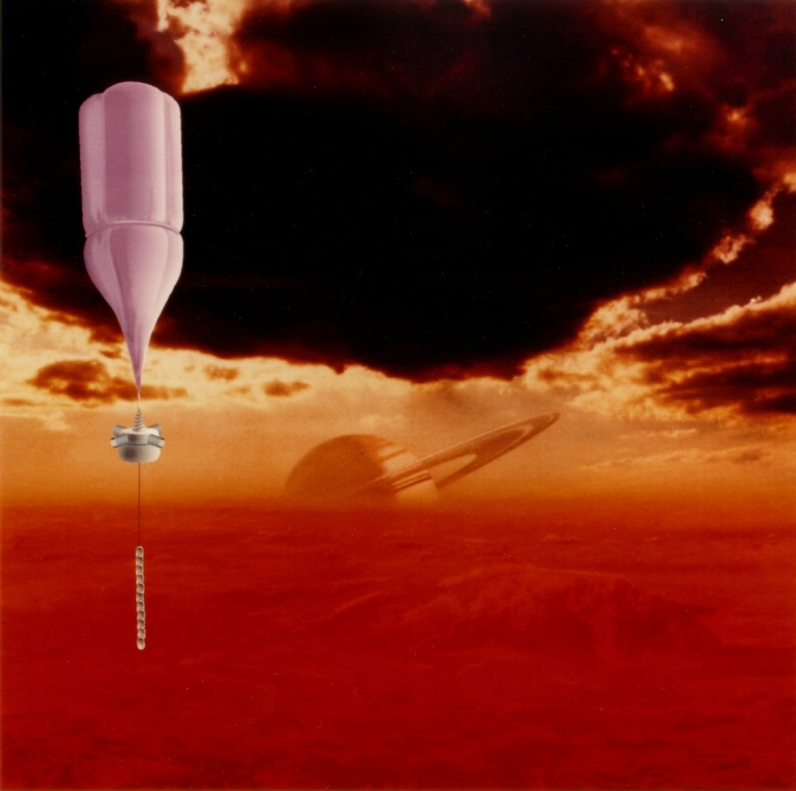
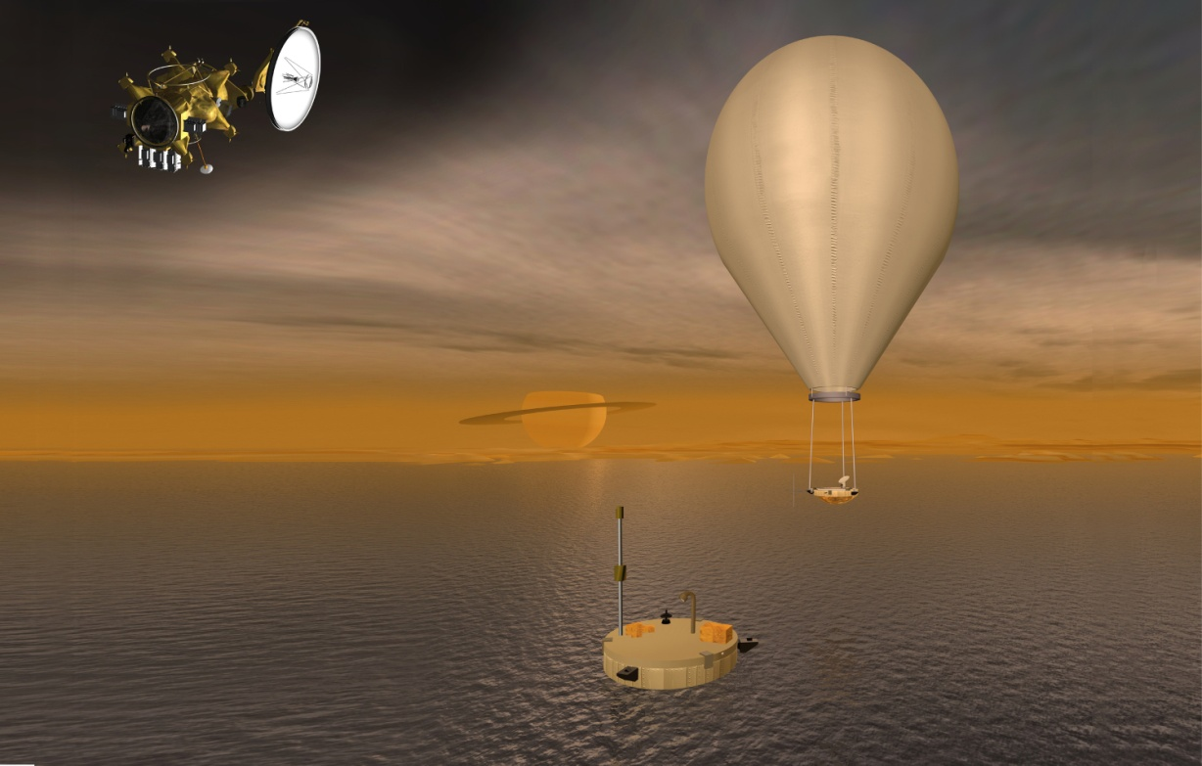
Ballooning on Titan
SciEd.UCAR.edu

Slide 22
Atmosphere of Titan
Very cold – moon of Saturn – so it is very far from Sun
Only moon in our solar system with a substantial atmosphere; ~40% denser at surface than Earth’s atmosphere!
High density and low gravity mean that a human on Titan equipped with wings would be strong enough to flap wings and fly!
Atmosphere is mostly nitrogen, like Earth
Also has some methane (“natural gas”)
Thick cloud and haze layers; cannot see surface in visible light wavelengths from Earth or spacecraft
SciEd.UCAR.edu

Slide 23
Atmosphere of Titan 2
Inverse greenhouse effect through much of atmosphere; haze layers block most incoming (warming) sunlight, but are transparent to outgoing infrared heat, so heat escapes; net effect is that much of Titan’s atmosphere is colder than if there were no atmosphere!
Clouds of methane and ethane – and lakes of liquid ethane/methane on surface – there is a methane cycle on Titan like the water cycle on Earth – methane evaporates from lakes, forms clouds, which produce methane rain, which runs downhill to lakes, etc.
SciEd.UCAR.edu

Slide 24
Atmosphere of Titan 3
Thick atmosphere and low gravity means atmosphere extends very high; hundreds of kilometers!
Sunlight (including UV) hitting methane in atmosphere makes complex organic chemicals which creates the haze layers
SciEd.UCAR.edu

Slide 25
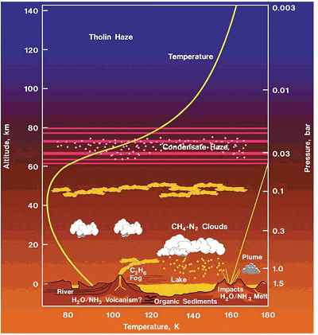
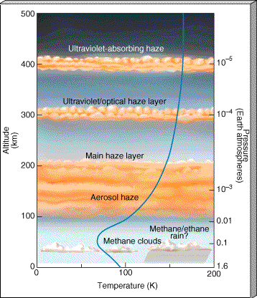
Titan’s Atmosphere
SciEd.UCAR.edu

Slide 26
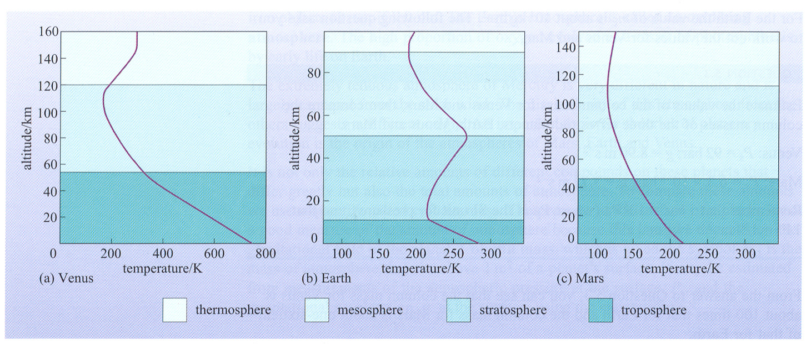
Atmospheres: Venus/Earth/Mars
No stratosphere on Venus or Mars!
SciEd.UCAR.edu

Slide 27
Atmosphere Layers
Troposphere – lowest, weather, gets cooler as you go higher (heated from below – ground heated by sunlight – heat from ground transferred to lower troposphere, so warmest down low)
Stratosphere – above troposphere; includes ozone layer; gets warmer as you go up – ozone absorbs UV radiation from sunlight, converts to heat – most warming up high
Mesosphere – no longer “well mixed”, different scale heights for different atoms/molecules; gets colder with increasing altitude; coldest part of Earth’s atmosphere; includes parts of ionosphere
SciEd.UCAR.edu

Slide 28
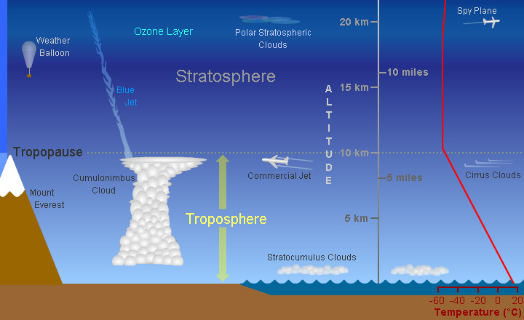
https://scied.ucar.edu/shortcontent/troposphere-overview
SciEd.UCAR.edu

Slide 29
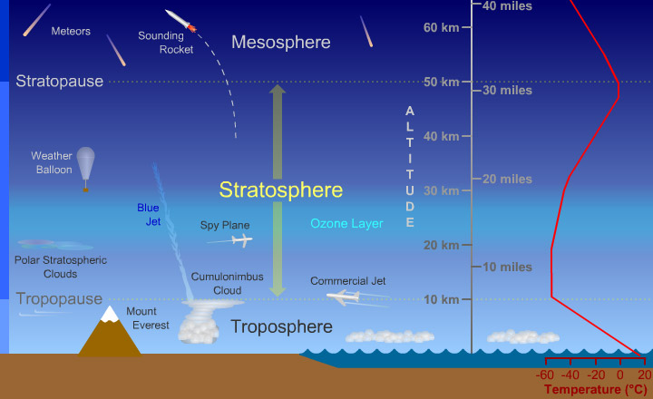
https://scied.ucar.edu/shortcontent/stratosphere-overview
SciEd.UCAR.edu

Slide 30
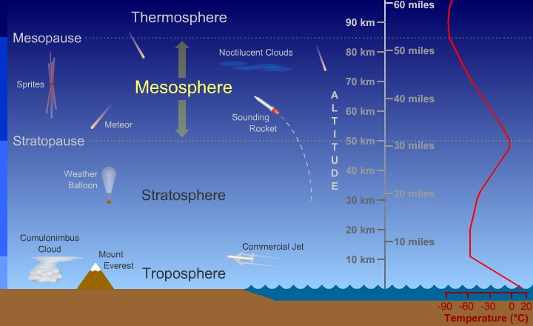
https://scied.ucar.edu/shortcontent/mesosphere-overview
SciEd.UCAR.edu

Slide 31
Atmosphere Layers (continued)
Thermosphere – shuttle orbits here; variable height and temperature with solar activity; includes ionosphere; VERY high temperatures, but so thin you wouldn’t notice; heated by UV and particle radiation
Exosphere – not always considered a layer; some planets have surface-bound exospheres; ballistic trajectories of atoms/molecules
SciEd.UCAR.edu

Slide 32
Contact
Randy Russell
rrussell@ucar.edu
SciEd.UCAR.edu

